Slide 1
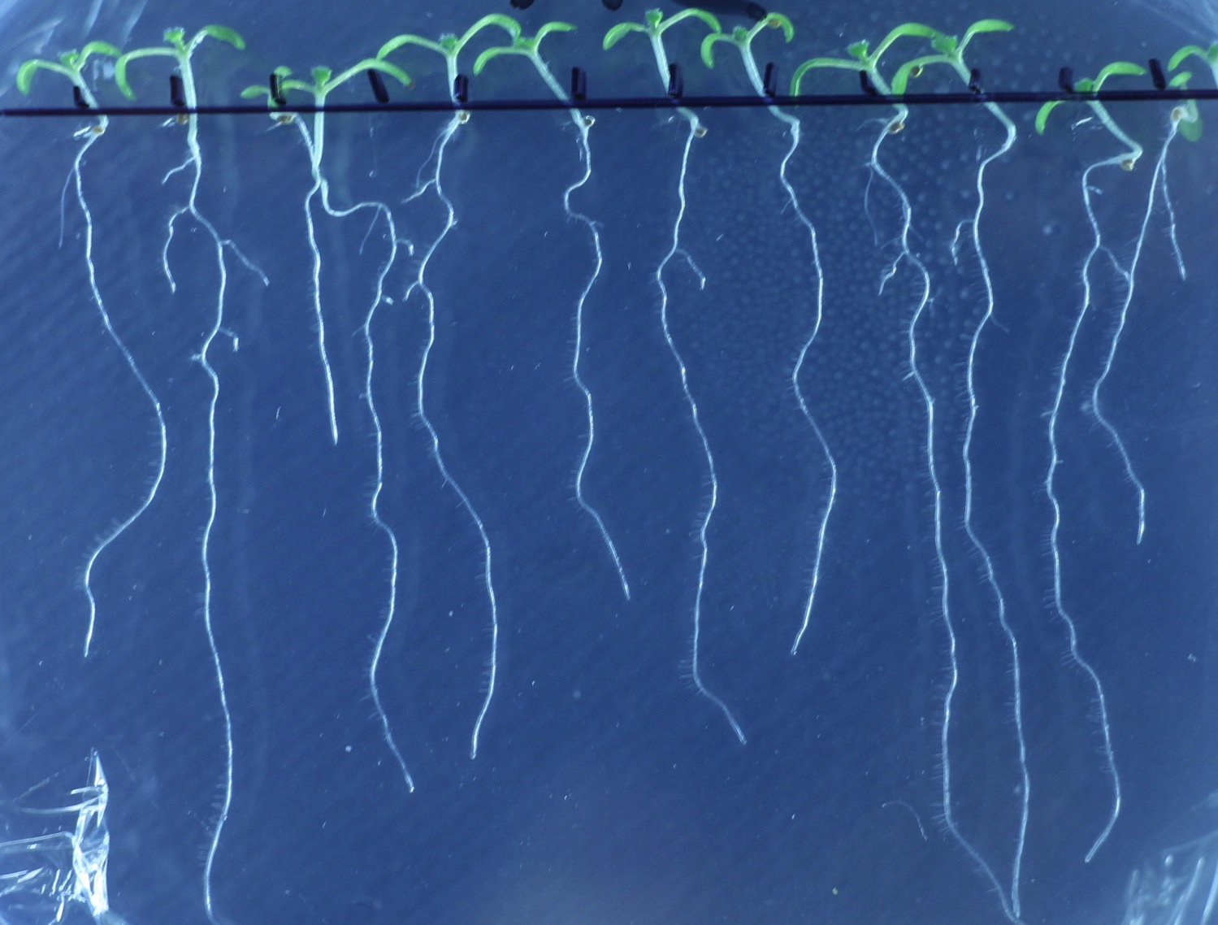
EFFECTS OF PLANT PEPTIDES ON DEVELOPMENTAL PROCESSES IN PLANTS AND ON REDOX PROCESSES IN BICARBONATE AQUEOUS SYSTEMS.
POSSIBLE ROLE OF WATER.
V.L. Voeikov,
E.V. Buravleva, A.V. Glybin, A.Yu. Skripnikov
Lomonosov Moscow State University, Faculty of Biology,
Department of Bioorganic Chemistry

Slide 2
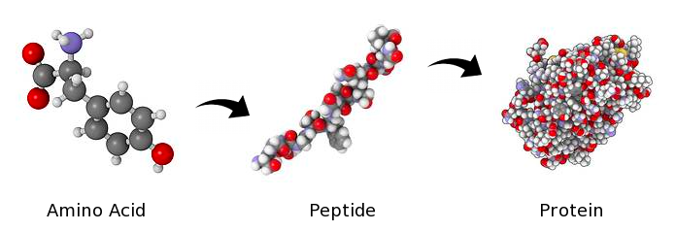
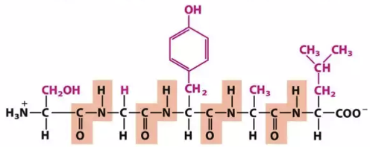
Current status of peptides in biochemistry
“Peptides are distinguished from proteins on the basis of size, and as an arbitrary benchmark can be understood to contain approximately 50 or fewer amino acids”
Proteins are peptides > 50 Amino Acids
Oligopeptides are peptides (2 ~ 20 AA)
Standard biology textbook

Slide 3
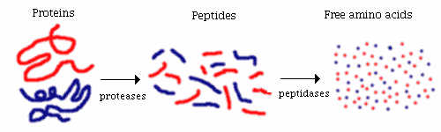
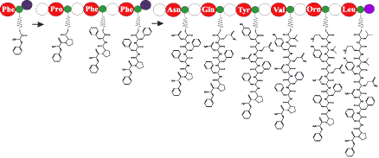
Origination of peptides:
Cleavage of proteins (ubiquitous)
Enzymatic synthesis of particular peptides (by bacteria, fungi)
Could it be that peptides are not just “small proteins”,
but rather they represent a specific class of biomolecules?
Notes:
Баскаков И.В., Воейков В.Л. (1996). “Образование полимерной субстанции с активностью глициндеаминазы при УФ-облучении растворов аминокислот.” Биоорганическая химия, 22(2), 94-100.
Новиков В.В., Лисицын А.С. Конденсация аминокислот в водных растворах при действии слабых электромагнитных полей. Биофизика N 6, 1996, т.41, стр.1163-1167

Slide 4
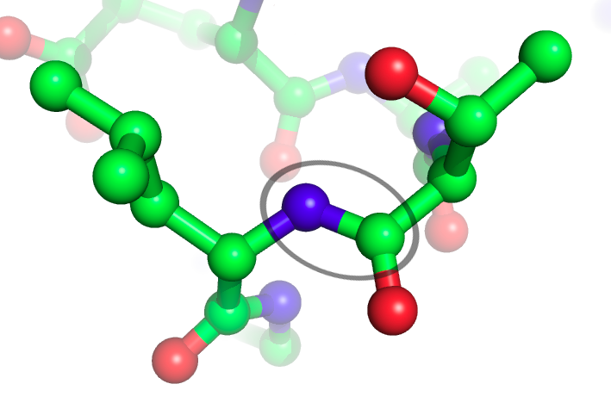
Versatile biological functions of peptides
peptides are known as the molecules possessing a very wide spectrum of biological activities:
In nervous system peptides play the role of neurohormones, neuromediators, neuromodulators;
In digestive system they play the role of major hormones controlling various functions of digestive organs;
In immune system peptides are key factors mobilizing the defense of an organism against foreign invaders and endotoxins;
In cardiovascular system natriuretic peptides promote blood pressure reduction, can play a role of antithrombotic agents, and besides exhibit antilypolytic activity.

Slide 5
Recently recognized KEY biological functions of peptides
peptides play central role in tissue and organ DEVELOPMENT and REGENERATION in all eukaryotic kingdoms, e.g.:
Cell-cell fusion in yeast is guided by mating pheromones – oligopeptides 12-13 AA residues ;
Neuron regeneration peptides stimulate neural proliferation, migration, and differentiation with no apparent toxicity and high target specificity in CNS.
Numerous peptides in plants control practically all developmental processes – from fertilization and seed formation to cell proliferation, differentiation and floral abscission

Slide 6

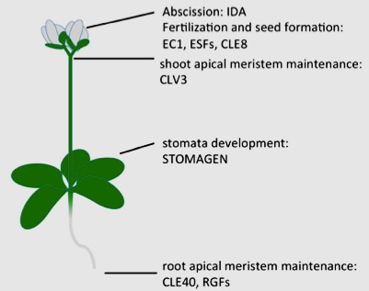
For Arabidopsis thaliana (Ar.th) more than 1000 signaling peptides are already postulated. Some of them are presented at the picture.
One of the best-studied peptide/receptor pair is CLV3 and a receptor like kinase, CLV1. This pair modulates stem cell maintenance or cellular differentiation in SHOOT meristems.
RTVPSGPDPLHH
M. Breiden, R. Simon. BMC Biology, 2016

Slide 7
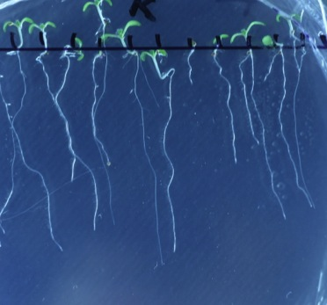
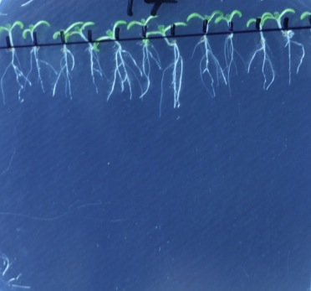
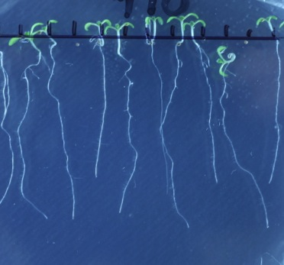
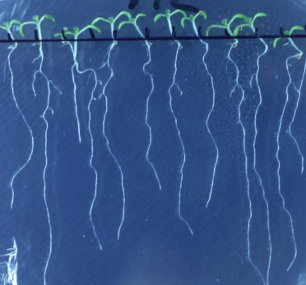
However, application of pCLV3 into the culture medium of Ar.th. influences ROOT growth though no putative receptors of it have been identified in roots.
We studied the effects of the synthetic peptide pCLV3 in concentrations including ultra-low ones on the main root and on lateral roots growth of Ar.th. defining root development. We observed complex effects of the peptide on both processes.
Control
10⁻⁷ M
10⁻¹⁰ M
10⁻¹² M
Notes:
Breiden M., Simon Rudiger. Q&A: How does peptide signaling direct plant development? BMC Biology (2016) 14:58

Slide 8
Concentration dependence of the effects of of pCLV3 and homologous peptides on the growth of roots of Ar.th.:
(mean data from 5 experiments)
-- RTVPSGPDPLHH (from Ar.th)
-- RMVPSGPNPLHN*
-- RMVPTGPNPLHN*
(* both from moss Physcomitrella pattens )
Asterics – p<(0,05 or 0,01)

Slide 9
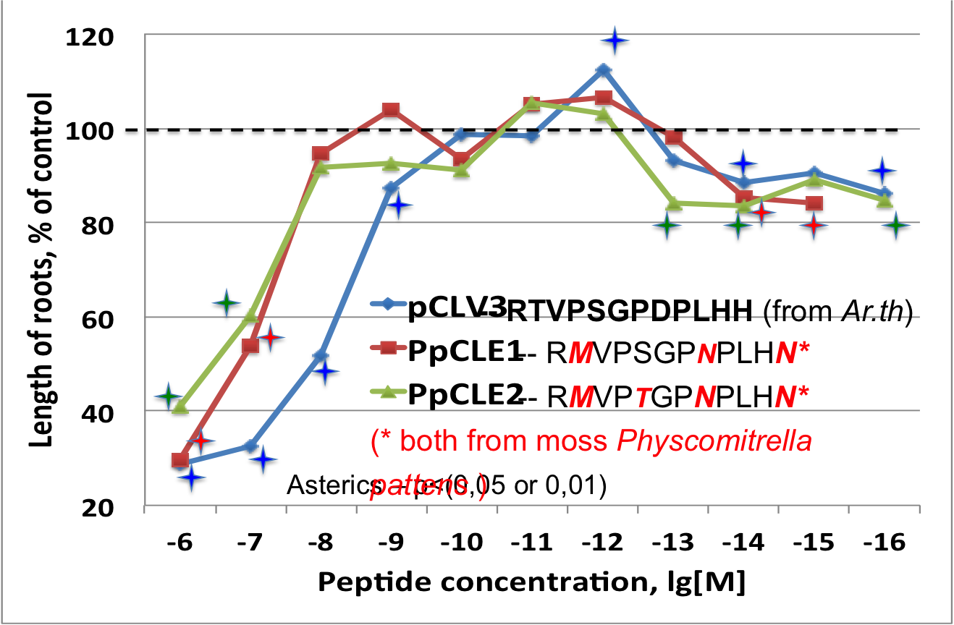
Concentration dependence of the effects of of pCLV3 and homologous peptides on the growth of roots of Ar.th.:
(mean data from 5 experiments)

Slide 10

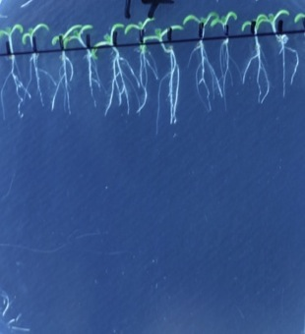
INHIBITION of the main root growth by peptides in the 10⁻⁶ -10⁻⁸ concentration range is accompanied by STIMULATION of lateral roots growth in the same concentration range
Control
10⁻⁷ M
Notes:
Breiden M., Simon Rudiger. Q&A: How does peptide signaling direct plant development? BMC Biology (2016) 14:58

Slide 11
However, in the 10⁻¹¹ -10⁻¹² concentration range pCLV3 moderately stimulates both main and lateral roots growth
10⁻¹² M
10⁻¹⁰ M
Notes:
Breiden M., Simon Rudiger. Q&A: How does peptide signaling direct plant development? BMC Biology (2016) 14:58

Slide 12
Thus, in the range of 10⁻⁶ -10⁻⁸ M pCLV3 inhibits main root growth (cellular proliferation) and promotes differentiation (appearance of lateral roots).
The balance between cellular proliferation and differentiation is a key aspect of development in multicellular organisms.
This balance in Arabidopsis roots is modulated by the balance of reactive oxygen species (ROS) between the zones of cell proliferation and the zone of cell elongation where differentiation begins.
(Tsukagoshi, H., et al. (2010). Cell 143, 606–616).
Notes:
Breiden M., Simon Rudiger. Q&A: How does peptide signaling direct plant development? BMC Biology (2016) 14:58

Slide 13
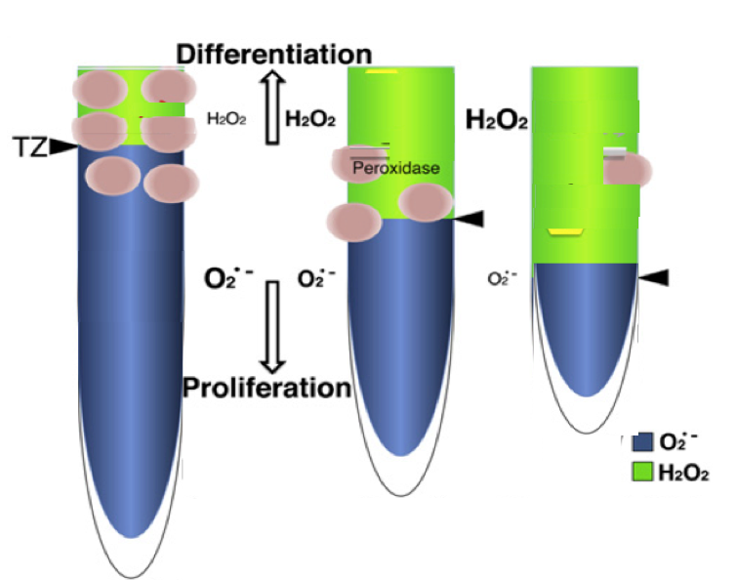
Cell proliferation (root growth) is supported by the abundance of superoxide anion radical (O₂⁻•) in the meristematic zone,
Cell differentiation in the elongation zone is supported by H₂O₂
When peroxidases are
over-repressed,
cell division is attenuated and differentiation is promoted
When peroxidases are
de-repressed,
cell division is stimulated,
differentiation is attenuated
Peroxidase
Tsukagoshi, H., et al. (2010). Cell 143, 606–616
Transcriptional Regulation of ROS Controls Transition from Proliferation to Differentiation in the Root

Slide 14
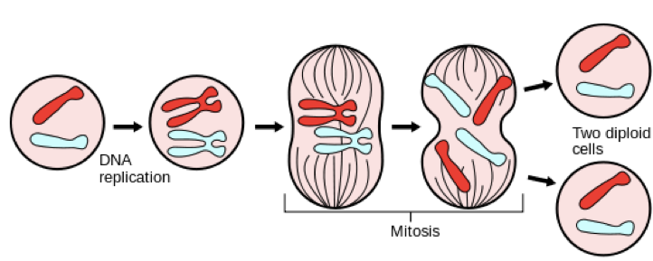
Cell proliferation – mitosis – is the major process promoting root growth
Two alternative mechanisms of mitosis triggering are suggested
Notes:
Breiden M., Simon Rudiger. Q&A: How does peptide signaling direct plant development? BMC Biology (2016) 14:58

Slide 15

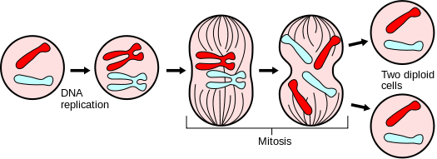

Alternative mechanisms for the perception of a mitotic stimulus:
The “key and lock” model:
2) The “resonance” model: cell surface is a coherent oscillating unit, “resonating” to a mitotic stimulus of an oscillatory nature…
Classical “Key & Lock” concept dominating in current biology
Receptor molecule
Mitotic hormone
“Key & Lock” concept realization in modern everyday life
through the principle of RESONANCE
According to “key and lock” model discrete particles - receptors of “mitotic hormones” are present at a cell surface…
Notes:
No action at a distance! Where is the source of energy to “rotate” the key in the lock?

Slide 16
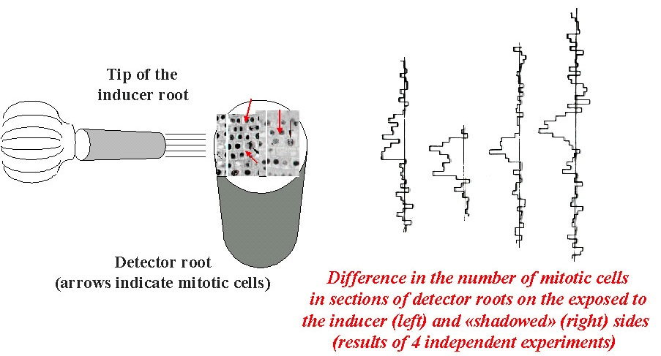
SCHEME OF THE FAMOUS GURWITSCH’s EXPERIMENT WITH ONION ROOTS.
The number of mitotic cell in sections of detector roots on the exposed to the inducer root side (left) significantly exceeds that on the “shadowed” side (results of 4 experiments)
A.G. Gurwitsch experimentally proved that mitosis are triggered with UV photons (Mitogenetic Radiation) emitted from tips of onion ROOTS

Slide 17
One of the major sources of MGR – recombination of oxygen free radicals and atoms (O₂⁻•, •HO, •O•, •H, ••C=O, •CO₃⁻, etc…) originating in the course of enzymatic and also physical chemical phase transitions (e.g., sol-gel transition) proceeding in aqueous systems
(e.g.: H• + •HO → H₂O + hv (MGR)
Notes:
Breiden M., Simon Rudiger. Q&A: How does peptide signaling direct plant development? BMC Biology (2016) 14:58

Slide 18

Using Electron Paramagnetic Resonance method we discovered that continuous generation of superoxide radical takes place in bicarbonate aqueous solutions.
We suppose that origination of superoxide radicals in aqueous systems becomes possible due to charge separation according to G. H. Pollack between EZ-water (negatively charged) and bulk water containing oxygen – electron acceptor.

Slide 19
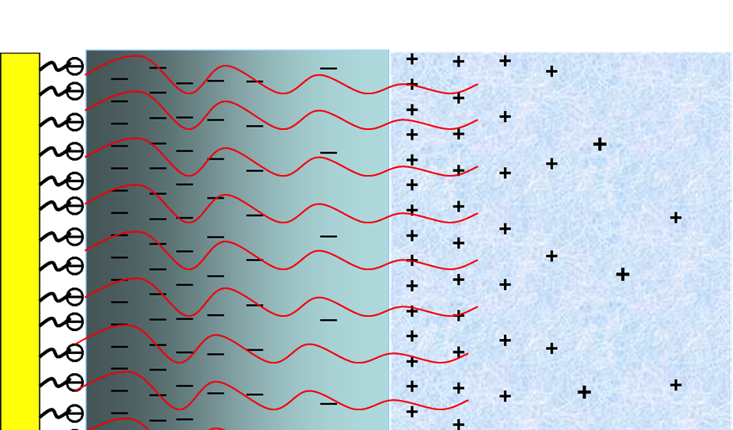
SCHEME OF “WATER BURNING” – network of processes providing for the emergence of ROS in water.
4 e─
+
4H+
O₂ → ROS → 2H₂O+ Energy
O₂
EZ-water
O₂
O₂
2H₂O + O₂ → O₂⁻ •→ H₂O₂→O₂* → O₂ + 2H₂O + hv
Water oxidation is catalyzed by HCO₃⁻ dissolved in water

Slide 20
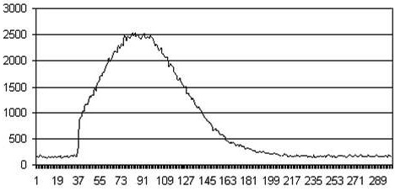
Addition of Fe (II) salts in catalytic quantities to bicarbonate waters results in the development of the wave of Luminol-amplified photon emission from them.
“Reagent” added to water
Data processing
Photo multiplier tube
Counts/sec
Time series
“Reagent”:
FeSO₄ (0,1-10 mkM) ± Luminol (0,1-10 mkM)
Reagent
Emission intensity
INTENSITY OF PHOTON EMISSION WAVE IS RELATED TO THE LEVEL OF SUPEROXIDE RADICAL IN SOLUTION
Time (sec)

Slide 21
Can small signaling peptides affect the the balance of ROS between the zones of cell proliferation and the zone of cell elongation where differentiation begins?
We tested if peptides that inhibit root growth can affect generation of ROS in much more simple aqueous systems -- bicarbonate aqueous solution.
Notes:
Breiden M., Simon Rudiger. Q&A: How does peptide signaling direct plant development? BMC Biology (2016) 14:58

Slide 22
Effect of pCLV3 on Fe(II) induced photon emission from bicarbonate aqueous solution
Note that pCLV3 attenuates photon emission in aq.solutions (indication of O₂- level) and inhibits root growth in Ar.th. In the same concentration ranges
Root length
Notes:
Breiden M., Simon Rudiger. Q&A: How does peptide signaling direct plant development? BMC Biology (2016) 14:58

Slide 23
Why can they play so many different biological functions including regulation of developmental processes and as a consequence -- regeneration of impaired biological functions in specialized organs and tissues?
Can these ubiquitous functions of small signaling peptides relate from their ability to modulate oxygen-dependent processes in aqueous systems?
What is so special about small signaling peptides from the point of Physics, Chemistry and Biology of Water?

Slide 24

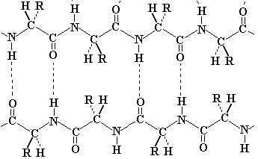
The properties of small signaling peptides may be considered in the frame of
Gilbert Ling’s Polarized-Oriented Multilayer Theory of Cell Water (PM-Theory)
“…dipolar backbone NH and CO groups are the primary seat of water sorption — but especially the carbonyl oxygen atoms with its lone pair electrons…”
Specificity – unique feature of a particular peptide
Θ
Θ
Θ
Θ
Θ
Θ
R₁
R₂
Regularity of hydration – the common feature of all peptides
R₃
Θ
R₄
Θ
Θ
Θ

Slide 25
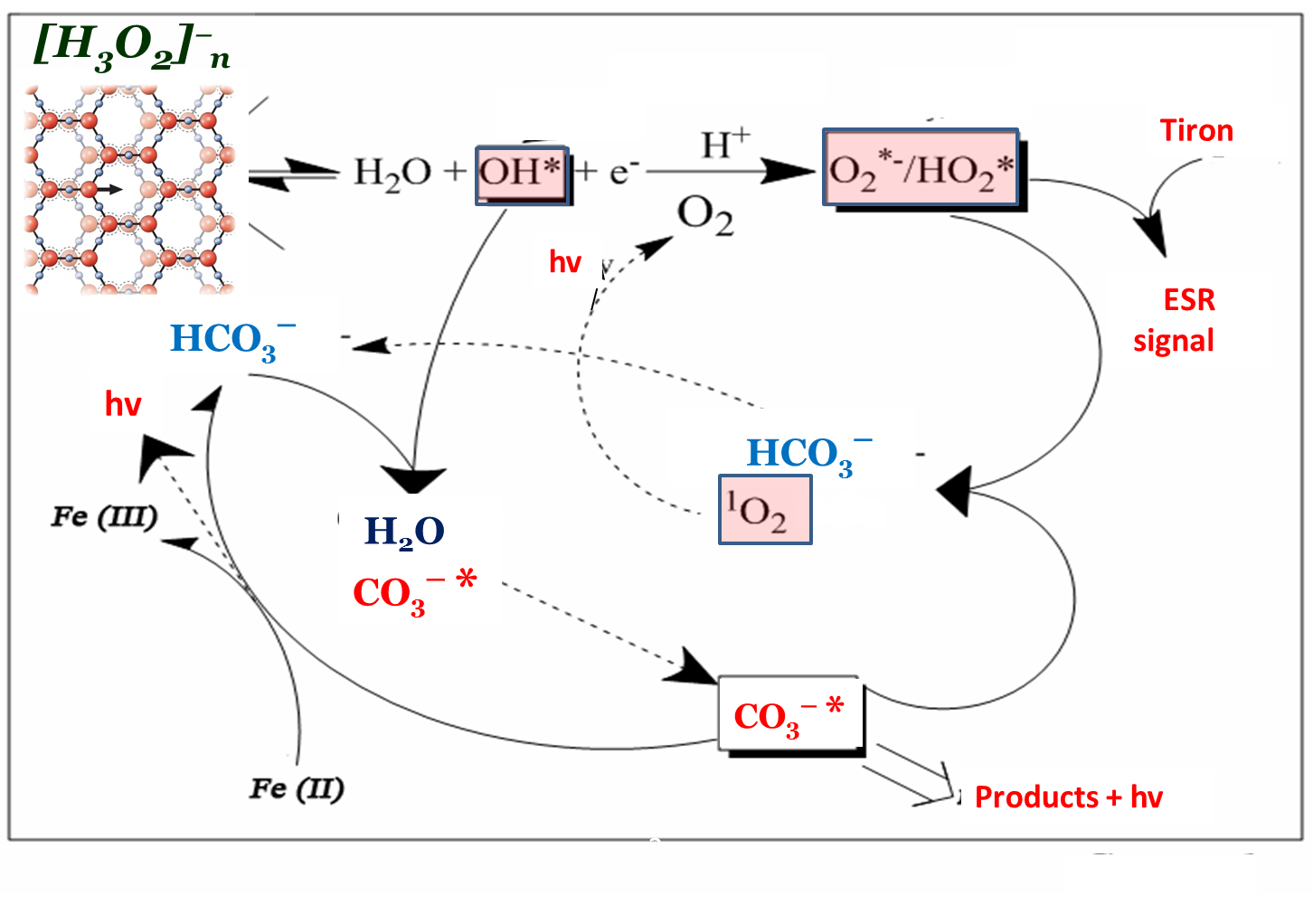
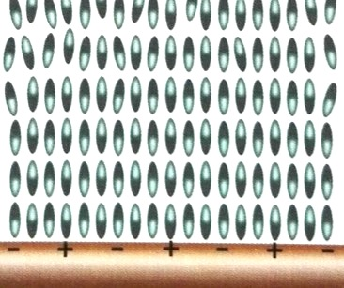
Probably these two features of SSP – ability to form multiple layers of highly polarized water and specific hydration of particular AA residues may provide for their versatile role in regulation of multiple biological functions not only in plants but in all living systems.
Small signaling peptides could thus play a role of specific modifiers of organized water and modulate structural-dynamical processes with ROS participation in aqueous systems.
Notes:
Breiden M., Simon Rudiger. Q&A: How does peptide signaling direct plant development? BMC Biology (2016) 14:58

Slide 26
It is interesting to speculate that due to the limited number of building blocks (amino acid residues) patterns of hydration of such bioorganic molecules as peptides could be significantly different from those characteristic of other bioorganic molecules.
This provides SSP with the ability to change water structure and modify parameters of regular processes going on in water in a manner characteristic only for this class of bioorganic molecules
Notes:
Breiden M., Simon Rudiger. Q&A: How does peptide signaling direct plant development? BMC Biology (2016) 14:58

Slide 27
Taking into consideration that peptides with necessity originate at the final stage of any protein life cycle, one may imagine that not only protein emergence, but its elimination may be a stimulus for rejuvenation of a living system
Signaling, regeneration, rejuvenation
I hope that this hypothesis is crazy enough for pretending to become true
(a joke after Niels Bohr)
Notes:
Breiden M., Simon Rudiger. Q&A: How does peptide signaling direct plant development? BMC Biology (2016) 14:58

