Slide 1
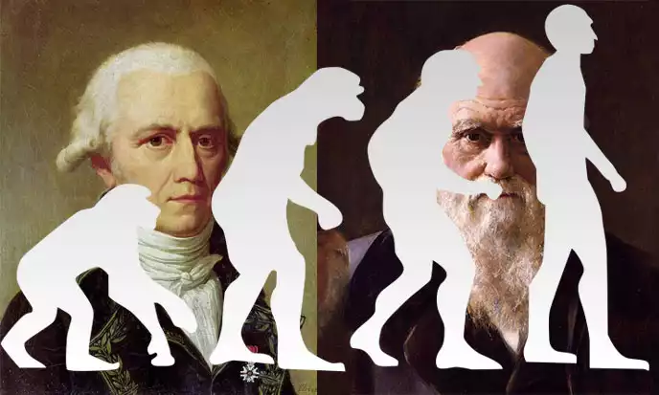
On the advent of the new
EVOLUTIONARY SYNTHESIS in BIOLOGY
SHOULD THE NEW EVOLUTIONARY SYNTHESIS ACKNOWLEDGE the “MEMORY OF WATER” AND THE TENDENCY TO SELF-ORGANIZATION OF AQUEOUS SYSTEMS?
Vladimir Voeikov, Ekaterina Buravleva
Faculty of Biology, Lomonosov Moscow State University,
Moscow, Russia

Slide 2
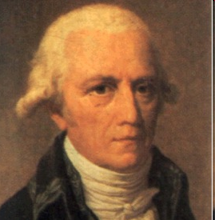
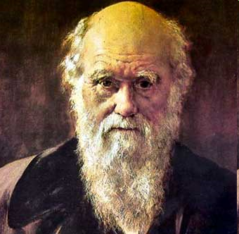
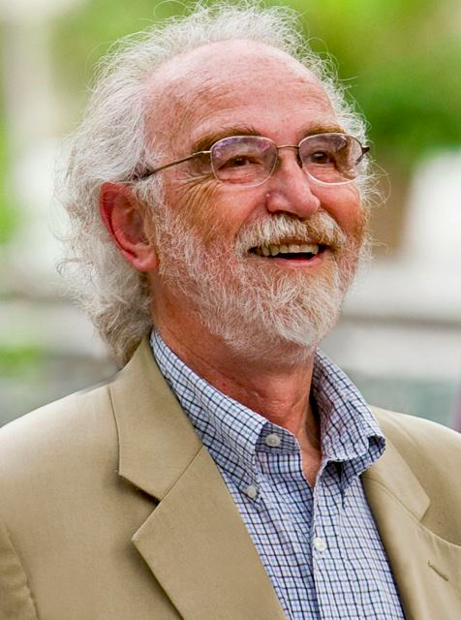
More and more biologists agree that currently the new evolutionary foundation of biology is emerging. It is based on the following premises:
Living systems possess intrinsic activity
ensuring their perfection (self-organization)
(Lamarckian Craving for Perfection)
and
Living systems are capable to inherit
adaptive acquired characteristics
(Darwinian Epigenetic Inheritance = Pangenesis)
Here we claim that both of these premises
stem from
Coherent Activity of Water Systems

Slide 3
Where do we stand now?
Until now and for about 100 years
the Synthetic Theory of Evolution (Neo-Darwinism)
was considered to be the theoretical foundation of Biology.
It is based on
the Darwinian principle of Natural Selection of the fittest originating from
hereditable variations of chance mutations of genetic material (DNA)

Slide 4
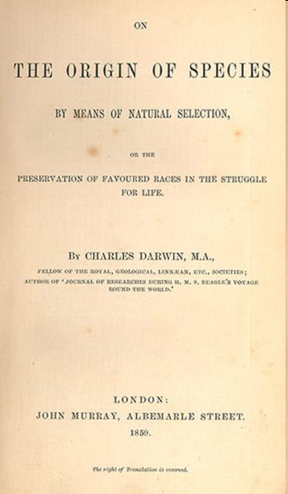
What is Natural Selection –
the essence of Darwinism?
“The Struggle for Existence amongst all organic beings … inevitably follows from their high geometrical powers of increase....
This is the doctrine of Malthus, applied to the whole animal and vegetable kingdoms.
As many more individuals of each species are born than can possibly survive …. it follows that any being, if it vary however slightly in any manner profitable to itself … will have a better chance of surviving, and thus be
NATURALLY SELECTED

Slide 5
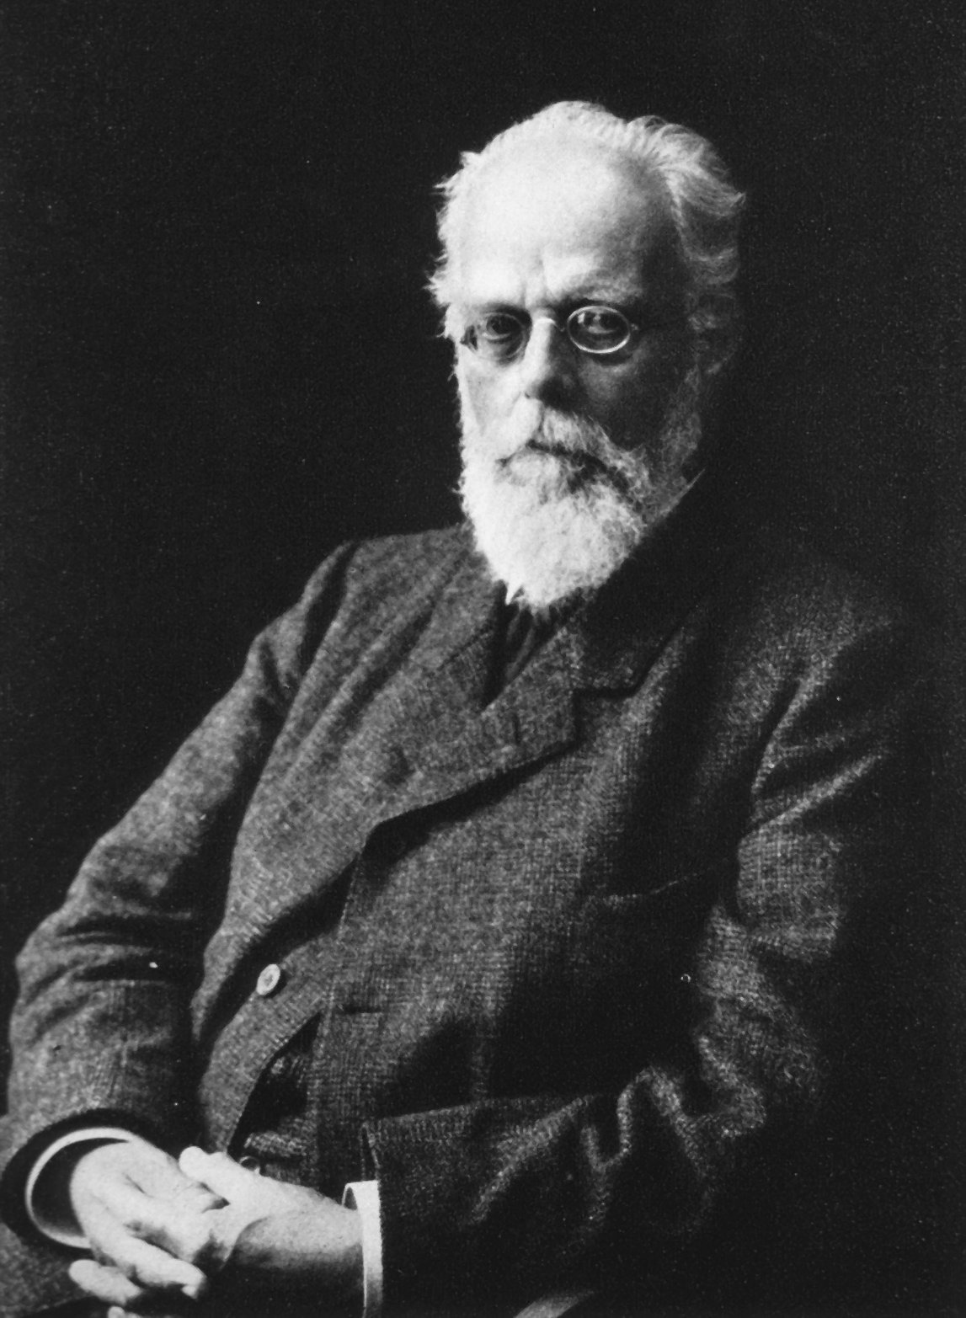
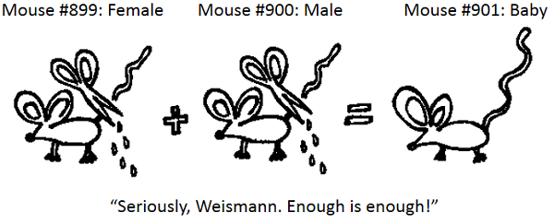
In 1920-30-ies, DARWINISM was replaced by
NEO-DARWINISM = Synthetic Theory of Evolution in which
the Malthusian basis of the "struggle for existence" is not mentioned,
variability is due to ONLY random (nondirectional) mutations – meaning that EVOLUTION is the natural selection of the "lucky ones”.
The possibility of inheritance of the acquired features was “refuted” by August Weismann experiments -- the cutting off of the tails in mice

Slide 6
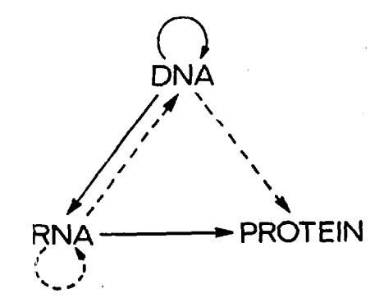
Contemporary biology is essentially reduced to
MOLECULAR BIOLOGY
based on the CENTRAL DOGMA proclaimed by Francis Crick
DNA (genes)
“The Dogma is a modern version of the Weismann barrier. … hereditary information moves only from genes to body cells, and never in reverse. Hereditary information moves only from germline cells to somatic cells.”
Wikipedia
RNA (messengers)
Proteins (function)
“…the discovery of just one type of a cell which could carry out any of the transfers (protein→DNA, protein→RNA, protein→ protein) would shake the whole intellectual basis of molecular biology...”
Francis Crick
NATURE, vol. 227, August 8, 1970

Slide 7
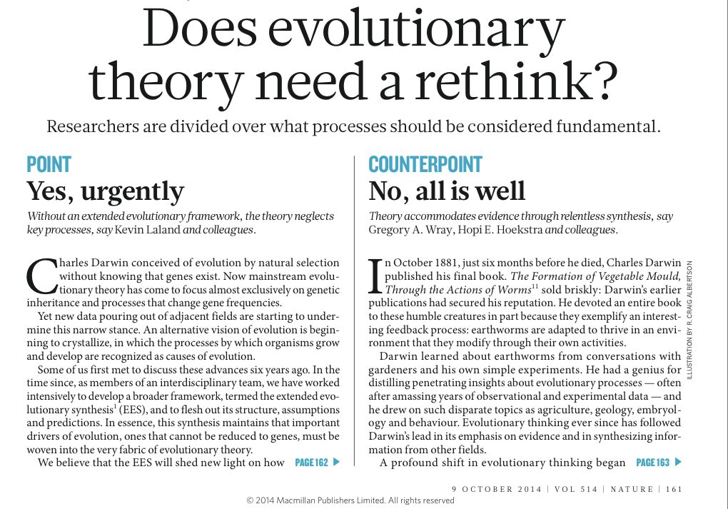
Dispute in Nature (October, 2014):
…In our view, this ‘gene-centric’ focus fails to capture the full gamut of processes that direct evolution. Missing pieces include:
-- how physical development influences the generation of variation;
-- how the environment directly shapes organisms’ traits;
-- how organisms modify environments;
-- how organisms transmit more than genes across generations (extra-genetic – EPIGENETIC -- inheritance).
Notes:
For SET, these phenomena are just outcomes of evolution.
For the the new theory, they are also causes.

Slide 8
Adventures of the phenomenon of
“INHERITANCE OF ACQUIRED CHARACTERISTICS”:
from mainstream science (XIX century)
to “pseudoscience” (XX century)
and back to MAINSTREAM (XXI century)
… organisms transmit more than genes across generations –
extra-genetic – EPIGENETIC – inheritance.
Nature, 2014….

Slide 9
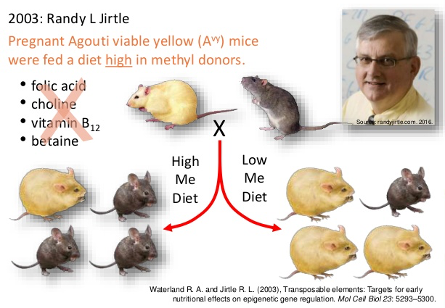
EPIGENETIC INHERITANCE OF NUTRITIONAL EFFECTS

Slide 10
EPIGENETIC INHERITANCE OF BEHAVIORAL TRAITS
Lamarck revisited: epigenetic inheritance of ancestral odor fear conditioning
Moshe Szyf
Nature Neuroscience 17, 2–4 (2014)
A study shows that when MALE mice are taught to fear an odor, both their offspring and the next generation are born fearing it. THEIR SPERM IS THE CARRIER OF THE NEW TRAIT
Notes:
acetophenon

Slide 11
The idea of inheritance of acquired characteristics is usually ascribed to Lamarck.
Typical presentation of Lamarck’s ideas on evolution in a biological textbook:
Organs used a lot could grow and change shape
Organs not used would shrivel and disappear
Acquired traits can be inherited
This theory was incorrect but significant because Lamarck was the first scientist to recognize that organisms had changed over time

Slide 12
It’s not the full truth!
Darwin was Lamarckist!
He did not doubt the inheritance of the acquired features and even suggested a possible mechanism for it, the hypothesis of ”Pangenesis"
Darwin, 1868 «The Variation of Animals and Plants Under Domestication» .

Slide 13
Darwin considered that “hard heredity” is the basis of heredity, but it could not explain all of the observable phenomena:
the effects of use and disuse of organs,
the inheritance of acquired characters,
graft hybridization,
telegony,
development,
regeneration,
To include all these phenomena, Darwin assumed that there was another means of transfer of hereditary characters.

Slide 14
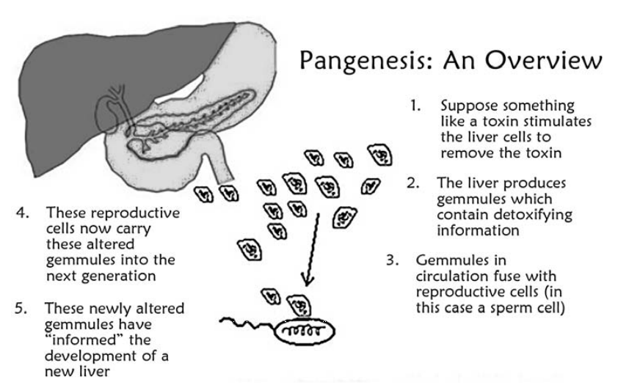
Darwin, 1868
Gut
Pangenesis
Liver
‘‘…Pangenesis will be called a mad dream, . . .but at the bottom of my mind I think it contains a great truth’’
Darwin, 1888
Notes:
The Variation of Animals and Plants Under Domestication. Murray J (Ed.). London, UK (1868).

Slide 15
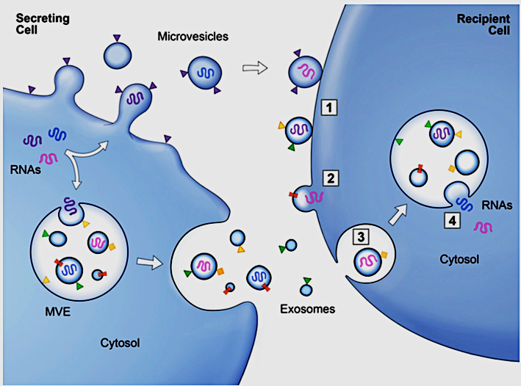
2000-ies: PANGENESIS Revival
Extracellular vesicles (EV) are vehicles for intergenerational transmission of acquired traits
Raposo S., Stoorvogel W. J.Cell Biol. 200, 4, 373-383, 2013
EVs are nanovesicles (40-100 nm) derived from cells ubiquitously found in biofluids. They are jelly-like particles containing specific mixes of lipids, proteins and especially variable RNAs. RNA content of EVs display sensitive responses to environmental factors.
Notes:
EVs are membrane-bound microvesicles that are ubiquitously found in biofluids. They display sensitive responses to bodily conditions53 and are frequently found in mammalian reproductive tracts, particularly in the epididymis, semen and uterine fluids54. Cellular communication through EVs rep- resents a new frontier in cell biology, bringing novel approaches for biomarker diagnostics55 and drug deliv- ery56, and raising the possibility of transferring RNA car- goes from somatic cells to germ cells as a way to deliver environmentally obtained information (either harmful or adaptive). Recent data have shown that EVs in the epididymis (called epididymosomes) contain abundant tsRNAs, similar to mature sperm11, and in vitro experi- ments have demonstrated that epididymosomes can fuse with and transfer tsRNAs into sperm11.

Slide 16
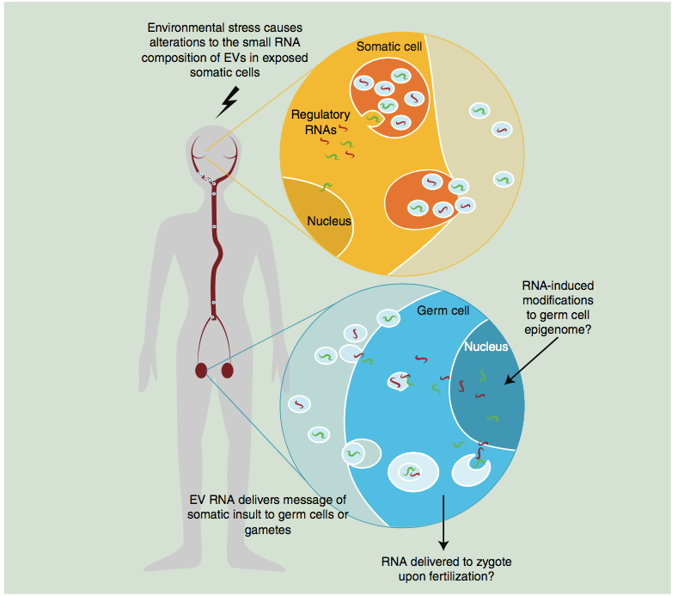
2015: PANGENESIS Revival
Extracellular vesicles (EV) and intergenerational transmission of acquired traits
Environmental stress causes alterations to the small RNA composition of EVs in exposed somatic cells;
EV RNA delivers message of somatic insult to germ cells or gametes;
RNA-induce modifications to germ cell epigenome;
RNA deliver to zygote upon fertilization
Eaton S. A., et al. Epigenomics (2015) 7(7), 1165–1171
Notes:
Somatic cells alter the regulatory RNA composition of EVs in response to an environmental stressors. Somatically derived EVs can passage through the circulation and may reach the germ line. Given the correct complement of surface antigens, somatic EVs may fuse with germ cells to deliver the somatic RNA message. RNA delivered to germ cells by somatic EVs may alter the germ cell epigenome, or alternatively be delivered to the egg at fertilization and interfere with molecular events in early embryogenesis.

Slide 17
Charles Darwin (1871):
“The supposed gemmules must be much more minute than the smallest particles that can be seen by the highest magnifying powers used in these days,”
“...the gemmules are actual particles suspended and not dissolved in the fluid”.
These Darwin’s descriptions were visionary, as the properties of gemmules proposed 150 years ago appear to match well with those of extracellular vesicles (EVs)
Thus, EVs (gemmules) ensure body memory, its development and transmission of the actual (acquired) memory to progeny.
However, currently the major attention is paid to the bioorganic molecular composition of EVs, while like any living matter they consist mainly of water and without associated “water memory” none of these features may be realized.

Slide 18
Lamarck’s concept of evolution was no less visionary
According to Lamarck the responsiveness of living things to external factors is provided by the the
nature of chemical material of living things:
GELATINOUS AND MUCILAGINOUS MATTER = “WATER”
and by
SELF-ORGANIZING DYNAMICS OF FLUXES OF
“SUBTLE FLUIDS” (ELECTRICITY AND HEAT)
that shape this “WATER” in a way that leads to its self-maintenance and complexification.

Slide 19
Lamarck’s concept of evolution is essentially DYNAMICAL:
Evolution is the result of an internal strive of living things for progressive development.
“… Nature endows animal life with the POWER TO MAKE ORGANIZATION GRADUALLY MORE COMPLEX, and to bring increasing complexity and perfection to their organization”.
— Jean-Baptiste Lamarck Histoire Naturelle des Animaux sans Vertèbres (1815-22)
This POWER (=potential) is the intrinsic property
of water systems

Slide 20
Lamarck:
once (gelatinous) matter is exposed to fluxes of environmental caloric and electricity, the matter self-organizes into living, self-sustaining entities…
(Philosophie zoologique… Paris, 1809).
WATER IS ABLE TO SELF-ORGANIZE at MESOSCOPIC, MICROSCOPIC AND NANOSCOPIC LEVELS...
Emilio del Giudice (1988 and later on…)
Gerald Pollack, (2003 – continued…)

Slide 21
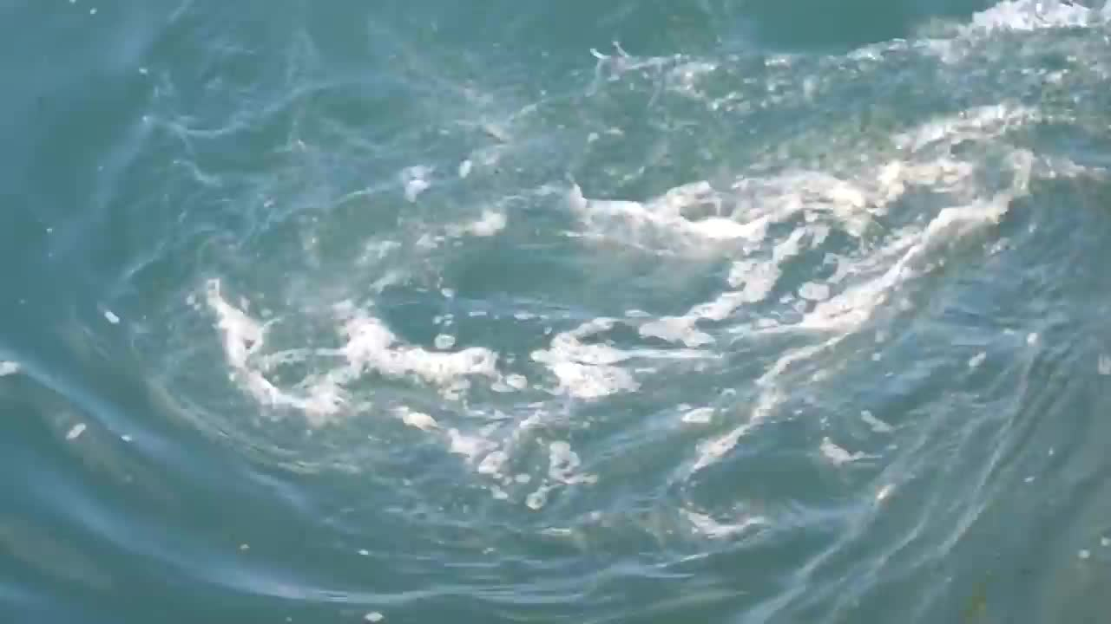
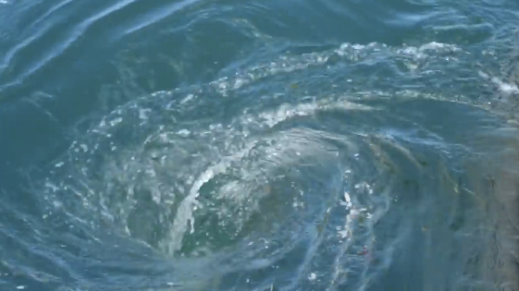
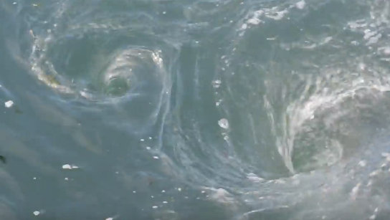
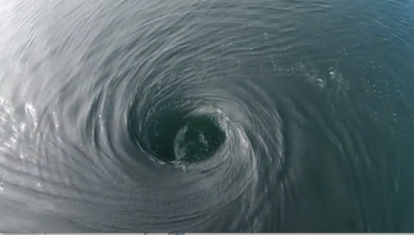
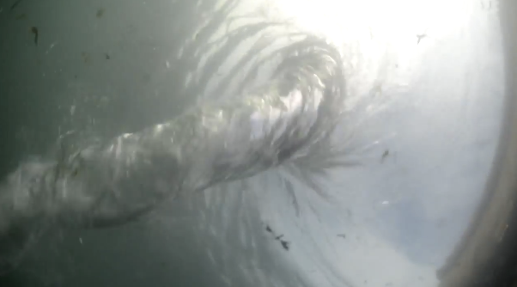
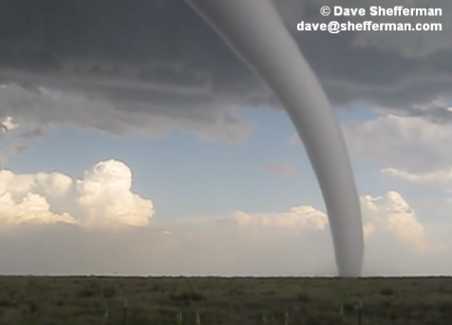
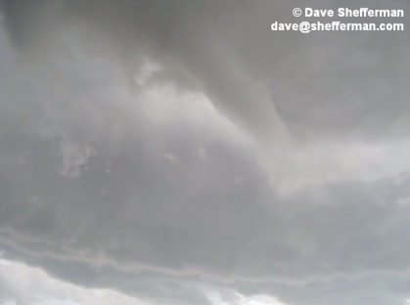
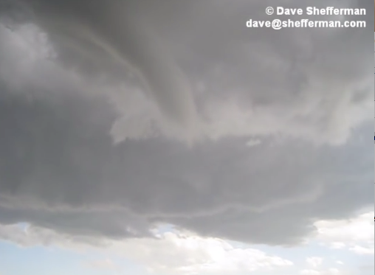
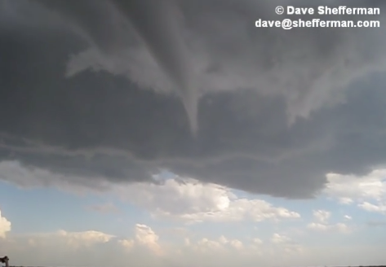
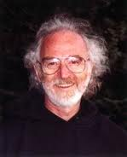
Examples of water self-organization at the macroscopic level
Vortices spontaneously appear in moving liquid or …
… or atmospheric water
Example of water self-organization at the mesoscopic and microscopic levels
Liquid crystalline EZ water spontaneously emerges near hydrophilic surfaces

Slide 22
Experimental evidence obtained by now indicates that all natural aqueous systems possess the following properties:
they are represented by coexisting liquid crystalline (coherent) water and quazi-chaotic “bulk” water,
charge separation between these two phases is ensured
electron flow from coherent water to oxygen present in bulk water is provided
These properties of aqueous systems are provided by their existence in space filled with physical fields and possessing these properties they are able
to transform external low density energy into organized (coherent) free energy = self-organization

Slide 23
Thus the necessary condition for water self-organization is availability of enough energy (thermal or IR or other) to support liquid state of water.
The same condition is needed for the spontaneous emergence, existence and self-organization (evolution, development) of living systems in the forms known on Earth.

Slide 24
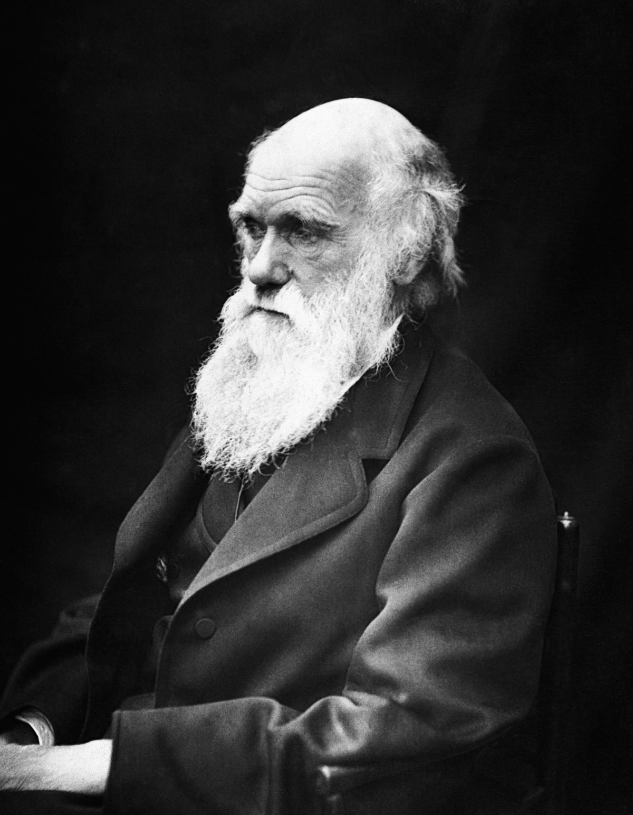
The intrinsic activity of aqueous systems “endows animal life with the POWER TO MAKE ORGANIZATION GRADUALLY MORE COMPLEX, and to bring increasing complexity and perfection”
(self-organization)
The intrinsic capacity of aqueous systems to change their state in response to external irritations and stay in it (“water memory”) is the basis for Darwin’s “pangenesis”, for the origination of liquid crystalline “gemmules” capable to transfer new traits from the parents to progeny

Slide 25
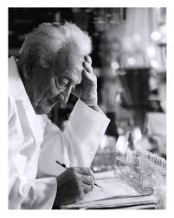
We should also acknowledge the protagonists of the New Science of Water –
the Mother and Matrix of Life
Albert Szent-Giorgyi
Emilio Del Giudice
Gerald Pollack

Slide 26
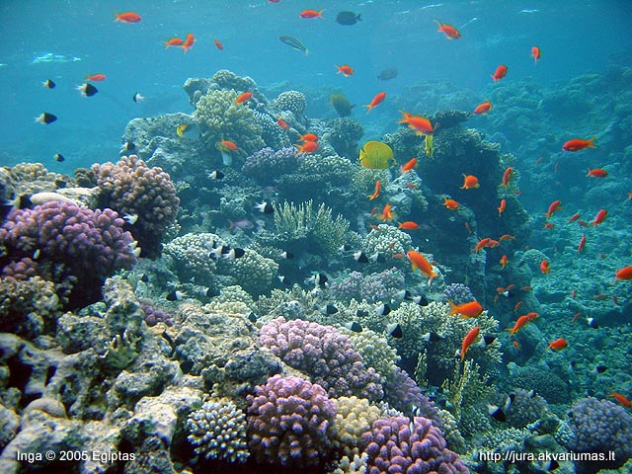
СПАСИБО
Thank you!

