Slide 1
Electron extraction from Bi-Distilled Water
Roberto Germano
PROMETE Srl – CNR Spin off, Napoli, Italy
11th October 2014
WATER_Bulgaria
In memory of EMILIO Del Giudice

Slide 2
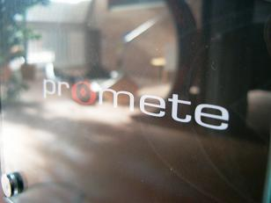
CNR_INFM Spin off Company
PROMETE Srl
INFM-CNR Spin off

Slide 3
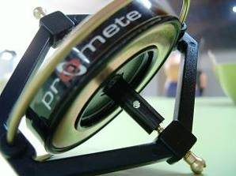
PROMETE is a Spin off Company of the Italian National Research Council (CNR) PROMETE’s LAB is certified in the Regional List of laboratories in the Campania Region that are authorized to provide consultancy and research activities to promote innovation and scientific & technological development of regional SMEs (executive decree No. 450 of the Campania Region, 13/07/2005) in the field of Experimental Physics PROMETE is certified ISO 9001 - No. 4719/05 for Research and Development in the field of Experimental Physics
CNR_INFM Spin off Company
www.promete.it

Slide 4
PROMETE uniquely positioned to bring in and accrue new competencies in a well diversified technologies’ asset base
CNR_INFM Spin off Company
actively present in 3 interrelated business areas
_environment &
new technologies
3
core
business areas
of growth
_process control & industrial automation
_technology
transfer

Slide 5
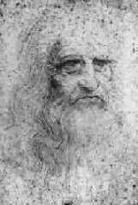
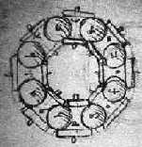
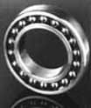
An example of missing Technology Transfer …
1500
400 years ...
1900

Slide 6
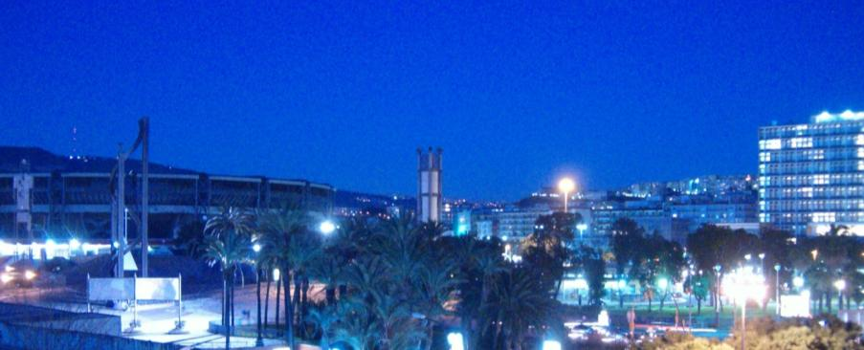
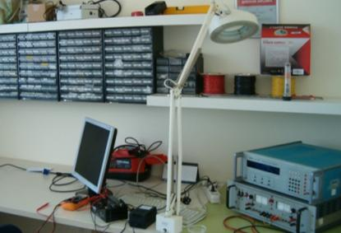
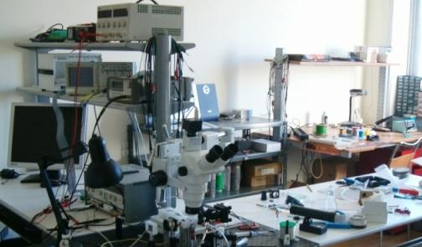
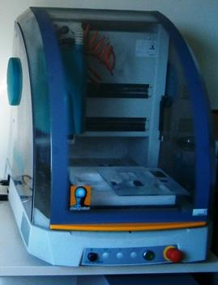
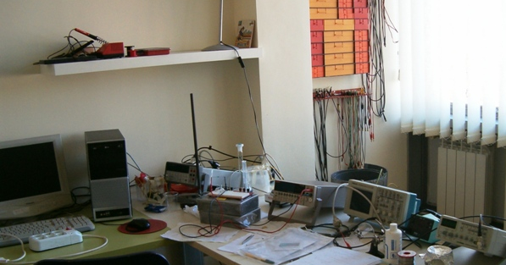
Tel/Fax : (+39) 081 - 056851 V.le Kennedy, 5 - 80125 Napoli ITALY www.promete.it
CNR_INFM Spin off Company

Slide 7
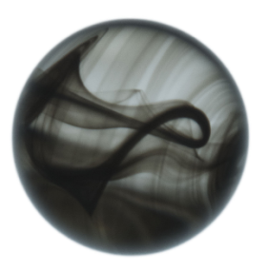
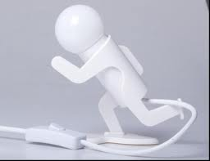
Oxhydroelectric Effect
in Bi-Distilled Water
What is the novelty?
Oxhydroelectric Effect - electricity extraction from water electrolytic solution by twin Platinum (Pt) electrodes, mediated by oxygen molecules - is reported for the first time in bi-distilled water (electric conductivity of 1.2 μS/cm).
a dc power of the order of 10⁻¹² W was measured through a resistor (47 kOhm) connected to twin Pt electrodes immersed into bi-distilled water;
the addition of a very small amount of hydrogen peroxide (H₂O₂)
to the bi-distilled water (only 0.004wt% H₂O₂), as a source of oxygen, determines a dc power jump of more than 5 orders of magnitude, reaching a stable value of the order of microW that lasts for many hours.

Slide 8
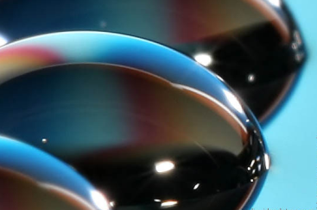
Oxhydroelectric Effect
in Bi-Distilled Water
Why is it a novelty?
Electricity Extraction from Bi-Distilled Water by twin electrodes astonishing phenomenon in the frame of classical electrochemistry
due to
absence of any significant quantity of ionic solutes that seems to imply some kind of
“other than ionic” conduction
The unexpected phenomenon of electricity extraction from water by twin Pt electrodes, mediated by oxygen molecules - Oxhydroelectric Effect - has been already reported in a “standard” electrolyte solution¹.
The use of bi-distilled water instead of water-electrolyte solution exploits new physical concepts concerning pure water behavior, derived from numerous experimental results.
¹R. Germano et al. : Key Eng. Mat., 495 (2012) 100

Slide 9
Oxhydroelectric Effect
in Bi-Distilled Water
variation of the physical-chemical properties of pure, bi-distilled water such as huge changes in ³⁻⁵:
What are saying the experimental results on pure water behaviour?
pH
Density
electrical conductivity
UV-vis and IR absorbance
light scattering
mixing heat with alkaline or acid solutions
when subjected to some kind of physical treatments :
- iterative agitations or filtrations
- contact with hydrophilic surfaces
- exposure to electromagnetic fields, etc.
Example: electrical conductivity of pure water increases up to 300% after iterative filtrations.
³V. Elia, E. Napoli: Key Engineering Materials, 495 (2012) 37
⁴V. Elia, N. Marchettini, E. Napoli, E. Tiezzi: J. Opt. Adv. Mat., in press
⁵T. M. P. Cattaneo, S. Vero, E. Napoli, V. Elia: J. Chem. & Chem. Eng., 5 (11) (2011) 1046

Slide 10
Oxhydroelectric Effect
in Bi-Distilled Water
What are saying the experimental results on pure water behaviour?
The reported changes in the physical-chemical properties of pure, bi-distilled water are most likely to be attributed to variations in water super-molecular structure.
water exhibits an extraordinary auto-organization potentiality, triggered by several kinds of small energy perturbations - basis of every living system.

Slide 11
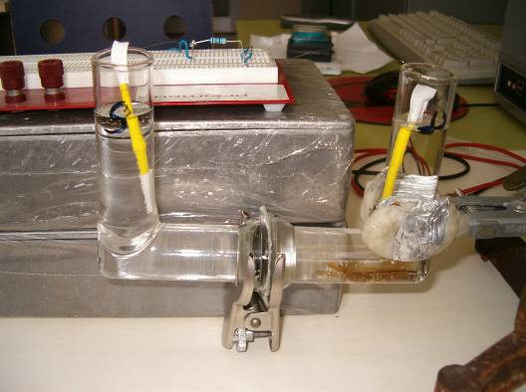
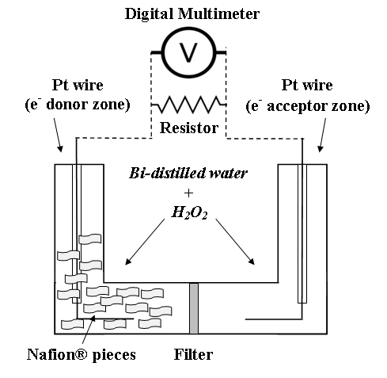
2 L shaped glass semi-cells provided with 25 nm filter Millipore®
bi-distilled water:1.2 μS/cm electric conductivity
twin pt wire electrodes (Laborplatina 99.95 % purity, 0.1 mm diam.)
∼20 squared pieces (5 mm side length, 0.2 mm thick) of Nafion® - strong hydrophilic material
standard 47 kΩ resistor
digital Multimeter 6½ digit Agilent 34401A + LabVIEWTM software
What is the experimental set-up by which we obtained the Oxhydroelectric Effect in Bi-Distilled Water?
2.0 cm
10.5 cm
7.5 cm

Slide 12
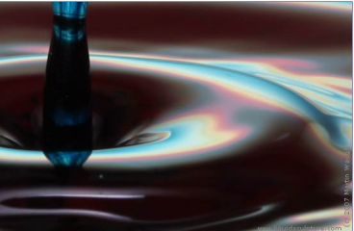
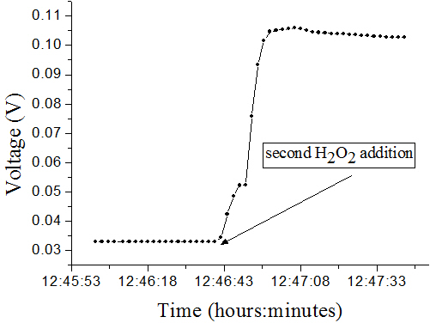
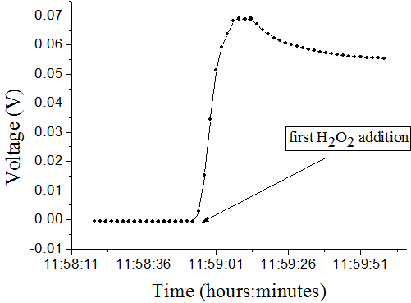
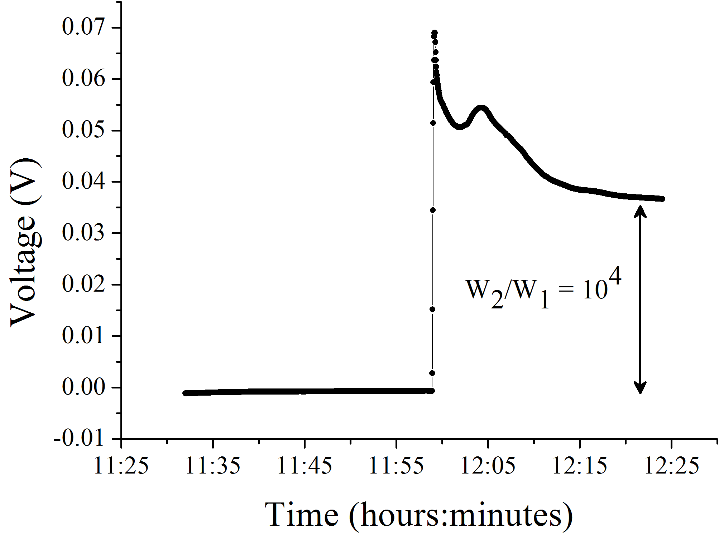
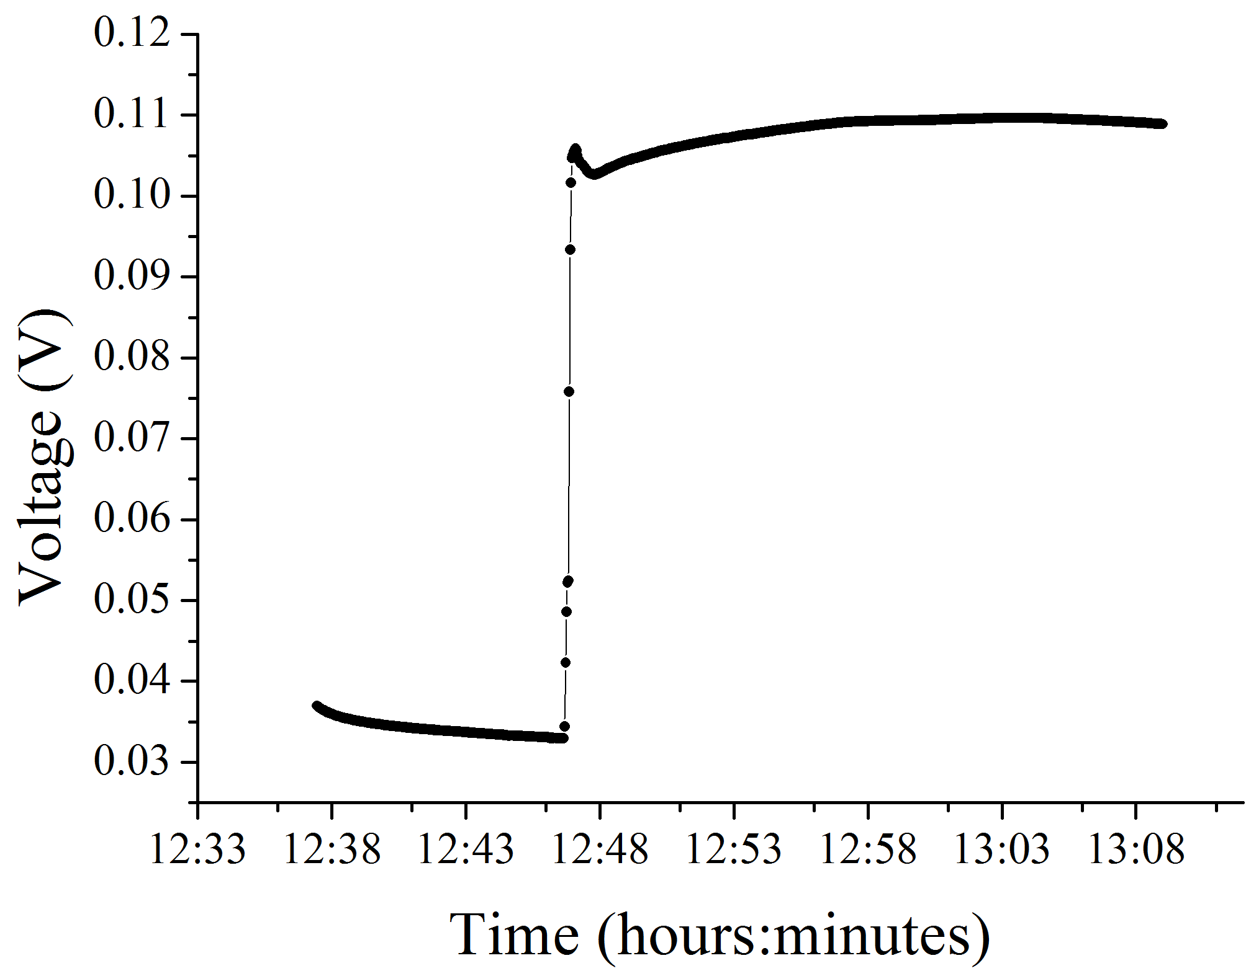
Oxhydroelectric Effect
in Bi-Distilled Water
What we measured?
Subsequent addition of H₂O₂ (0.002wt% H₂O₂) in each semi-cells generates another jump in the dc power up to W₃ = 2 microW, that is almost 6 orders of magnitude higher as compared to the initial value W₁ (W₃/W₁ ~ 800 000).
this dc power extracted from bi-distilled water is 2 orders of magnitude higher than that reported for the “standard” Oxhydroelectric Effect obtained in standard water-electrolyte solution.
insertion of Nafion® pieces in one semi-cell generates a very small electric power - picoW - through the resistor.
H₂O₂ addition to the bi-distilled water in each semi-cell (0.002wt% H₂O₂), as a source of O₂, determines in a few seconds a dc power jump of 4 orders of magnitude from W₁ = 2.6 picoW to a plateau of W₂ = 0.03 microW (W₂/W₁ ~ 10⁴) .
(a)
(b)
negligible noise current in the resistance when in the two semi-cells were only pure water and the electrodes.
Typical dc voltage across the resistor (47 kΩ) vs. time, measured after insertion of 18 Nafion® pieces in the bi-distilled water of one semi-cell, before and after the first (a), and the second (b) H₂O₂ addition to the bi-distilled water in each semi-cell (one experimental point every 2 s)

Slide 13
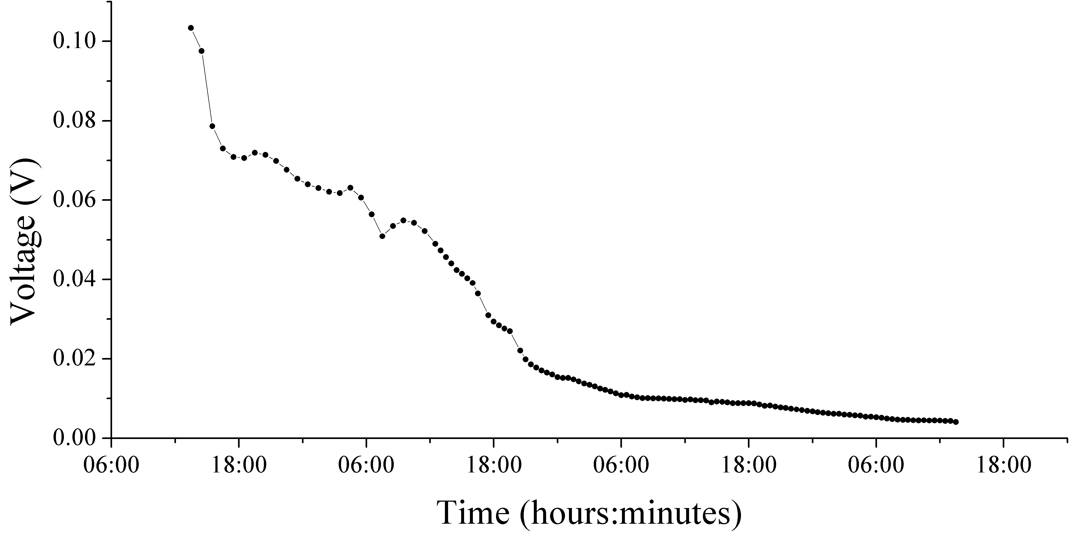
Oxhydroelectric Effect
in Bi-Distilled Water
What we measured?
The obtained electric power magnitude, microW, was lasting for some days before decaying to the initial values, with some daily variations depending on the temperature conditions of the laboratory.
DC voltage across the resistor (47 kΩ) vs. time during 3 days monitoring (one experimental point every 30 minutes).

Slide 14
Oxhydroelectric Effect
in Bi-Distilled Water
Keep in mind!
Nafion® is an inert and insoluble polymer, exactly as Teflon® from which it is obtained.
The solubility of Nafion® in water at room temperature was measured by ionic chromatography and it was determined to be as small as 10⁻⁶ mol/L.
Moreover, in our experiments Nafion® was “washed” many times in bi-distilled water.

Slide 15
Oxhydroelectric Effect
in Bi-Distilled Water
Water, Nafion® and Protons – how is it working?
it is well known that Nafion® has received a considerable amount of attention for “proton exchange” membrane fuel cells, but the chemical-physical basis of these peculiar properties remains a focus of research.
in particular, the real physical meaning of the high “proton” concentration in liquid water induced by Nafion® surface, extensively reported in the literature, is absolutely not clear.

Slide 16
Oxhydroelectric Effect
in Bi-Distilled Water
What is the theoretical explanation of the obtained results?
What is
the Coherent QED description of water?
We analyzed the obtained experimental results in the frame of the Coherent Quantum Electro-Dynamic (Coherent QED) description of water⁶⁻⁸.
⁶R. Arani, I. Bono, E. Del Giudice, G. Preparata: Int. J. Mod. Phys. B, 9 (1995) 1813
⁷V. L. Voeikov, E. Del Giudice: Water Journal, (1) (2009) 52
⁸G. Preparata: QED Coherence in Matter, World Scientific, Singapore, 1995

Slide 17
Coherent QED
description of water
Incoherent phase
In the seminal works of G. Preparata and E. Del Giudice on the modern quantum electrodynamics (QED) description of liquid water structure, an ab initio quantum field (QED) theoretical approach is used to demonstrate that liquid water is a system in a stable non-equilibrium state due to the co-existence of two phases characterized by different thermodynamic parameters^{6,8}:
A matrix of non-coherent water molecules
hosting
2. many “Coherence Domains” (CDs), about 0.1 μm in size, in which all water molecules are oscillating in phase with a self-trapped electromagnetic field
At room temperature
D = 750 Angstrom
r = 250 Angstrom
r
D
M. Buzzacchi, E. Del Giudice, G. Preparata
"Coherence of the Glassy State”
International Journal of Modern Physics B, 16 (2002) 3771-3786
⁶R. Arani, I. Bono, E. Del Giudice, G. Preparata: Int. J. Mod. Phys. B, 9 (1995) 1813
⁸G. Preparata: QED Coherence in Matter, World Scientific, Singapore, 1995
Coherence Domains

Slide 18
Coherent QED description of water
The dynamical oscillation of the coherent H₂O molecules takes place between a fundamental state, where electrons are firmly bound (ionization energy: 12.60 eV), and an excited state, characterized by a quasi-free electron configuration.
In fact, from QED calculations result that the energy of the excited state is 12.06 eV, which means that only a small amount of energy
12.60 - 12.06 = 0.54 eV
is sufficient to release an electron.
Non-Coherent Phase
At room temperature
D = 750 Angstrom
r = 250 Angstrom
r
D
Coherence Domains (CDs)

Slide 19
Coherent QED description of water
More exactly, the almost free electrons have to cross an energy barrier: (0.54 – 0.1) eV = 0.44 eV,
where 0.1 eV - electric potential difference at CD boundary with non-coherent water⁹.
This small amount of energy, ~0.44 eV, necessary for electron extraction, makes the coherent H₂O a reservoir of quasi-free electrons that can be easily released by:
quantum tunnel effect or
small external perturbation (e.g. 0.44 eV matches well O₂ electro-negativity. if present in H₂O, O₂ is the privileged receptor of the electrons extracted from CDs.)
⁹V. L. Voeikov, E. Del Giudice: Water Journal, (1) (2009) 52
Non-Coherent Phase
At room temperature
D = 750 Angstrom
r = 250 Angstrom
r
D
Coherence Domains (CDs)

Slide 20
Oxhydroelectric Effect
in Bi-Distilled Water
What is the theoretical explanation of the obtained results?
The analysis of our experimental results in the frame of the coherent QED description of H₂O induces us to consider the following hypothesis: the peculiar dynamic auto-organization of the liquid water structure in the presence of Nafion®, due to its very strong hydrophilic properties, determines the release of free electrons from the coherent water, whose privileged receptors are the O₂ molecules from H₂O₂, and the corresponding generation of ionized water molecules.
These ionized molecules may be the unexpected electricity carriers in our bi-distilled water system.

Slide 21
Oxhydroelectric Effect
in Bi-Distilled Water
Oxhydroelectric Effect exists also in bi-distilled water: a dc power of the order of 2 microW was measured through the resistor connected to the twin Pt electrodes immersed into the bi-distilled water, in the presence of Nafion® and H₂O₂.
- totally unexpected phenomenon in the frame of the classical electrochemistry considering the absence of any significant concentration of ionic solutes.
Conclusions

Slide 22
Oxhydroelectric Effect
in Bi-Distilled Water
Conclusions
As predicted by Coherent QED, the coherent fraction of water (CDs) is a huge reservoir of quasi-free electrons easily releasable either by quantum tunnel effect or by different tiny external perturbations such as the presence of O₂ molecules (coming from H₂O₂ in our experiment) having an electro-negativity equal to the energy barrier of the quasi-free electrons.
O₂ molecules are therefore privileged receptors of the electrons tunneling out of CDs.

Slide 23
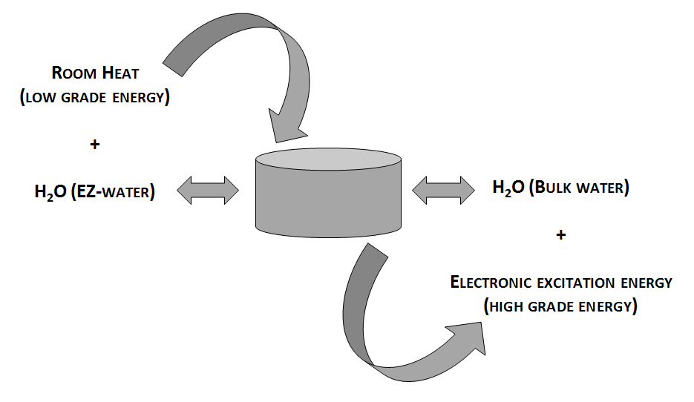
Oxhydroelectric Effect in Bi-Distilled Water
Conclusions
Schematic of the electron current extraction mechanism from water, by environmental low grade supplied energy,
thanks to liquid water asymmetry, in Oxhydroelectric Effect
and related phenomena: an exemplary dissipative system.

Slide 24
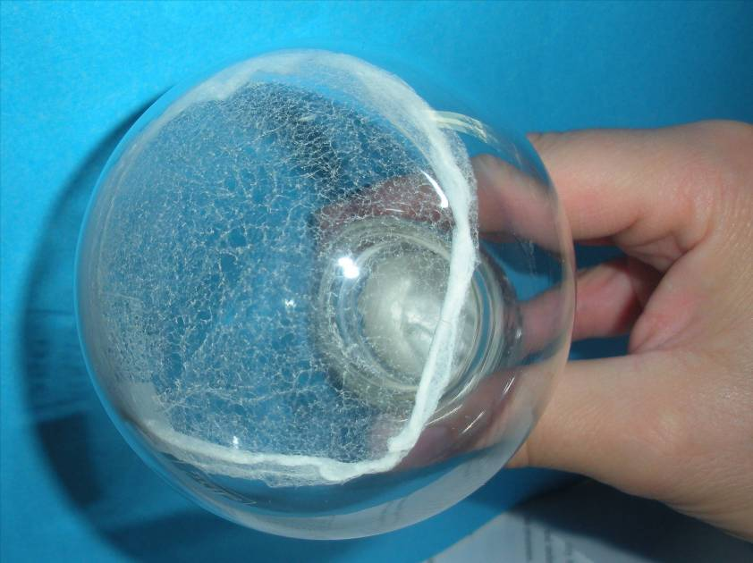
Appearance of the evidently ponderal solid residues:
a tenth of milligrams coming from lyophilization of only 250 ml of iteratively nafionated water (IFW) → Vittorio ELIA

Slide 25
Oxhydroelectric Effect
in Bi-Distilled Water
Conclusions
In what concern water supramolecular structures, they are much more in the semi-cell with different Nafion® pieces - the attractive interactions between H₂O molecules and the hydrophilic material assure the stabilization of the interfacial water CDs, protecting them from external thermal collisions. Consequently, the interfacial water becomes more coherent, giving birth to water supramolecular structures in this semi-cell. This physical asymmetry in the system is maintained by the filter positioned at the junction between the semi-cells – supramolecular structures dimensions > filter porosity.

Slide 26
Oxhydroelectric Effect
in Bi-Distilled Water
Conclusions
Once the electrons are released from some of the CDs molecules, they become non-coherent, “free” ionized H₂O molecules - unexpected electricity carriers in our bi-distilled water system - able to generate and sustain for long times important changes in some physical-chemical characteristics such as: conductivity, pH, density, UV-vis and IR absorbance, light scattering, and mixing heat with alkaline or acid solutions.
This behaviour may be due to the dramatic and enough stable in time changes in H₂O supra-molecular structure, as recently evidenced by different experimental techniques (UV-vis and IR Spectroscopy, Light Scattering, Atomic Force Microscopy, and Fluorescence Microscopy - in course of publication).

Slide 27
Oxhydroelectric Effect
in Bi-Distilled Water
Conclusions
The nowadays common description of the high “proton” concentration in liquid water caused by the Nafion® may be a misleading representation of this unexpected phenomenon; the good understanding of the real physical basis of Nafion® behavior in liquid water may lead to a much higher efficiency of the Nafion® based fuel cells.
The thorough theoretical explanation of the Oxhydroelectric Effect in bi-distilled water is under work.

Slide 28
Oxhydroelectric Effect
in Bi-Distilled Water
RECENTLY:
A home made and cheap strongly hydrophilic polymer
Electric current extraction for months (only “mechanical” polymer limits)
Cheap Electrodes and No Filter
Working “well” also without H₂O₂ - but very sensitive (fast answer) to LIGHT (expecially infrared)
MANY KINDS OF measurements have to be carried out, also because there are very interesting and strong “collateral” effects that we are going to measure better and to report in the next months.
LOOKING FOR EXPERIMENTAL COLLABORATIONS

Slide 29
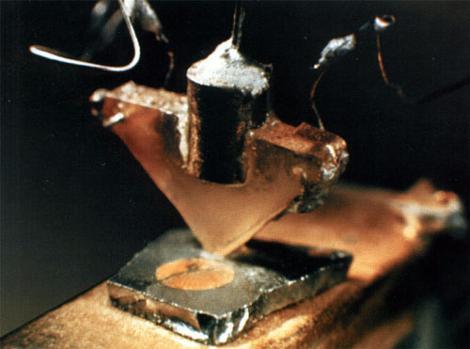
WHAT IS THIS ?

Slide 30
I dedicate this work to the living memory of my friend and teacher Emilio Del Giudice, who recently, suddenly and, from my limited point of view, prematurely, left this world.

