Slide 1
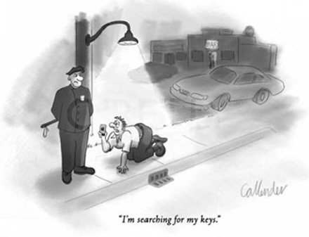
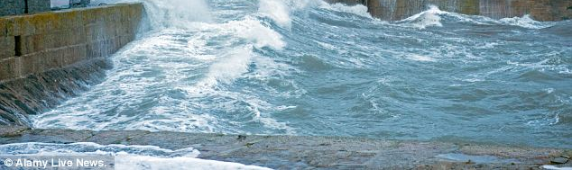
Where might a microbiologist look for answers?
I don’t search in the water because I can’t swim!
But what is the question?

Slide 2
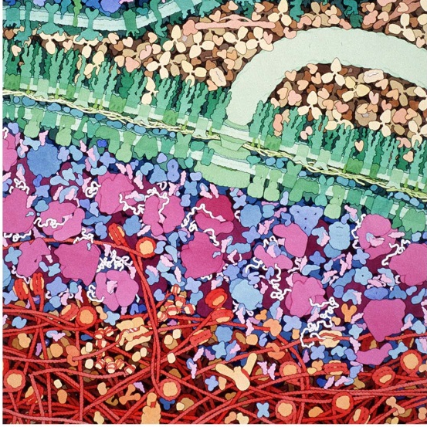
How do cells generate reproducible coherent behaviours from their many constituents?
Escherichia coli has over 4000 different genes, 1000’s of different RNAs, 1000’s of different proteins (which can undergo 10’s of post-translational modifications), 1000’s of different metabolites, 100’s of different lipids, polyamines, polyphosphates, polyhydroxybutyrate, various ions, water etc.
Sketched section of E. coli
DNA red; RNA white; ribosomes pink. Goodsell
The answer may lie in new findings and speculations:
The dynamics of hyperstructures
The production of different daughter cells via the cell cycle
How might water structures be involved?
Notes:
I am going to introduce you to these ideas and speculate further about a role in them for water structures, Firstly, let’s look at hyperstructures.

Slide 3
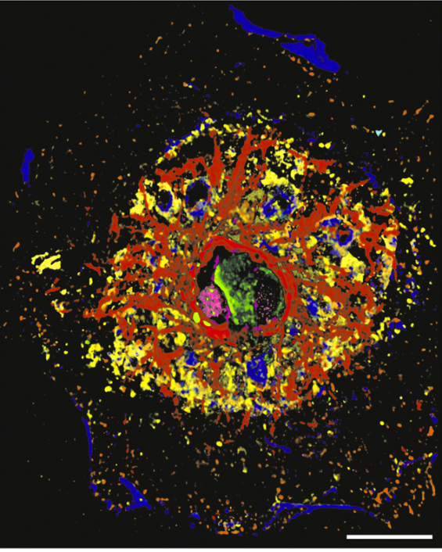
Cells are made of hyperstructures
Study them via e.g.: First antibody – secondary fluorescent antibody – end of experiment
Toponome of a hepatocyte
Colours code for clusters of different proteins. Bar: 20 um Schubert, W. 2006. Nat. Biotechnol. 24, 1270– 1278
Can we identify these hyperstructures?
Notes:
One of the limitations of localising proteins using antibodies with fluorescent tags is that only a couple of different proteins can be localised because each protein needs a tag that fluoresces differently. In 1988, Walter Schubert was on a Greek island near where Hippocrates treated patients. Walter was thinking about a disease, polymyosis, at the same time as he observed patterns of sunlight. He suddenly put the two together. When he returned to Germany, he did the usual experiment of adding an antibody to a protein and recognizing this protein using a secondary antibody with a fluorescent tag. But then he left the tag to bleach in the sun and then added an antibody to a different protein followed by the same secondary antibody with the SAME fluorescent tag). This allowed him to localise a second protein in the same cell. Waiting until the fluorescence had again faded, he repeated the experiment with an antibody to a third protein and so on. He found that 17 different proteins could be localised within the same cell. Toponomics was born.

Slide 4
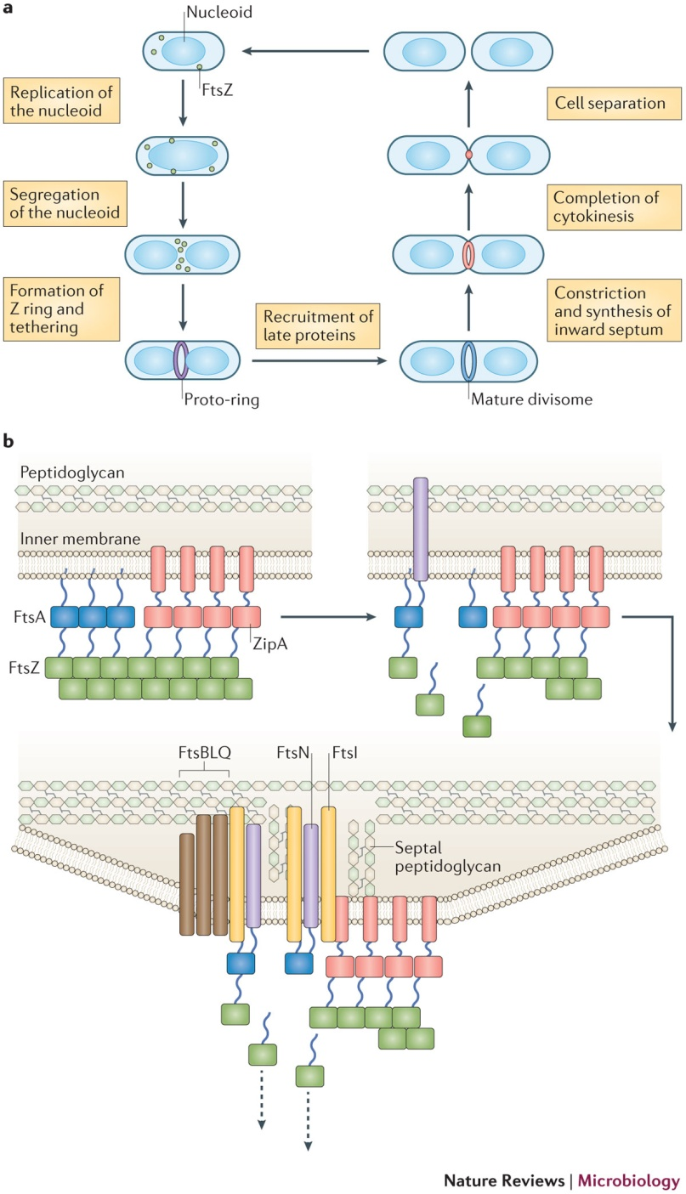
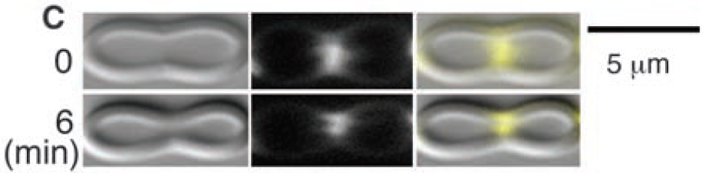
Example of an individual hyperstructure
Divisome
Margolin Nat Rev Micro 2016
FtsZ constricting a liposome
Osawa, Erickson Science 2008
DNA
Is water involved in the assembly and operation of the divisome?

Slide 5
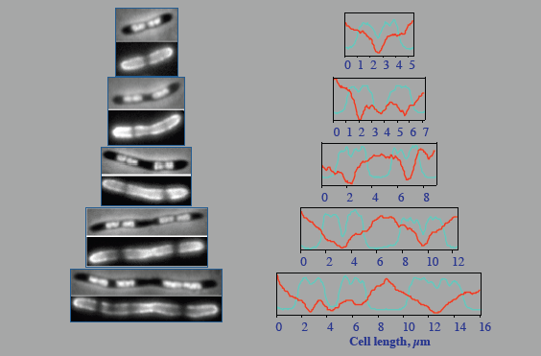

The composition of the divisome differs from the rest of the cell
Divisome assembly involves cardiolipin – and water structures?
Divisome operation involves altered membrane viscosity
– and water structures?
E. coli: DNA in red
cardiolipin in green
Mileykovskaya and Dowhan 2000
E. coli stained for DNA with DAPI (upper and blue) and membrane viscosity with FM4-64 (lower and red)
Fishov and Woldringh 1999
Are reaction rates altered in the divisome?
What happens in the presence of D₂O?
Notes:
This article summarizes our current views on the dynamic structure of the mitotic spindle and its relation to mitotic chromosome movements. The following statements are based on measurements of birefringence of spindle fibers in living cells, normally developing or experimentally modified by various physical and chemical agents, including high and low temperatures, antimitotic drugs, heavy water, and ultraviolet microbeam irradiation. Data were also obtained concomitantly with electron microscopy employing a new fixative and through measurements of isolated spindle protein. Spindle fibers in living cells are labile dynamic structures whose constituent filaments (microtubules) undergo cyclic breakdown and reformation. The dynamic state is maintained by an equilibrium between a pool of protein molecules and their linearly aggregated polymers, which constitute the microtubules or filaments. In living cells under physiological conditions, the association of the molecules into polymers is very weak (absolute value of DeltaF(25 degrees C) < 1 kcal), and the equilibrium is readily shifted to dissociation by low temperature or by high hydrostatic pressure. The equilibrium is shifted toward formation of polymer by increase in temperature (with a large increase in entropy: DeltaS(25 degrees C) approximately 100 eu) or by the addition of heavy water. The spindle proteins tend to polymerize with orienting centers as their geometrical foci. The centrioles, kinetochores, and cell plate act as orienting centers successively during mitosis. Filaments are more concentrated adjacent to an orienting center and yield higher birefringence. Astral rays, continuous fibers, chromosomal fibers, and phragmoplast fibers are thus formed by successive reorganization of the same protein molecules. During late prophase and metaphase, polymerization takes place predominantly at the kinetochores; in metaphase and anaphase, depolymerization is prevalent near the spindle poles. When the concentration of spindle protein is high, fusiform bundles of polymer are precipitated out even in the absence of obvious orienting centers. The shift of equilibrium from free protein molecules to polymer increases the length and number of the spindle microtubules or filaments. Slow depolymerization of the polymers, which can be brought about by low concentrations of colchicine or by gradual cooling, allows the filaments to shorten and perform work. The dynamic equilibrium controlled by orienting centers and other factors provides a plasusible mechanism by which chromosomes and other organelles, as well as the cell surface, are deformed or moved by temporarily organized arrays of microtubules or filaments.

Slide 6
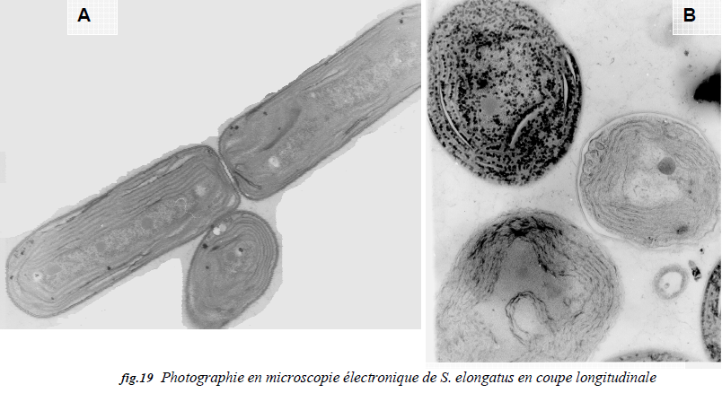
D₂O affects process of division
Tubulin polymerisation increased by D₂O
Inoue and Sato J Gen Phys 1967; Itoh and Sato BBA 1984
Cell division blocked by D₂O
Gross and Spindel Science1960
Structure of Synechococcus elongatus changed in D₂O
Ouali et al DESS University of Paris VI 2004
Is this telling us about the function of the cell cycle?
Notes:
Figure 19, on observe les cellules en coupe longitudinale, sur la photo A en milieu hydrogéné
et sur la photo B en milieu deutérié. La différence de morphologie est flagrante, hormis la
taille plus importante, la modification la plus importante est surtout la forme de bâtonnet (en
milieu hydrogéné) qui devient un ovale (cellules cultivées en eau lourde). On peut expliquer
ce changement par la nécessité de la cellule à réduire sa surface de contact avec le milieu
deutérié qui semble-t-il provoque un stress très important. Afin de pouvoir observer les cyanobactéries en microscopie électronique, nous avons réalisé
un prélèvement de cellules à la fin de la culture. L’échantillon prélevé a été fixé par l’équipe
du Dr J.M. Verbavatz pour réaliser les coupes au microtome. On observe sur la figure 16, les
cellules en coupe transversale dans un milieu deutérié à 99,6%. En comparant ces mêmes
cellules aux cellules en milieu hydrogéné (fig.18), on remarque que le diamètre est 2 fois
plus important, passant de 1 à 2 microns. Les membranes thylakoïdales apparaissent moins
contrastés. La plus grande différence est surtout la présence d’une multitude d’inclusions
dans les cellules cultivées en eau lourde, qui semblent être des granules de polyphosphate.
Sato: spindle birefringence=retardation = filament concentration in Arbacia sea-urchin eggs during mitosis; 15 min after insemination, 96% D2O added for 80 min

Slide 7

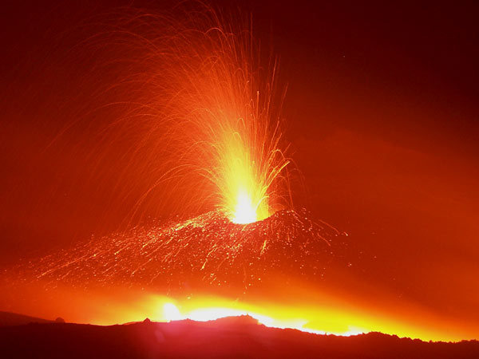
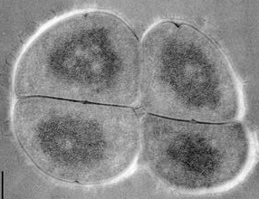
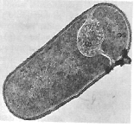
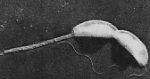
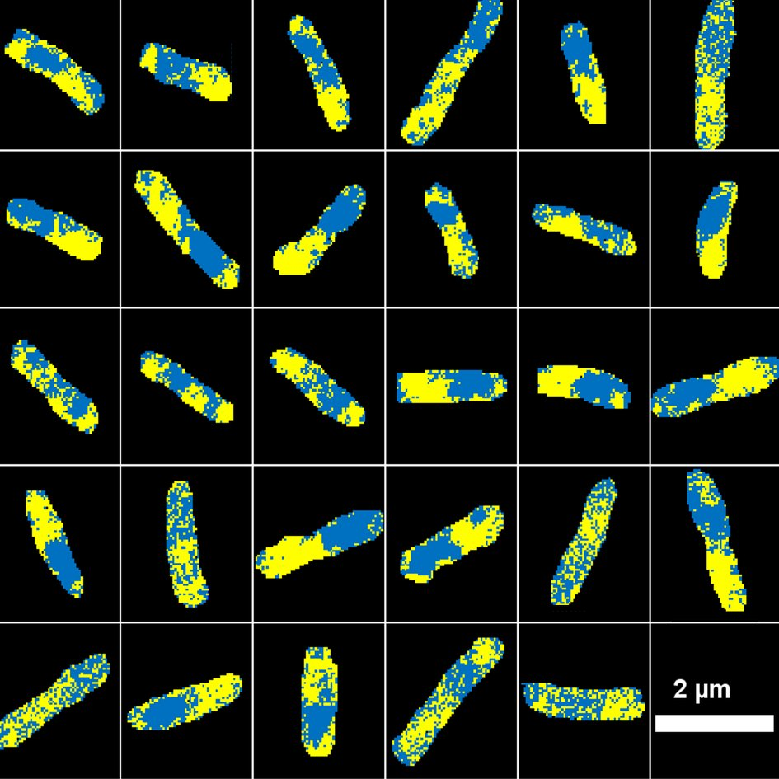
Bacteria must grow in heaven and survive in hell
versus
This is achieved via the cell cycle
Different daughters of Deinococcus radiodurans
Stalked and swarmer cell of Caulobacter crescentus
Spore and mother cell of Bacillus subtilis
Asymmetric growth of Escherichia coli
Are water structures involved?

Slide 8
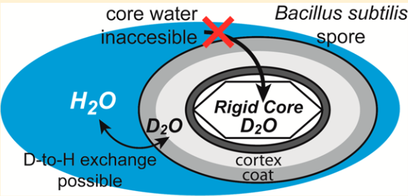
Water is different in spores
Some cytoplasmic water is mobile and accessible to proton exchange with the external environment whilst some is more rigid and inaccessible to exchange
Friedline et al 2014
Does this difference in water involve the dynamics of hyperstructures during the cell cycle?
Notes:
Two main theories present themselves: either the water in the spore core is mostly immobile and the core and its components are in a glassy state, or the core is a gel with mobile water around components which themselves have limited mobility. Using deuterium solid-state NMR experiments, we examine the nature of the water in the spore core. Our data show the presence of unbound water, bound water, and deuterated biomolecules that also contain labile deuterons. Deuterium-hydrogen exchange experiments show that most of these deuterons are inaccessible by external water. We believe that these unreachable deuterons are in a chemical bonding state that prevents exchange. Variable-temperature NMR results suggest that the spore core is more rigid than would be expected for a gel-like state. However, our rigid core interpretation may only apply to dried spores whereas a gel core may exist in aqueous suspension. Nonetheless, the gel core, if present, is inaccessible to external water.
Compared with H2O, this isotopic addition
increases bulk density by about 11%, increases viscosity by
about 25%, and increases the energy of the hydrogen bond
by about 20% {Lenormand, 2011 #5408}

Slide 9
Separation of hyperstructures in the cell cycle involves different water structures
Growth
Survival
Divisome
Fluid membrane
Stiff membrane
Non-equilibrium
hyperstructures
Equilibrium
hyperstructures
Decondensed DNA
Liquid crystal DNA
One type of water
Another type of water
Fast vibrations
Slow vibrations
Water might be central to both growth and survival strategies
– EZ, LDW/HDW, interfacial water, water wires … ?
Do water structures help initiate the cell cycle?

Slide 10
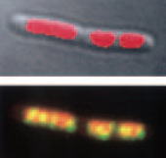
Hypothesis: a high intensity of activity initiates the cell cycle
Growth depends on the activity of ribosomes which in eukaryotes are made in the nucleolus
HeLa nucleolus: UBF, upstream binding factor=transcription, BrUTP=RNA, Dapi=DNA
Hernandez-Verdun et al.
The bacterial ‘nucleolus
DNA red, RNA polymerase yellow
Cabrera and Jin 2003
How might ribosomes provide intensity sensing?

Slide 11
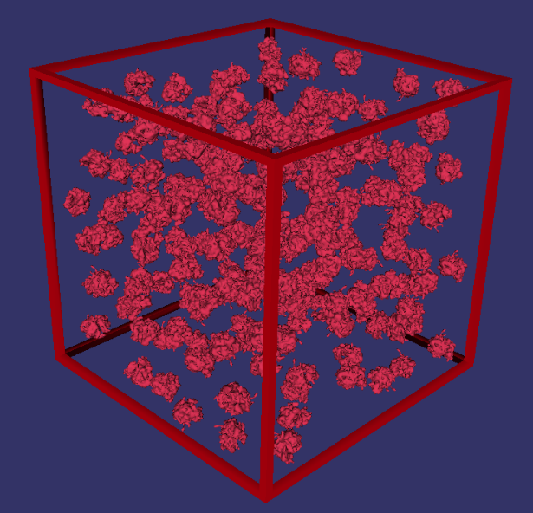
Perhaps sensing is via coupled ribosomes
Ribosomes are densely packed
Ribosomes on a single mRNA
Brandt et al 2009
200 ribosomes in cube of side 220 nm
LifeExplorer (Bremer & Dennis 1996; Cancedda 1974).
Coherent oscillations exist
Possible concerted nanomechanical activity in S cerevisiae
Pelling et al. Science 2004 305:1147-50
Possible sonic communication in bacteria
Matsuhashi et al J. Bacteriol. 1995
Are ribosome movements coupled by water?
Notes:
sound waves emitted from cells of Bacillus subtilis at frequencies between 8 and 43 kHz with broad peaks at approximately 8.5, 19, 29, and 37 kHz were detected using a sensitive microphone system
The cell wall of living Saccharomyces cerevisiae (baker’s yeast) exhibits local temperature-dependent nanomechanical motion at characteristic frequencies.
The periodic motions in the range of 0.8 to 1.6 kHz with amplitudes of 3
nm were measured using the cantilever of an atomic force microscope. Exposure
of the cells to a metabolic inhibitor causes the periodic motion to cease. From the strong frequency dependence on temperature, we derive an activation energy of 58 kJ/mol,
which is consistent with the cell’s metabolism involving molecular motors such as
kinesin, dynein, and myosin. The magnitude of the forces observed (10nN) suggests
concerted nanomechanical activity is operative in the cell.

Slide 12
The people who have done the SIMS work
Yannick Gangwe Nana
Laurence Janniere
Armelle Cabin
Anthony Delaune
Jean-Nicolas Audinot
Esther Lentzen
Patrick Grysan
David Gibouin
Corinne Loutelier
Gerard Grancher
Gaelle Chagny
Camille Ripoll

Slide 13
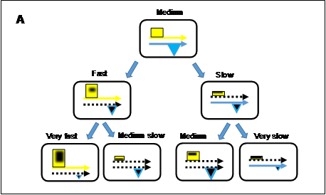
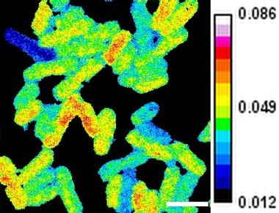
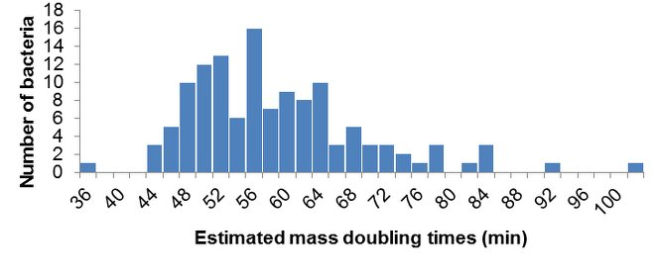
Growth rate diversity and two loops
4 min labelling
1/
2/
1/ Same quantity of rybosomes per cell with Matthew effect for daughters
2/ Growth (rybosomes) versus survival material with Matthew effect for daughters

Slide 14
The strand inheritance pattern
Growth
Survival
A
C
2
2
1
2
2
3
A
B
D
C
3
2
1
2
2
2
1
3
1
3
2
2

Slide 15
Overview of twin loops program
Each bacterial cell, x, is represented by 7 parameters: Cell(x,1) = the number of rybosomes on the fast strand; Cell(x,2) = the number of rybosomes on the slow strand; Cell(x,3) = the number of non-rybosomal molecules; Cell(x,4 ) = time remaining to division; Cell(x,5) = mass doubling time; Cell(x,6) = parental strand with 1 for fast strand, 2 for slow strand; Cell(x, 7) = grand-parental strand with 1 for fast strand, 2 for slow strand.
How is the composition of the mother cell related to its composition at birth?
How are the constituents of the mother shared out to the daughters?

Slide 16
Extra: list of hyperstructures
Cell cycle: replisome Lemon and Grossman 1998 Science 282:1516–19; DnaA hyperstructure Boenemann et al. 2009 Mol Micro 72: 645-57
compaction Corre and Louarn 2005 Mol Microbiol. 56:1539–1548.
divisome Bi and Lutkenhaus 1991 Nature 354: 161-164; Aarsman et al 2005 Mol. Microbiol. 55:1631–1645
RNA degradosome Taghbalout and Rothfield 2007 PNAS 104: 1667-1672
Carboxysome Cheng et al 2008 BioEssays 30: 1084-95
‘Nucleolus’ Cabrera and Jin 2003 Mol. Microbiol. 50:1493–505; Woldringh and Nanninga 1985 Molecular Cytology of Escherichia coli
lac hyperstructures Kennell and Riezman 1977 J. Mol. Biol. 114:1–21; Muller-Hill 1998 Mol. Microbiol. 29:13–18;
EF-Tu hyperstructure Beck 1979 Eur. J. Biochem. 97:495–502; Mayer 2003 Cell Biol. Int. 27:429–38; Defeu et al 2010
H-NS hyperstructure Wang et al. 2011 Science 333:1445-9
Glycolytic hyperstructure Mowbray & Moses 1976 Eur J Biochem. 66:25-36, Srere 1987 Ann Rev Biochem 56:89–124
PTS hyperstructure Lopian et al. 2010 EMBO Journal 29: 3630–3645
1,2-propanediol degradative hyperstructure Fan and Bobik 2011 J. Bacteriol 193:5623-8
Transport: export hyperstructure Campo et al 2004 Mol. Microbiol. 53:1583–99
Repair: repairosome Levin-Zaidman et al 2000 Proc. Natl. Acad. Sci. USA 97:6791–96
Signalling: chemotaxis array Alley et al.. 1992 Genes Dev. 6:825–36; Bray 1998; Nature 393:85–88
MreB (actin) hyperstructure Jones et al 2001 Cell 104:913–22;
FtsZ (tubulin) hyperstructure Thanedar and Margolin 2004 Curr. Biol. 14:1167–73; Ptacin 2010 Nature Cell Biol 12:791-
Cholesteric DNA Chow et al. 2010 Eukaryotic Cell 9:1577–1587
Watt et al 2007 NAR e37; Norris et al. 2007 Ann Rev Micro ; 2007 MMBR

Slide 17
The cell cycle
Initiate DNA replication
Separate and segregate
Divide

Slide 18
How do cells satisfy the conflicting constraints of growth and survival?
By generating a large diversity of phenotypes via 1/ hyperstructure dynamics
Inter and intracellular heterogeneity in E. coli in steady state growth, ¹⁵N-labelled for 128 min

Slide 19
How do cells reconcile growth and survival?
By generating a large diversity of phenotypes 2/ via the cell cycle
N.E.
E.
Inter and intracellular heterogeneity in E. coli in steady state growth, ¹⁵N-labelled for 128 min

Slide 20
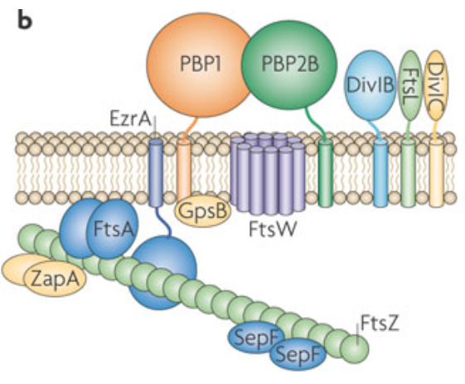

Slide 21
Hyperstructures and water
The nature of the regulation of the bacterial cell cycle and the generation of a broad range of coherent phenotypes are fundamental problems. We have proposed that the two problems are intimately related. In our proposal, a major function of the cell cycle is to maintain a diversity of phenotypes; to achieve this, bacteria sense both the intensity with which their constituents are working and the quantity of material they have accumulated. This sensing is proposed as done at the intracellular level of hyperstructures, which are spatially extended assemblies of many hundreds of molecules and macromolecules and which perform specific tasks. To investigate the dynamics of these hyperstructures, we have used Secondary Ion Mass Spectrometry to image bacteria labelled with stable isotopes. These results support the idea that the dynamics of hyperstructures drives the cell cycle. Here, I propose that hyperstructure dynamics depends on the different states of water.

Slide 22
Biochemistry. 2000 May 2;39(17):5075-81.
Suppression of microtubule dynamic instability and treadmilling by deuterium oxide.
Panda D¹, Chakrabarti G, Hudson J, Pigg K, Miller HP, Wilson L, Himes RH.
Author information
¹Department of Molecular Biosciences, University of Kansas, Lawrence, Kansas 66045, USA.
Abstract
Deuterium oxide (D(2)O) is known to promote the assembly of tubulin into microtubules in vitro, to increase the volume of mitotic spindles and the number and length of spindle microtubules, and to inhibit mitosis. Reasoning that its actions on cellular microtubules could be due to modulation of microtubule dynamics, we examined the effects of replacing H(2)O with D(2)O on microtubule dynamic instability, treadmilling, and steady-state GTPase activity. We found that replacing 50% or more of the H(2)O with D(2)O promoted microtubule polymerization and stabilized microtubules against dilution-induced disassembly. Using steady-state axoneme-seeded microtubules composed of pure tubulin and video microscopy, we found that 84% D(2)O decreased the catastrophe frequency by 89%, the shortening rate by 80%, the growing rate by 50%, and the dynamicity by 93%. Sixty percent D(2)O decreased the treadmilling rate of microtubules composed of tubulin and microtubule-associated proteins by 42%, and 89% D(2)O decreased the steady-state GTP hydrolysis rate by 90%. The mechanism responsible for the ability of D(2)O to stabilize microtubule dynamics may involve enhancement of hydrophobic interactions in the microtubule lattice and/or the substitution of deuterium bonds for hydrogen bonds.

Slide 23
Biochim Biophys Acta. 1984 Jul 16;800(1):21-7.
The effects of deuterium oxide (2H2O) on the polymerization of tubulin in vitro.
Itoh TJ, Sato H.
Abstract
The initial rate and final extent of polymerization of both bovine brain tubulin and sea urchin egg tubulin were enhanced in the presence of 2H2O. The yields were increased in association with the elevation of the 2H2O concentration. 2H2O also reduced the critical concentration for polymerization of brain tubulin. Thermodynamic analysis was attempted using the temperature dependence of the critical concentration for polymerization in the presence of 2H2O. We obtained linear van 't Hoff plots and calculated thermodynamic parameters which were positive and were increased with the elevation of the 2H2O concentration. The enhancement of the polymerization of tubulin by 2H2O could, therefore, be the result of the strengthening of intra- and/or inter-molecular hydrophobic interactions of the tubulin molecules. We believe that the increase in length and number of microtubules of the mitotic spindles in the dividing cells of the eukaryotes with 2H2O may be caused by the direct involvement of 2H2O in the polymerization of tubulin

Slide 24
It is generally believed that water transport across biological membranes is essentially a near-instantaneous process, with water molecules diffusing directly across the membrane as well as through pores such as aquaporins. As a result of these processes by which water can equilibrate across a membrane, a common assumption is that intracellular water is isotopically indistinguishable from extracellular water. To test this assumption directly, we measured the hydrogen isotope ratio of intracellular water in Escherichia coli cells. Our results demonstrate that more than 50% of the intracellular water hydrogen atoms in log-phase E. coli cells are isotopically distinct from the growth medium water and that these isotopically distinct hydrogen atoms are derived from metabolic processes. As expected, the (2)H/(1)H isotope ratio of intracellular water from log-phase cells showed an appreciably larger contribution from metabolic water than did intracellular water from stationary-phase cells (53 +/- 12 and 23 +/- 5%, respectively). The (2)H/(1)H isotope ratio of intracellular water was also monitored indirectly by measuring the isotope ratio of fatty acids, metabolites that are known to incorporate hydrogen atoms from water during biosynthesis. Significantly, the difference in the isotopic composition of intracellular water from log- to stationary-phase E. coli cells was reflected in the hydrogen isotope ratio of individual fatty acids harvested at the two different times, indicating that the isotope ratio of metabolites can be used as an indirect probe of metabolic activity. Together, these results demonstrate that contrary to the common assumption that intracellular water is isotopically identical to extracellular water, these two pools of water can actually be quite distinct.

Slide 25
Look again at xie and zubarev

Slide 26
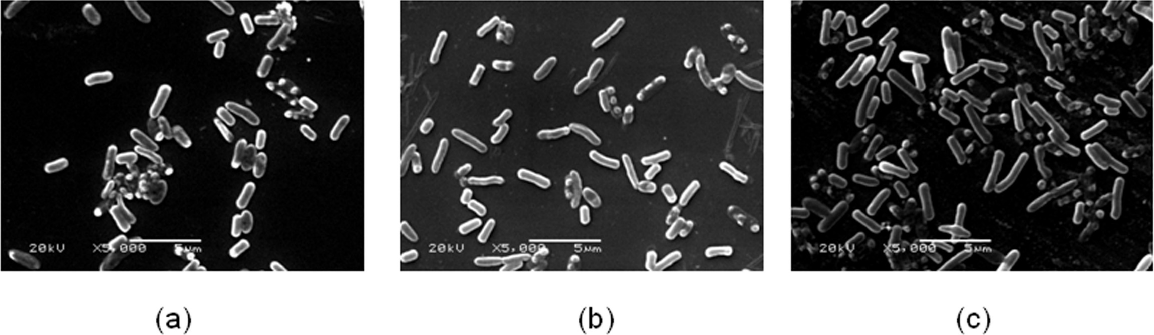
PeerJ. 2016 Apr 7;4:e1920. doi: 10.7717/peerj.1920. eCollection 2016.
Effects of sound exposure on the growth and intracellular macromolecular synthesis of E. coli k-12.
Gu S¹, Zhang Y¹, Wu Y¹.
Author information
Abstract
Microbes, as one of the primary producers of the biosphere, play an important role in ecosystems. Exploring the mechanism of adaptation and resistance of microbial population to various environmental factors has come into focus in the fields of modern microbial ecology and molecular ecology. However, facing the increasingly serious problem of acoustic pollution, very few efforts have been put forth into studying the relation of single cell organisms and sound field exposure. Herein, we studied the biological effects of sound exposure on the growth of E. coli K-12 with different acoustic parameters. The effects of sound exposure on the intracellular macromolecular synthesis and cellular morphology of E. coli K-12 were also analyzed and discussed. Experimental results indicated that E. coli K-12 exposed to sound waves owned a higher biomass and a faster specific growth rate compared to the control group. Also, the average length of E. coli K-12 cells increased more than 27.26%. The maximum biomass and maximum specific growth rate of the stimulation group by 8000 Hz, 80dB sound wave was about 1.7 times and 2.5 times that of the control group, respectively. Moreover, it was observed that E. coli K-12 can respond rapidly to sound stress at both the transcriptional and posttranscriptional levels by promoting the synthesis of intracellular RNA and total protein. Some potential mechanisms may be involved in the responses of bacterial cells to sound stress.
Figure 6 The bacterial cell morphology of E. coli K-12 of SCE. (A) The cells in the control group.
(B) The cells exposed to sound frequency 8 KHz, intensity level 80 dB and power level 61 dB.
(C) The cells exposed to sound frequency 8 KHz, intensity level 100 dB and power level 61 dB. Cells were sampled at 48 h.

