Slide 1

Anton Fedorenko, faa@phystech.edu
Jeremy Pfeiffer, Jeremy@newpharm.com

Slide 2
को नमस्कार
भगवान आपका भला करे
जानकारी क्या है?
Notes:
Good day ladies and Gentlemen! My name is Anton
In this presentation I want to discuss with you what is information and informational influence.
Principle of transfer of information.
What mechanisms of information reading biological organisms have.
In the end of presentation I will shortly describe IC Medicals technology and present a fresh laboratory and clinical results
I want to start from the common question. What is information? What we call information? What if this presentations will be on Hindi, would you understand it? And this is not information for you
This short report is about interaction of information and materia.
There will be example of the technology with certain application in the area and healthcare – technology based on meteria property changes under the influence of information.

Slide 3
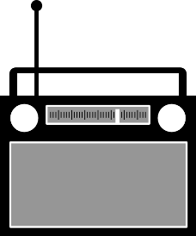
Is Something is information?
YES
NO
1. Is it HETEROGENEITY
no
को नमस्कार
yes
This something
can’t be information
2. Can “we” perceive this?
no
For “us” this something
is not information
yes
3. Does it inFORMATE “us”?
no
Just do it!
बस यह करो!
yes
Something is information
Notes:
Ok!
(40 sec)
Briefly about information. Short instruction how to understand is something is information
1. At first Something should be heterogeneous
2. Then we should somehow perceive this something. Our sensors should be on some “resonance frequency“ with something
3. We should “understand” this something. And “understanding” in this context is related to concept of “Informational influence”
What is Informational Influence?

Slide 4
In the results of
informational
energy
influence
The object of influence changes its state using:
own internal energy
&
Influence is as “call to action”
or “instruction of action”
external energy
of influence
Notes:
(40 sec)
Lets consider two kinds of influence: Energy influence and Informational influence. (It seems that these kinds are basic and others are superposition of them)
As a result of energy influence – the object of influence changes is state using external energy of influence
As a result of informational influence – the object of influence changes its state using internal (own) energy. And information itself it is just some impulse (energy of information is not equal to zero, but energy of this impulse is needed just to start the changes in this object)

Slide 5

External energy only starts the process
Change of state
due to own potential energy
Change of state
due to external energy
E_{wind} << E_{own}
E_{wind} ≠ 0
E_{own}=M*g*h
E_{hammer}=m*V²/2
h
m
V
M
Notes:
(30 sec) There is a simple examples
We can use external energy to change the state of the stone
Or if this stone has potential energy and locates on the edge of the cliff in some equilibrium position - there will be enough light wind to bring the stone out of balance. And then potential energy will be transformed into kinetic and finally stone will be broken – and state is changed.

Slide 6
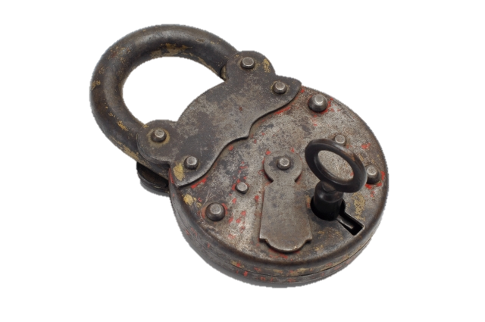
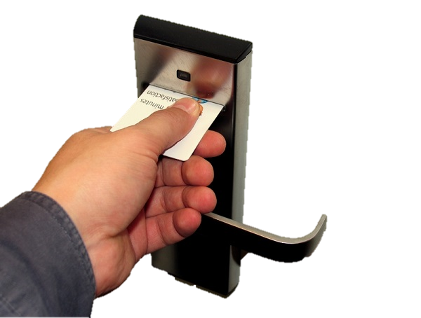

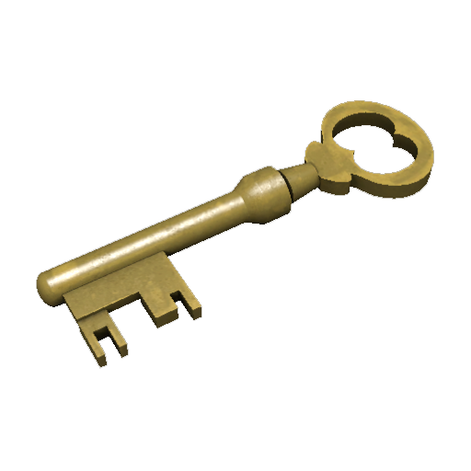
Key Lock Principle:
THEN AND NOW
We need to apply external energy
to change the state of the lock
Lock has internal source of the energy,
We just need to send information
to change the state of the lock
heterogeneity,
some locks perceive it
as information
Notes:
One more example (may be even biological):
We apply our energy to change the state of Lock. This variant of lock is passive it has not mechanism and energy to change it state by itself.
In the modern version of Key-Lock relationship – Lock system changes its state using own energy. In this variant we do informational influence when we apply plastic card

Slide 7
step to healthcare pharmacology
Notes:
What influence from the pills?
But not really to pharma, but to biology

Slide 8
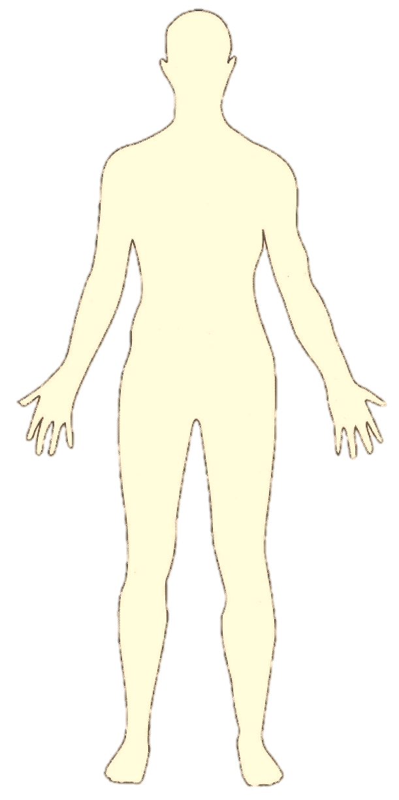
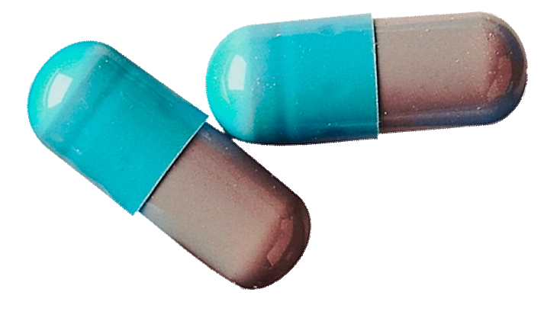


What kind of influence BAS has?
Pills
E_{pill} ≠ 0
=
?
Message (instructions)
to our body
Notes:
It seems that we can say that BAS causes informational influence in the scale of change of the state of whole body.
(we considering body as a single system)
When the pill gets into the body, all changes of the body’s system state is due own energy of the system, right?
External chemical substance has potential chemicals energy in the body and use to start the reaction.
/////
for information….
Chemical energy is the potential of a chemical substance to undergo a transformation through a chemical reaction or to transform other chemical substances. Breaking or making of chemical bonds involves energy, which may be either absorbed or evolved from a chemical system.
A chemical reaction is a process that leads to the transformation of one set of chemical substances to another.

Slide 9
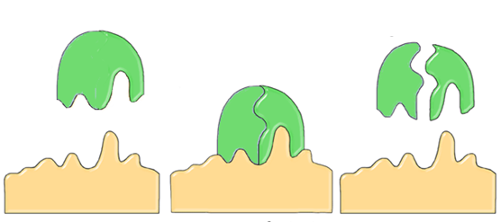
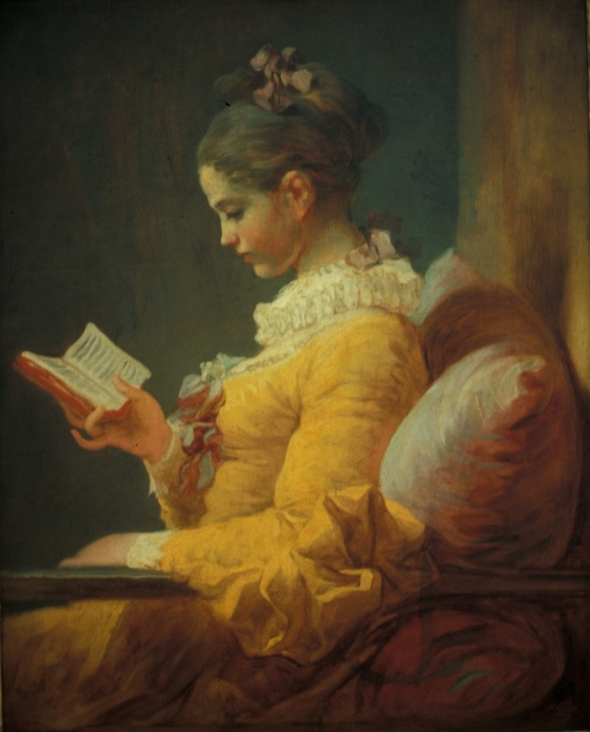
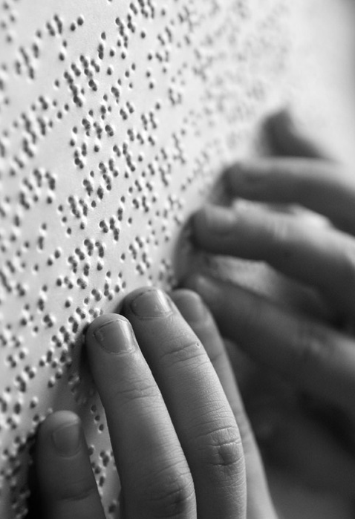
Shape
VS
“e-Shape”
Can our organism read spectrum of molecules or only their shapes?
Notes:
Do we know everything about interaction of substance and the receptor?
Well know suggestion that our receptors read shape of the molecules, and what about reading an electronic shape?
What kind of information can read our organism?

Slide 10
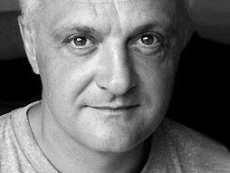
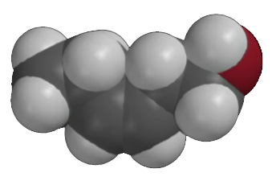
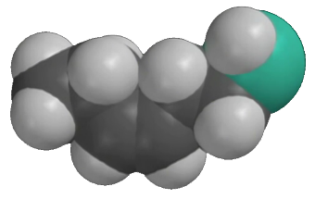
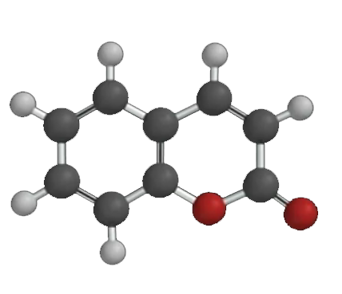
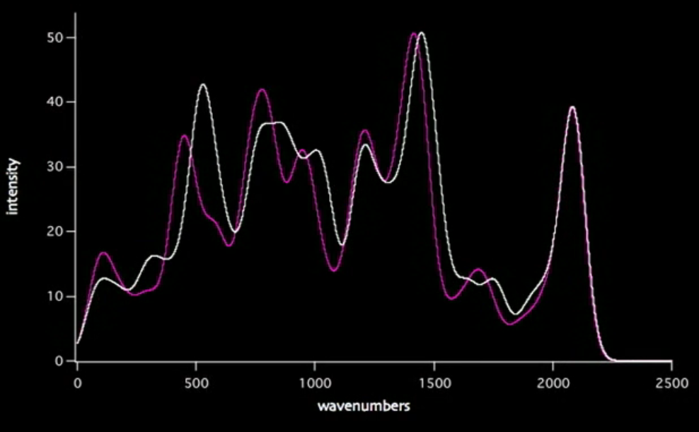
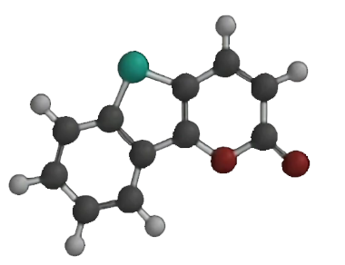
Luca Turin: We Smell Vibrations
Same shape
Different spectra
Different smell:
Cut grass
Rotten eggs
Different shape
Same spectra
Same smell
Coumarin
Benzo [4,5] thieno
[3,2-b] pyran-2-one
Notes:
There is one of the examples that confirm possibility of reading an electronic shapes.
Luca Turin showed that we smell not shape but vibration of molecules, their electronic shape.
In his research he have shown that molecules with about the same shape may have very different smell.
BUT
Two molecules with different shapes and about the same spectra may have about the same smell!!

Slide 11
1. Medical drugs cause informational effect on organism, starting the reactions.
2. Our organism has mechanisms of reading of a spectrum of the substances
Can we use “informational image” of the substance to start the reaction?
Notes:
Medical drugs cause informational effect on organism, starting the reactions.
Our organism has mechanisms of reading of a spectrum of the substances
there is the question
Can we use informational image of the substance to start the reaction?
To check this we need
some carrier which can store an informational image of a substance
Somehow transfer “information” from a substance to the carrier.

Slide 12
The Principle Scheme of a devices
for Transmission of IC to secondary carrier
Solution of BAS
Water with IC of BAS
Generator
Electromagnetic
coils
Amplifier
Biologically
Active
Substance
Biologically
Neutral
Substance
1
2
Electromagnetic coil
creates a field
Electromagnetic field as a carrier of “informational image”
Notes:
Principal scheme to do such kind of research.
Electromagnetic field as a carrier of information.
Water as secondary carrier.

Slide 13
CAN WATER BE HETEROGENEOUS?
Notes:
Can Water be heterogeneous? If not, it could not store an information.

Slide 14
QED Theory
Giuliano Preparata, Emilio Del Giudice and Giuseppe Vitiello
Del Giudice, E., Preparata, G., Vitiello, G. 1988. Water as a free electric dipole laser. Physical Review Letters, 61, 1085.
Notes:
From popular QED theory of water, that pretends to explain how homeopathy works, we know that it is energetically favorable for water molecules to create coherent domains.
Put it briefly, there is theoretical & experimental support that water can store information.

Slide 15
Published evidence that support principle of IC transfer:

Slide 16

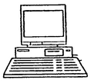
IC of acetylcholine, histamine, ovalbumin and other BAS had been transmitted to distant addressees using communication networks including Internet
W. Hsueh
Chicago, USA
J. Benveniste
Paris, France
Internet
Water treated with IC of BAS exerted specific effects on the biological test systems
J. Benveniste, P. Jurgens, W. Hsueh, J. Aissa TRANSATLANTIC TRANSFER OF DIGITIZED ANTIGEN SIGNAL BY TELEPHONE LINK. J. Allergy Clin. Immunol., 99:S175 (1997).
Benveniste, J., Benveniste L., Guillonnet, D. 2010. Method and system for producing a substance or a signal with a coagulating or anticoagulant effect. US Patent N◦ 0 233, 296 A1
Notes:
To refresh the memory on this experiments.
Well known Jacques Benveniste and his experiments with transfer digital informational copies of different bio active substances using internet
(French – American experiments)

Slide 17
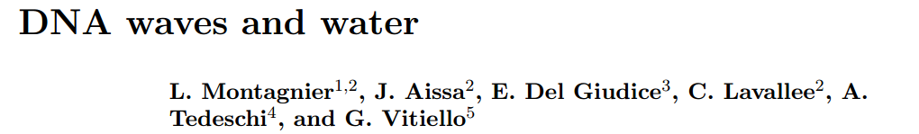
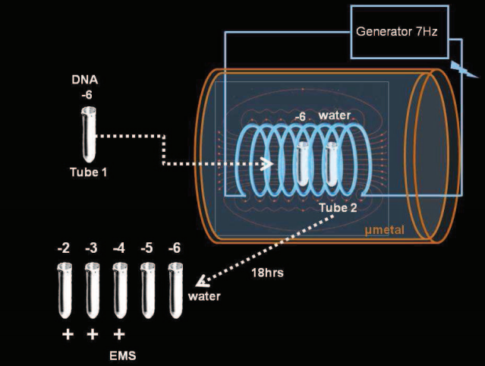
Montagnier L., et al. (2009) Electromagnetic signals are produced by aqueous nanostructures derived from bacterial DNA sequences., Interdiscip. Sci. Comput. Life Sci., 1: 245-253.
Montagnier, L., Aissa, J., Del Giudice, E., Lavallée, C., Tedeschi, A. & Vitiello, G. 2011. DNA waves and water. Journal of Physics: Conference Series. 306: 012007.
Notes:
Luc Montagnier. Transfer of information from the DNA solution to pure water.
(French and French _ Italian Experiments)

Slide 18
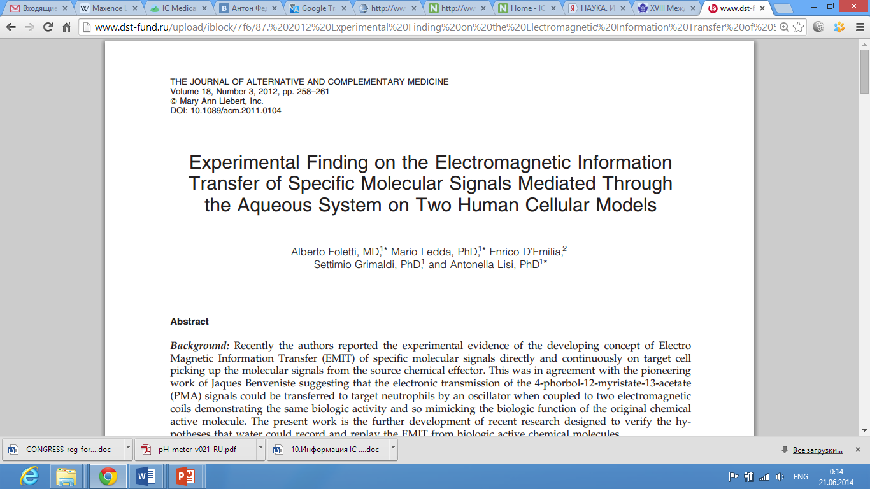
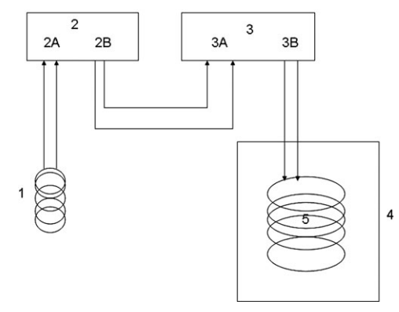
Foletti A., et al. (2011) Differentiation of human LAN-5 neuroblastoma cells induced by extremely low frequency electronically transmitted retinoic acid. JACM 17(8), 701-704.
Foletti A. et al, Electromagnetic Information Delivery as a New Perspsctive in Medicine, PIERS Proceedings, Stockholm, Sweden, Aug. 12-15, 2013
Notes:
Alberto Folletti and others
Transfer the signal from retinoic acid to the nutrient medium – where cancer cells were cultivated
In the results Growth of a cancer cells in this medium was partially inhibited

Slide 19
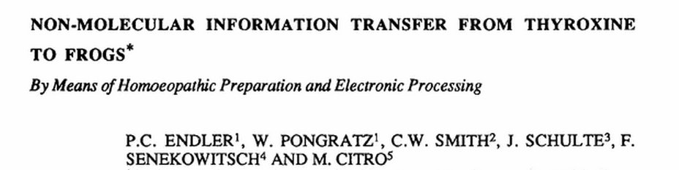
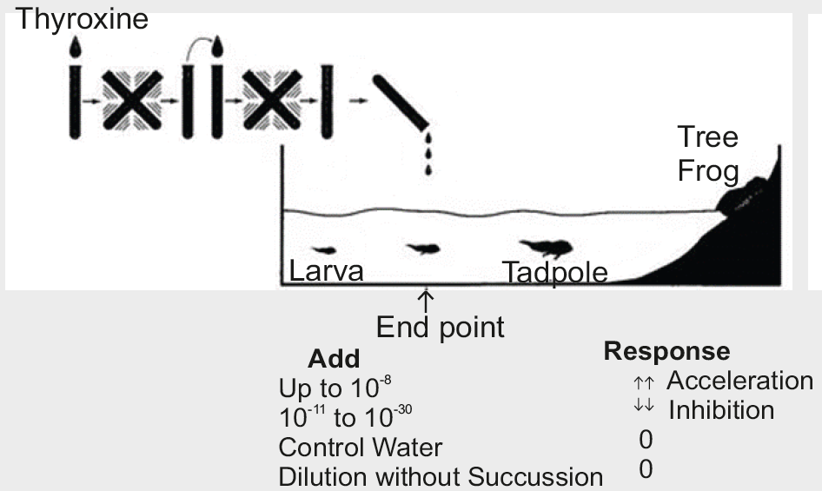
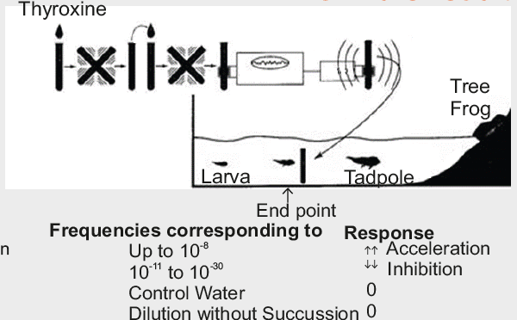
Citro M, Smith CW, Scott-Morley A, Pongratz W, Endler PC. Transfer of information from molecules by means of electronic amplification. In: Endler PC, Schulte J, editors. Ultra high dilution: physiology and physics. Dordrecht (Nederland): Kluwer Academic Pub.; 1994. 209-214.
P. C. Endler, W. Pongratz, C. W. Smith, J. Schulte, F. Senekowitsch, M. Citro. Non-Molecular Information Transfer from Thyroxine to Frogs. Signals and Images 1997, pp 149-159
Notes:
Peter Christofer Endler
Transfer the signals from different dilutions of Thyroxin to pure water.
Effect from resulting water on Frog Larva depends on what thyroxin dilutions was used as a source of information.

Slide 20
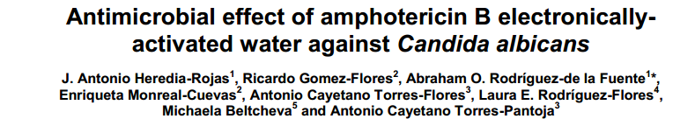
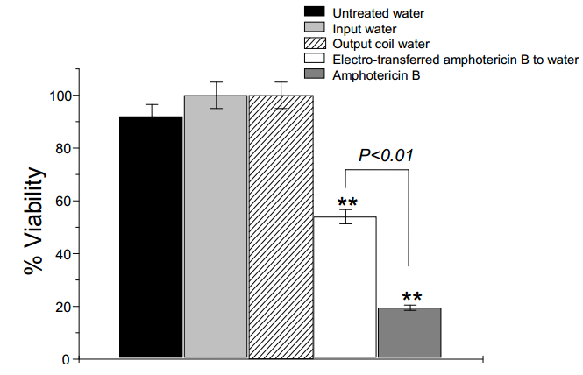
J.A. Heredia-Rojas, R. Gomez-Flores, A. O. Rodriguez-de la Fuente, E. Monreal-Cuevas, A. C. Torres-Flores, L. E. Rodriguez-Flores, M. Beltcheva, A. C. Torres-Pantoja. Antimicrobial effect of amphotericin B electronicallyactivated water against Candida albicans. African journal of Microbiology Research 6(15). 2012, pp. 3685-3689
Notes:
Antonio Heredia Rojas
Transfer the signals from amphotericin B to water,
and treated in such way water acquire antimicrobial activity

Slide 21
The Principle Scheme of a devices for Electronic Transmission of IC of BAS
Solution of BAS
Water with IC of BAS
Generator
Electromagnetic
coils
Amplifier
Biologically
Active
Substance
Biologically
Neutral
Substance
1
2
Electromagnetic coil
creates a field
Notes:
So again, please see these principle devices to transfer informational copies of substance to water.
Underlying principle is that we use electromagnetic field as a carrier of information

Slide 22
Role of the EM Field
Notes:
There is everyday life analogy of this principle to make a photo (informational image) of the object we need light (EMF).
Look around you don not interact with objects directly, there is mediator – electromagnetic field

Slide 23
Ok, water. What else?
Notes:
Yes, that experiments demonstrate that water can be secondary carrier of informational copy.
So water may be considered as “photopaper”, but not only water

Slide 24
Most popular Secondary carriers
Different authors mentioned such items as plastic, glass, tin, sugar middlings, distilled or boiled water, physiological and colloidal solutions, nutrient medium, 30-40% ethyl alcohol, 20% aqueous solution of glycerol, magnetic and photo films, dextro- and sinistrorotary sugar isomers, polysaccharides, wax, paraffin, metals and others as possible secondary carriers of ICs.
WATER
Alcohol
solutions
Wax
Paraffin
Aluminum
Falk, W., Aschoff, D.: Application for a patent of Germany № 1521779, А61Н/00,1985
Ludwig, W.: Application for a patent of Germany № 2525621, А61B5/ 05,1975.
Ludwig, W.: Application for a patent of Germany № 2810344, А61Н/ 02,1978.
Kropp W. British Patent №2066047 A611. 2/02; A23L 1981
Theurer K. Application for a patent of Germany №2842691,A61K 41/00
Prinz J. Application for a patent of Germany №2442487, A61B5/00, 1987
Rae Instruments. Descriptions and Instructions for Use. Magneto-Geometric Applications. 1978. p.5.
Ludwig, W.: Biophysicalische Diagnose und Therapie im ultrafeinen Energiebereich. 3 Mitteilung., Erfahrungsheilkunde. 1983
...
…
Glass
or
Plastic
Notes:
In different articles and patents which describe technologies of use this phenomena of informational transfer you can find a lot of materials: alcohol solutions, wax, paraffin, different metals and plastics …

Slide 25
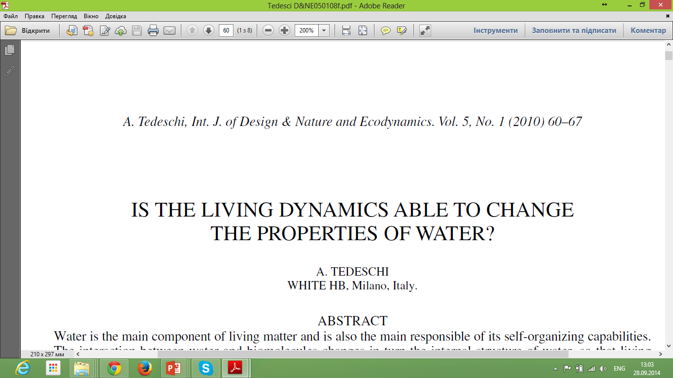
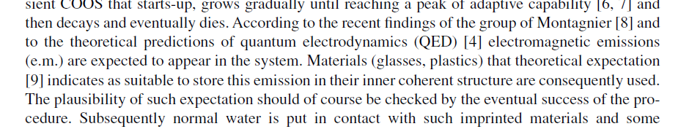
Presumably, the flow of information comes from living mater to the material (glass) and subsequently from the glass to a normal water
Changes are observed in the properties of water
without any apparent exchange of energy or other physical variable
9. Buzzacchi, M., Del Giudice, E. & Preparata, G., Coherence of the Glassy State. International Journal of Modern Physics B, 16, pp. 3771–3786, 2002.
Notes:
There is one example of the work which demonstrates that plastic suitable to store “informational copy” and the principle of transfer - external light as a carrier of “Informational copy”
Emilio del Giudice and his colloquies prepared QED theory not only for water but for condensed matter. Glass and plastic such a matter and they may have a coherent structures like a Water.

Slide 26
Application of this phenomenon in
metallurgy
Notes:
This is real existing, Industrially large technology of use Informational copies of materials in metallurgy.

Slide 27
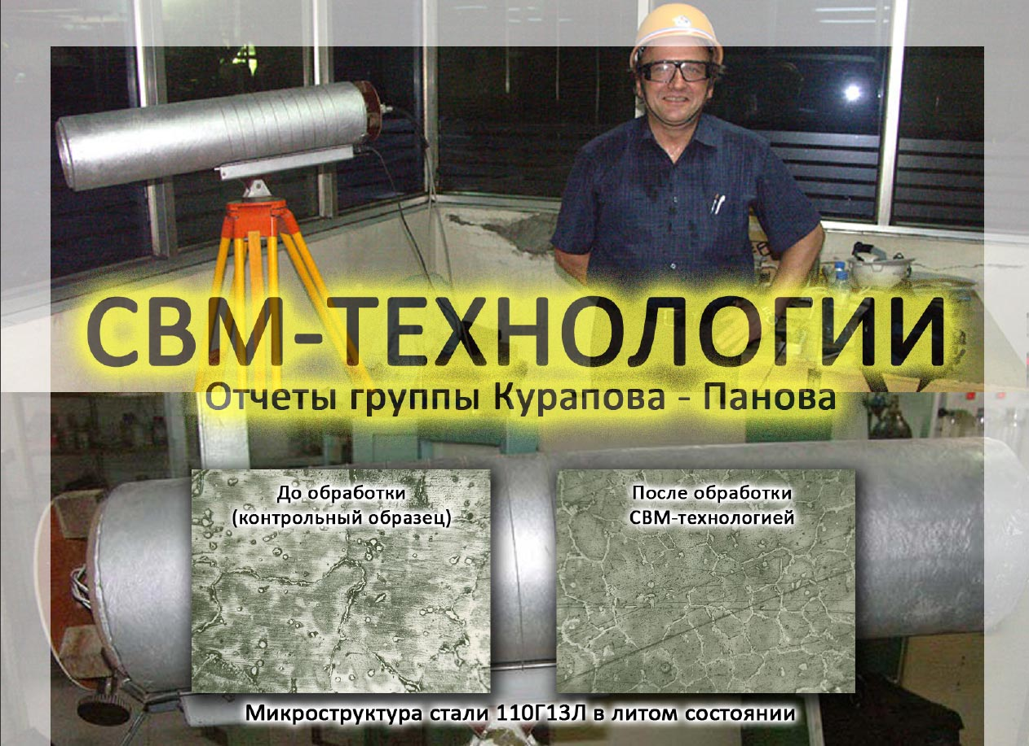
SWM-TECHNOLOGIES
From the Reports of Kurapov – Panov Group
Before treatment
(reference sample)
After treatment
with SWM technology
Microstructure of 110Г13Л in cast state
Notes:
This is real existing, Industrially large technology of use Informational copies of materials in metallurgy.

Slide 28
BLOCK MODULATOR:
3 toroidal coils
1. Magnetizing coil
2. Excitation coil on NMR frequency
3. Coil for signal reading
Emitter
Amplifier
molten metal
Material (e.g. magnesium, manganese)
Notes:
Technology has the same principle
There is one electromagnetic coil which excites material (for example magnesium). Then another electromagnetic coil reads the signal. Then this signal is used to modulate carrier field. And emitter irradiates molten metal with modulated field.
Molten metal is effected with carrier field modulated with informational image of Metallurgy active substance

Slide 29
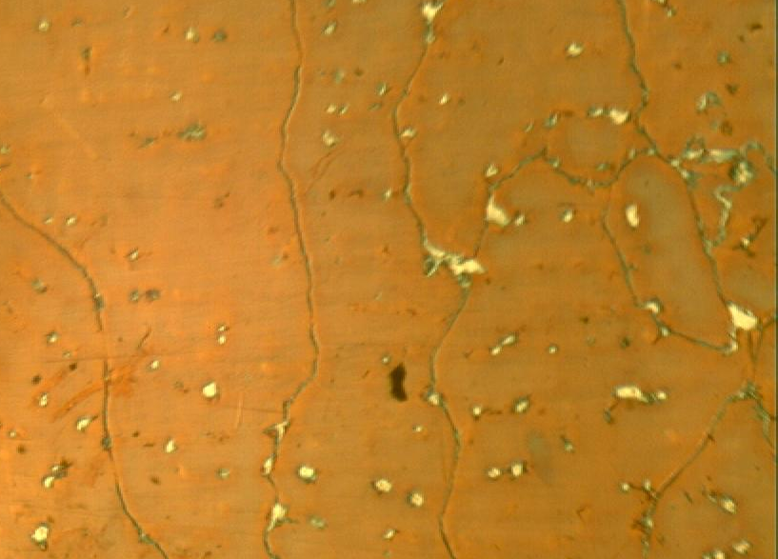
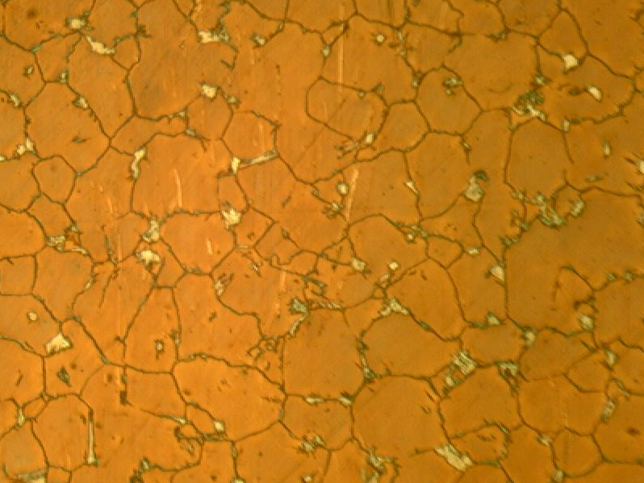
Power consumption
up to 50W
Control
а
Test
b
Melt treatment with the using of SWM technology. Wave emitter is on the front plane.
SWM allows:
reduce melting time
an increase in toughness up to 200%
obtain simple steel
with characteristics of doped steel
Microstructure of 110G13L (Hatfield Steel) samples (X100)
a) reference sample, austenite of 0 -1 units
b) after wave treatment; characteristic breakage of the grains (4-5 units) and more uniform of the carbides is observed/
Notes:
Power of this setup is only 50 watts
just two pictures which demonstrate the difference in structure.
This experiment were placebo controlled)
Using this method its possible to get great results.
Please welcome. Informational technologies in Metallurgy!

Slide 30
IC Medicals
Application in healthcare
Notes:
We prceed to short description of IC Medicals technolgy., you have a lot information about how it designed in your conference booklets.
I want to tell you who got the idea of this technology

Slide 31
Authors of method and technology of transfer of non-digital Informational Copies (IC) of material media and biological organisms, Israeli scientists:
Radiophysicist, Mark Grinshtein
Doctor, Michael Shraibman
Notes:
We can consider IC Medicals mostly as intuitively created technology by those two Israeli scientists.
And now this technology has mostly empirical approach of development.
IC Medicals it is technology of non-digital transfer of informational copies of biologically active substances through a long distance with the help of Internet addressing technologies.
and for more clarity I want to describe first experiments of Mark Grinshtain and Michael Shraibman

Slide 32
Laser
0. The substance is in the ground state
Aspirin
1. Turn on the laser
The laser beam excites substance
2. Super-weak field of the substance
modulates the carrier wave
Laser
Aspirin
Carrier field
Super weak modulation
Effect on aluminum foil
Diagram of modulation:
Notes:
Mark Grinshtain placed on the aluminum foil a medical drug and illuminate this system with laser beam
we may consider that laser beam – carrier field excites a substance, substance starts to emit the field and laser beam becomes modulated with characteristic field of the substance. And then modulated field interacts with aluminum

Slide 33
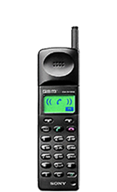
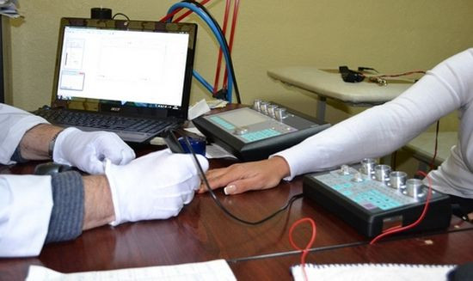
2004 year – First Experiments
Mark Grinshtein
Netanya (Israel)
Michael Shraibman
Herzlia (Israel)
Plate
of metal foil
1
2
Notes:
After that he putted prepared foil on the mobile phone and started calling to Micheal Shraibman.
And Dr. Shraibman putted aluminum foil on the mobile phone for 2 minutes.

Slide 34
2
Notes:
4. Then Dr Shraibman, using bio resonance testing devices studied the effect which foil causes on state of human health.
These experiments were blind: Michael Shraibman did not know what medical drugs Mark Grinshtain used
but
In 70% of cases, response of the organism was correlated to medical drugs which were used be Mark Grinshtain as a sores of information.

Slide 35
Non-digital variant of IC Medicals Tech. today
What do we have
Technical center
Secondary carrier
with IC of medical drug
Transmitter
Secondary carrier
e.g., compact-disc
Internet
Cell of the center
The receiving device
Supper-weak modulation
Carrier signal
Diagram of modulation:
The technology establishes a connection between the cell of the technical center and the personal computer
Non digital transfer of IC
Notes:
Today there are some improvements of the technology, it works automatically , but the principle the same as with mobile phones.
Instead of aluminum foil compacts disc is used . Because they are almost everywhere in our planed. And standardized.
There is technical center with 60 computer . In each computer there is compact disc prepared in the same way as aluminum foil. 60 separate computers - 60 informational copies of medical drugs, plants etc.
You can get more information about how the technology is designed in your booklet or on the web-site

Slide 36
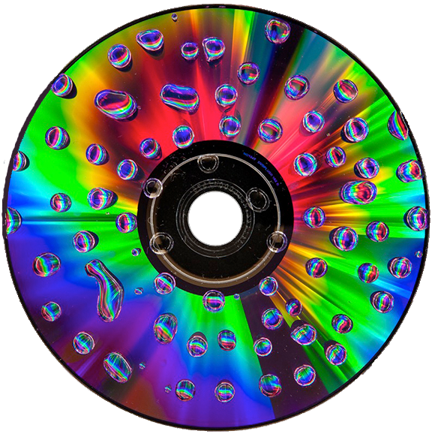
A
Polycarbonate plastic
Chemical Dye
B
Aluminum
C
Lacquer
D
Water
Cover, Label..
E
Light
Glass
A
Polycarbonate
B
C
Aluminum
D
E
Notes:
What is compact-disc?
Compact-disc has several layers of materials: polycarbonate plastic, aluminum, chemical dye, lacquer
these materials may be secondary carriers of informational image of the substance.
On picture it is shown how can we realize the process of water exposition on the compact disc. There is external field which reads information from materials of CD and transfer it to water. Again the same principle of information transfer.

Slide 37
FIRST QUESTION
Notes:
What is first question to this variant of the technology?
the first question is: does something happen with the disc after such kind of treatment?

Slide 38
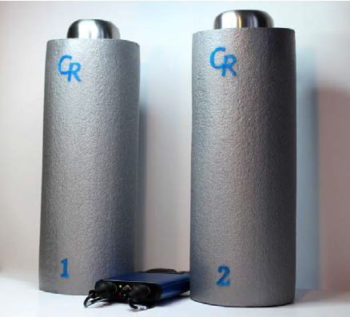
Detecting Informational Copies by means of high-precision differential pH-meter (resolution 10⁻⁶-10⁻⁷ pH)
Serge Kernbach et at.
Cybertronica Research (Germany),
Laboratory of Advanced Sensors
Notes:
To learn this we can use water, it seems that water is a very sensitive system for informational influence.
I want to present you recent fresh results with using high precision differential pH meter

Slide 39
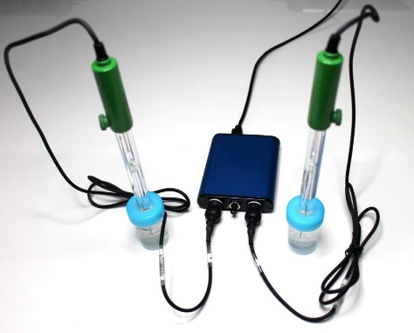
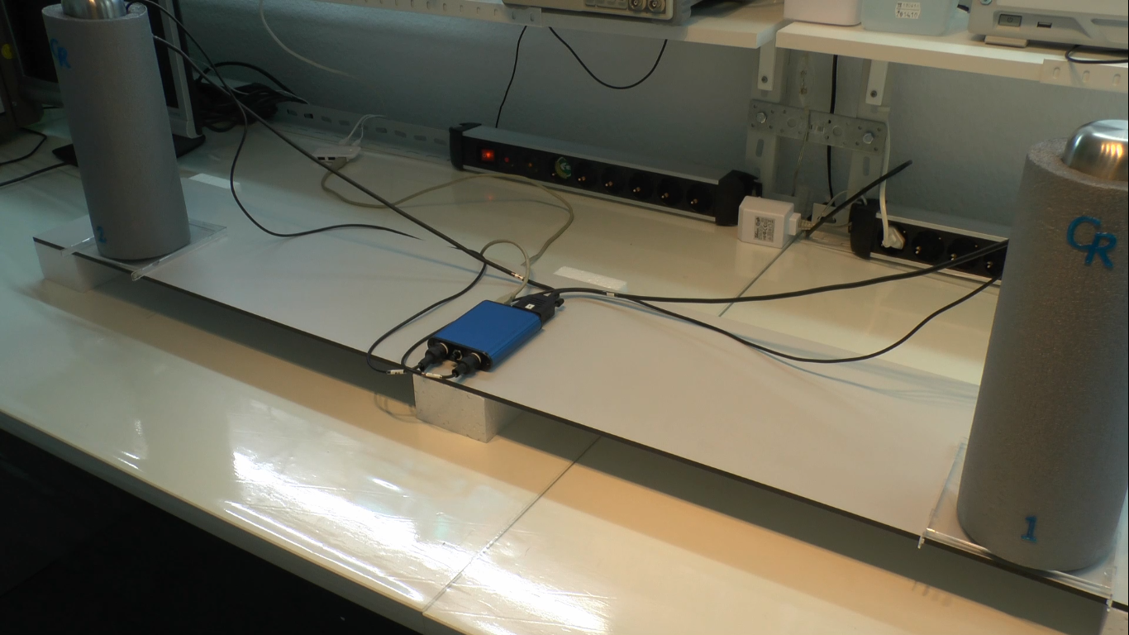
First type of control experiments
Measurements without compact-discs:
Notes:
There are two equal electrodes and two equal samples of water.
First type of control measurements:
1. Without compact disc

Slide 40
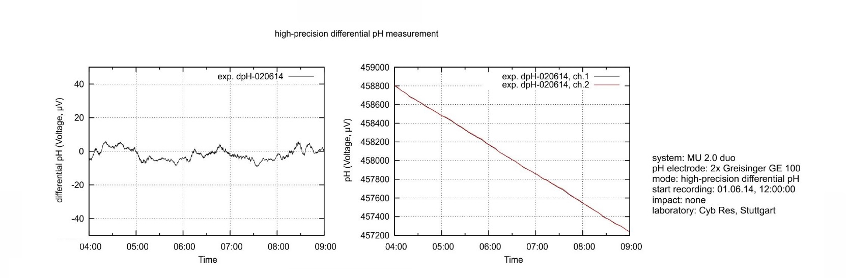
100mkV ≈ 0.0018pH
Measurement without compact-discs
Differential values
Absolute values
40
Notes:
Ok!
Control experiments. During all time there is nothing under the samples of water

Slide 41
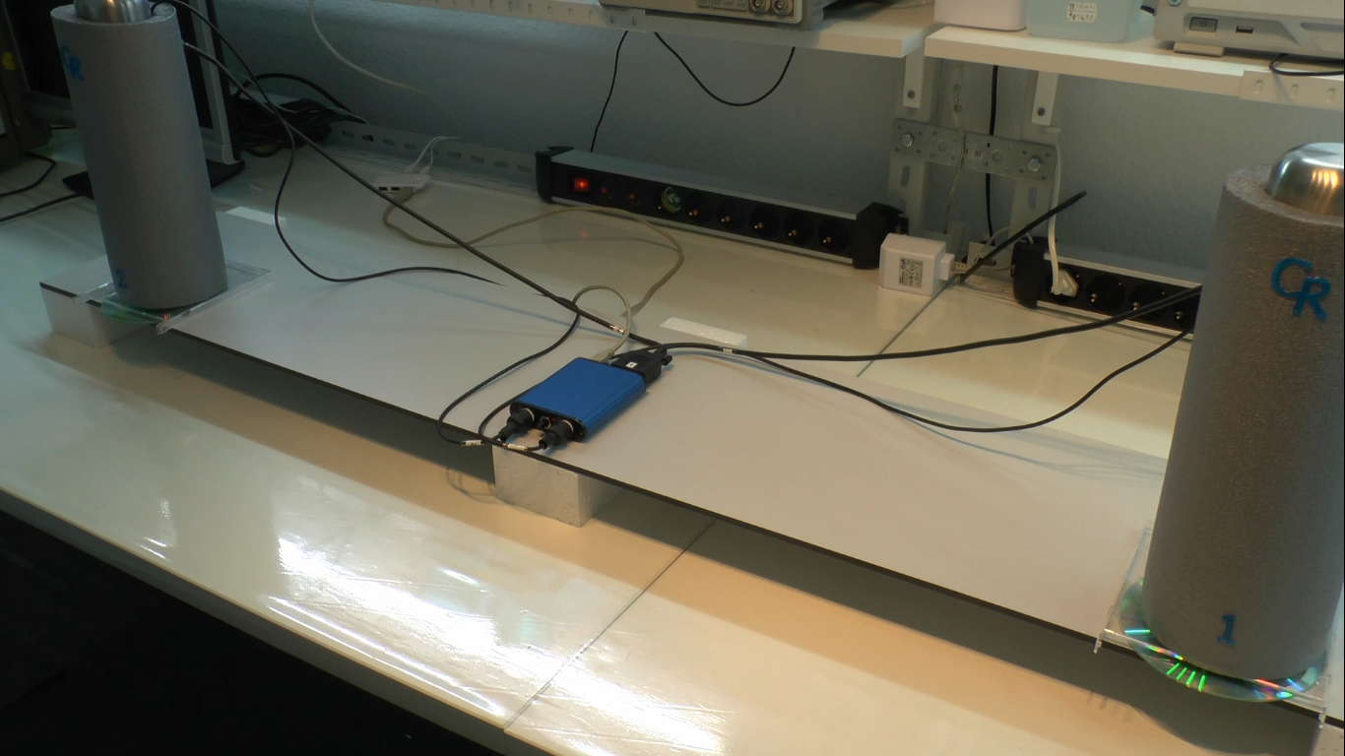
Control Experiments
2x equal non-activated CD disks:
Notes:
Second type of control experiments
we put two equal non activated compact discs under samples of water

Slide 42
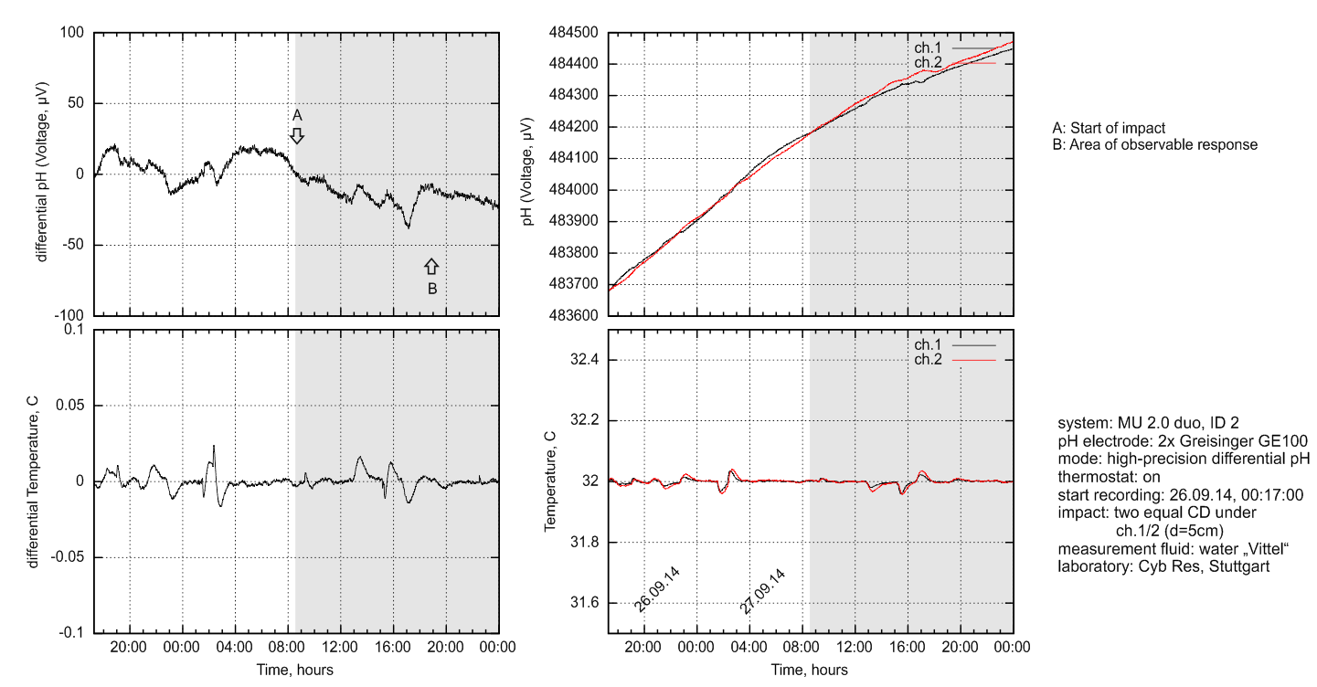
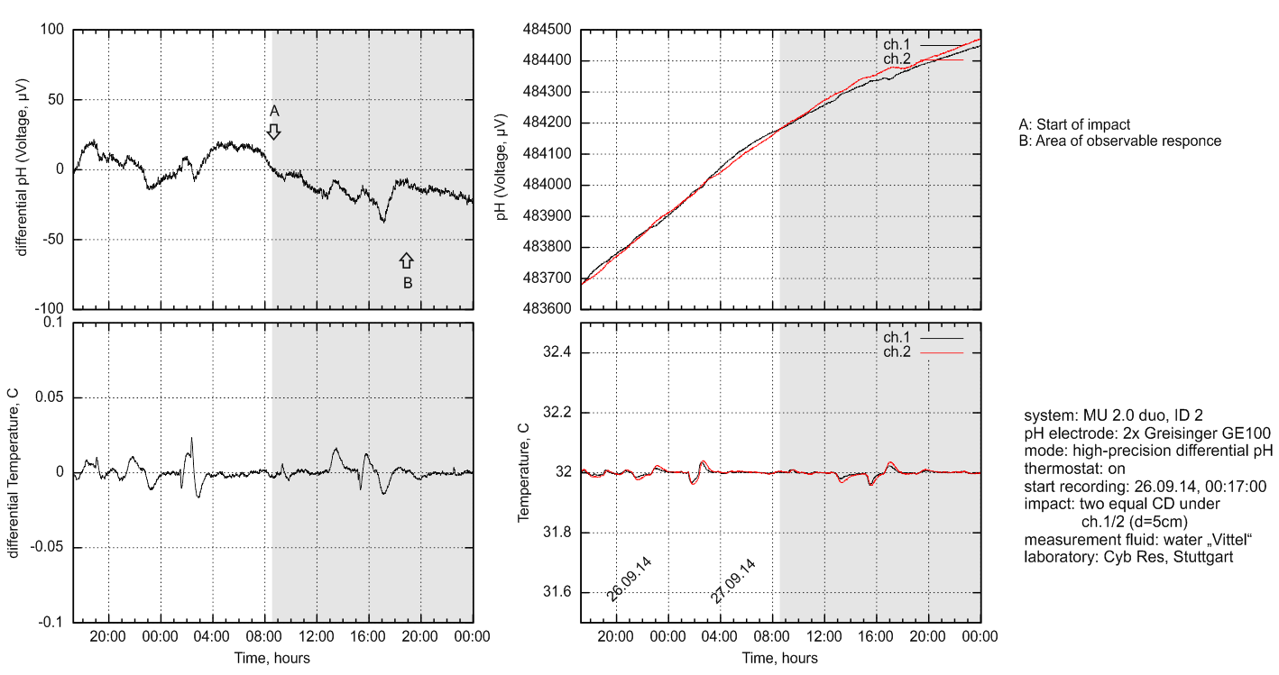
100mkV ≈ 0.0018pH
2x equal non-activated CD disks: measurement on Sep. 27, 2014
Control
Differential values
Absolute values
100
Small changes of dynamics with two equal objects
Notes:
Results Control experiment
We put two equal compact discs under the water samples
absolute values are drifting down, but equally. The differential value pH1 – pH2 is about zero
you can see the scale of the graphics - 100 mkVolts

Slide 43
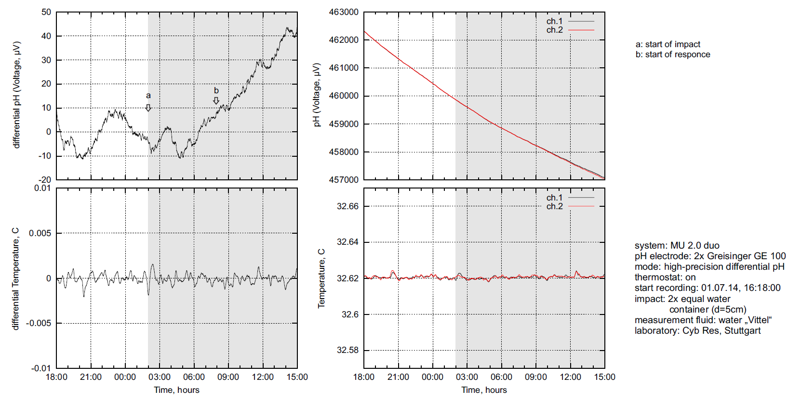
100mkV ≈ 0.0018pH
2x equal non-activated disks: measurement on Jule. 1, 2014
Control
50
(from Kernbach&Kernbach. On precise pH and dpH measurements, International Journal of Unconventional Science 5(2), 83-103, 2014)
Small changes of dynamics with two equal objects
Notes:
One more control. you can see the scale of the graphics - 50 mkVolt

Slide 44
Test experiments
one of two CD disks is activated

Slide 45
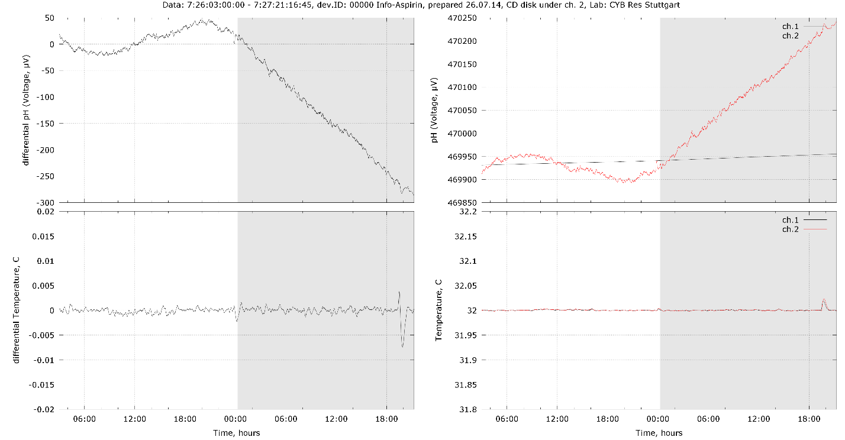
Channel 1
Channel 2
100mkV ≈ 0.0018pH
“blank”
With IC of Aspirin
Differential values
Absolute values
-300
Notes:
Test experiment. When One disc is activated.
During this period there were not discs under the water samples.
At this time we putted two discs under the water samples
See the scale – 300 units

Slide 46
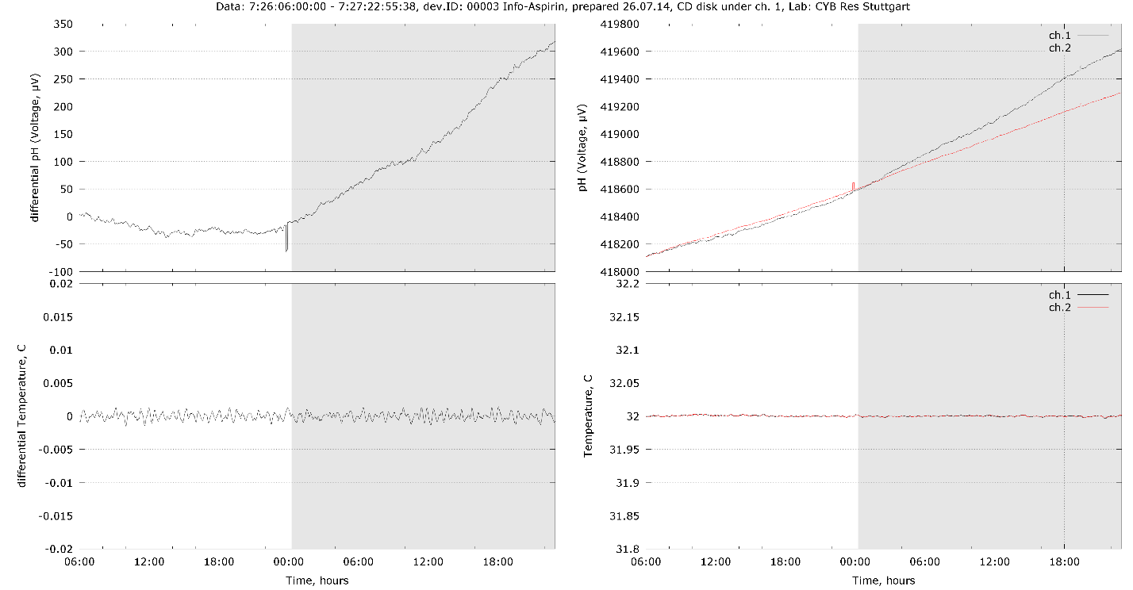
Channel 1
Channel 2
100mkV ≈ 0.0018pH
With IC of Aspirin
“blank”
Differential values
Absolute values
350
Notes:
Another test experiment
There is a difference

Slide 47
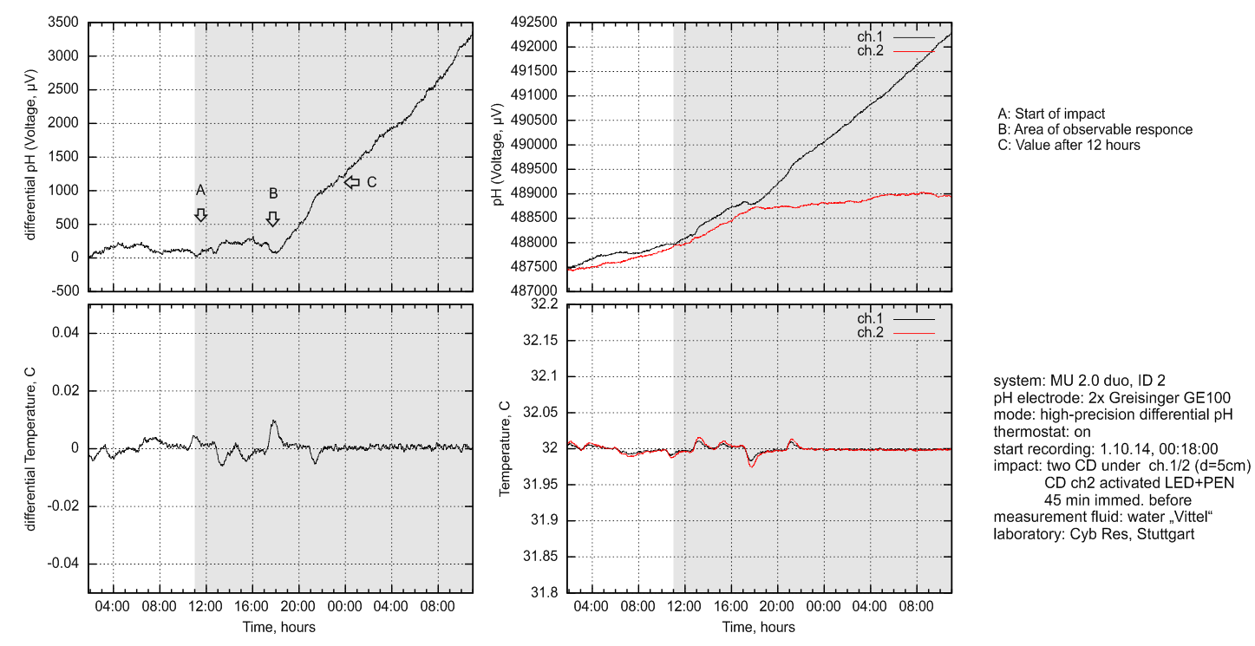
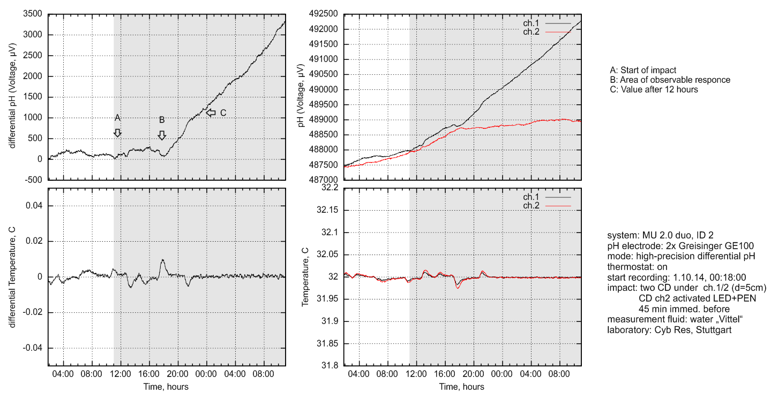
one of two CD disks is locally activated (LED+Pinicillin, 45 min, immediately before): measurement on Oct. 3, 2014
3500
significant change of dynamics after activated disk is under sensor
Notes:
Anothers one.

Slide 48
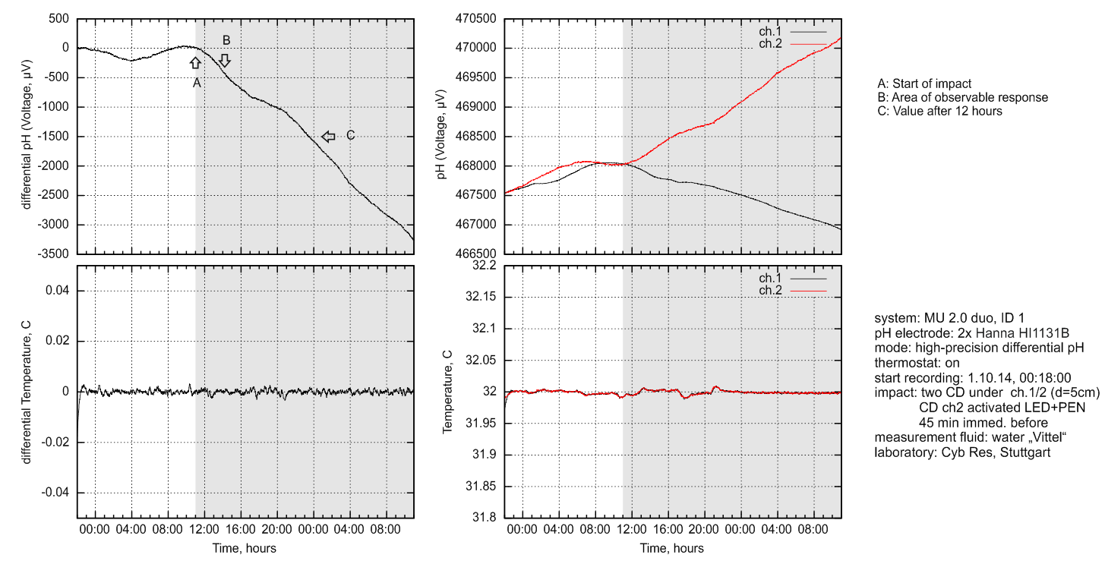
one of two CD disks is locally activated (LED+Pinicillin, 45 min, immediately before): measurement on Oct. 3, 2014
(second setup measured in parallel)
-3500
significant change of dynamics after activated disk is under sensor
Notes:
One more

Slide 49
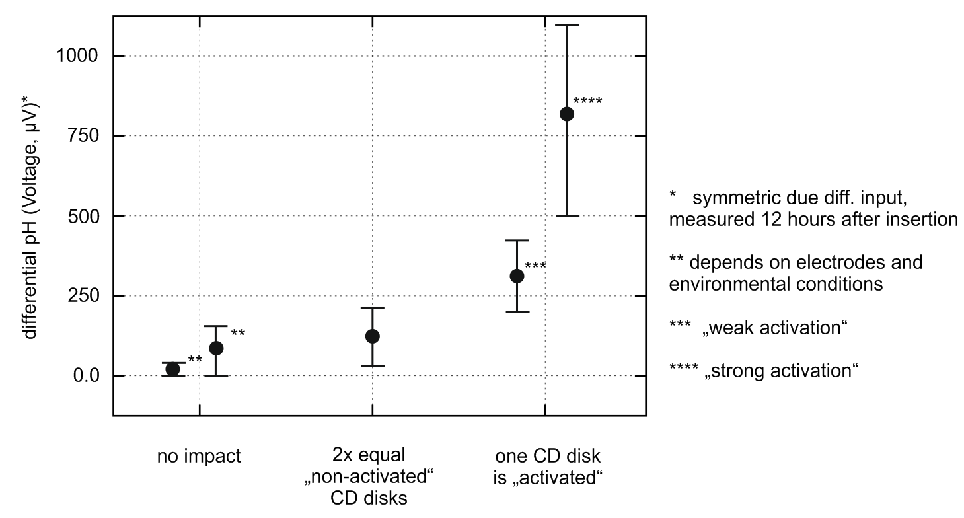
100mkV ≈ 0.0018pH
Summary
well observable impact on potentiometric system without measurable changes of E/H fields, temperature, power supply, mechanical impacts
transmission mechanism “activated CD disk –> pH electrodes” is unknown
there are different ways of “activating” CDs, their impact is different
low current statistics (in total about 40 measurements with CD disks), it is planned to accumulate significant statistics and to publish it in IJUS 2014/2015
Notes:
And summary of 40 experiments with compact discs
Effects from activated compact disc is not constant . And results were divided into two groups
We collecting results, statistics . And this methods seems promising to study informational copies of material media.

Slide 50
A
Polycarbonate plastic
Chemical Dye
B
Aluminum
C
Lacquer
D
Water
Cover, Label..
E
Light
Glass
A
Polycarbonate
B
C
Aluminum
D
E
Notes:
So we can say that after the treatment, discs changes it’s properties.
And then disc has information impact on the water.
We may suppose disc as a key and water as a lock which changes its state using own external energy, right?

Slide 51
SECOND QUESTION
Notes:
The next question.
Does compact disc has specific effect? To answer on this question we need biological experiments.

Slide 52
Preclinical trial of immunomodulatory properties of normal saline exposed of CD with Informational Copies of Arbidol, L-Thyroxine and Galavite
Boris Surinov et at.
of spleen
Notes:
We had blind experiments with mice.
You can read more about these results in the water conference booklet.
And one next question is can this technology helps people?

Slide 53
Notes:
Several example , I just want to announce that we already have clinical results. And they are surprising
People already use this alternative methods of treatment.
This results motivate and inspire us to develop this project.

Slide 56
IC of Glucophage
Impact on the pancreas
After a month of use, the insulin dose was reduced by 1/3
One month later the dose was decreased by 1/2
Aim: do not use insulin
1
2/3
1/2
До использования IC Medicals
Через месяц
Через 2 месяца
0
Notes:
Example of reduction of Insulin consumption.
After a month of use

Slide 57
Conclusions:
Electromagnetic field can be a carrier of information
We may use “informational image” of the substance instead of substance to start changes of material (physical, biological objects)
There are promising perspectives of using Informational Technologies in different kind of everyday life.

Slide 58
Free
Effective
Safe
Always available
Notes:
And us mentioned Jacques Benveniste in his presentation at the Cavendish:
it is rather an evolution then revolution .
There are a lot of opened question on which now we don’t have answers.
I am sure that informational medical technologies helps people be healthy. But this is not magic and people should make an effort to change its state and we.. we are only informing!

