Slide 1
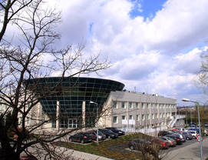
Protein structural dynamics and interactions
modulated by infrared light.
Magdalena Kowacz
Piotr Warszyński

Slide 2
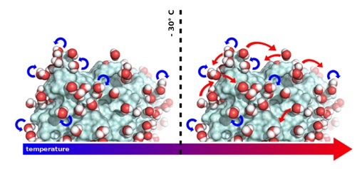
Protein functional motions and water of hydration
Protein functional motions and hydration water
inactive
active
The ability of hydration water
to undergo translational motions on a protein
surface is a necessary requirement for protein activity.
Schiro et al. (2015) Nature Communications 6
from https://phys.org/news/2015-03-molecules-proteins.html
Contraction induces loss of order in the muscle-protein complex (transition from α-helix to β-sheet-rich structures), accompanied by a destructuring
of hydration water.
activated
relaxed
actin-myosin filament
Yoo et al. (2014) J Phys Chem Lett. 5

Slide 3
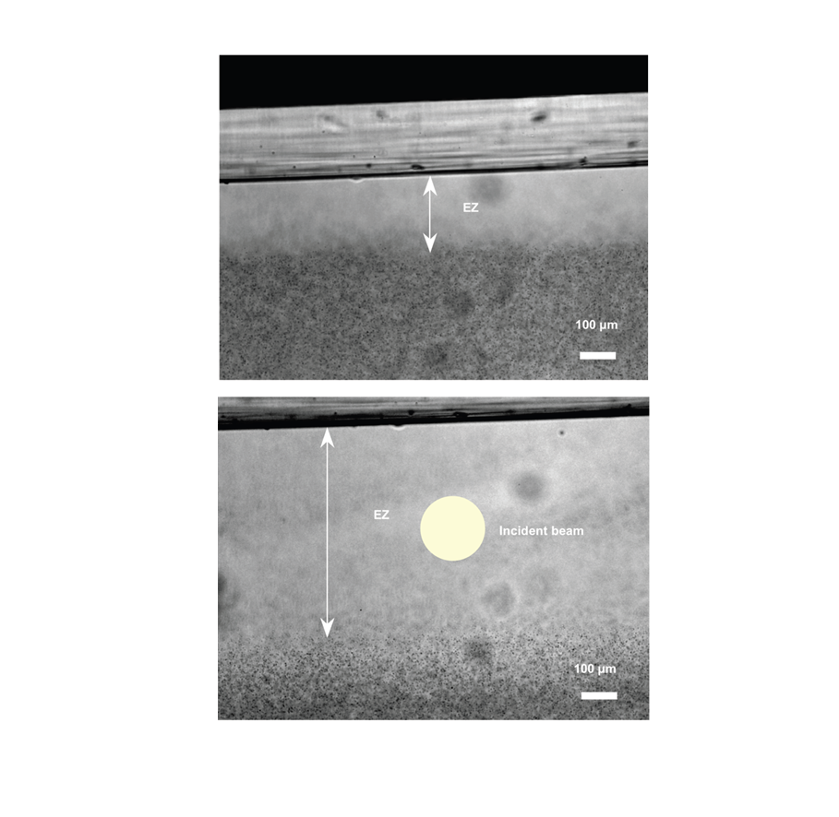
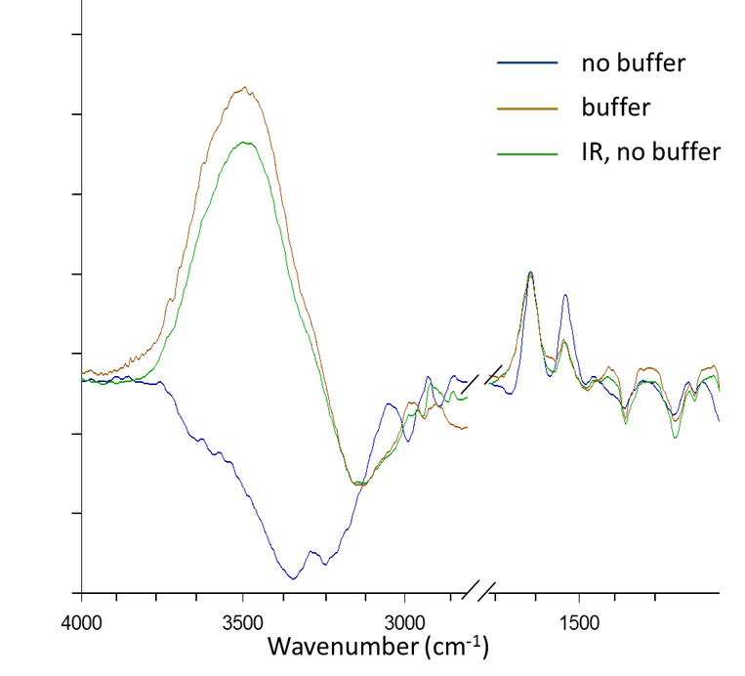
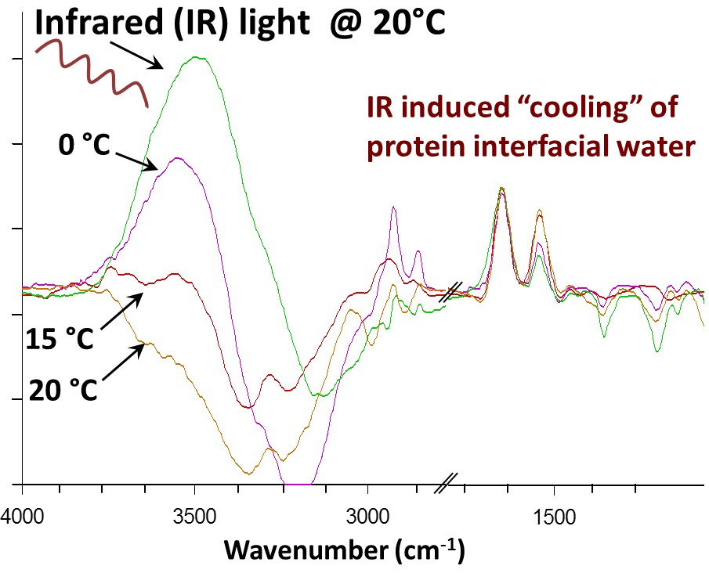
Effect of infrared light on water structuring
FTIR-ATR spectra of aqueous solution of lysozyme
Chai B. et al. (2009) J. Phys. Chem. B

Slide 4
Weak electromagnetic radiation (EMR) – water interplay
Increased conductivity of water
EMR polarizes (ion-stabilized)
gas nanobubbles,
induces bubble to bubble
and bubble to boarder attraction (Bjerknes forces),
promotes bubble coalescence, growth and escape from the liquid
Increased activity of ions
Increased surface tension of water
Shatalov et al. (2010) Electronic J. Biology; Shatalov (2012) Biophysics; Shatalov et al. (2012) Biophysics
Bioliquids (e.g. blood plasma, cytoplasm, interstitial fluid) contain small amounts (~2 vol %) of dissolved air gases, and part of these will exist as nanobubbles stabilized by adsorbed ions.
Shatalov (2012) Biophysics; Bunkin et al. (2010) J. Biophotonics
Chai B. et al. (2009) J. Phys. Chem. B

Slide 5
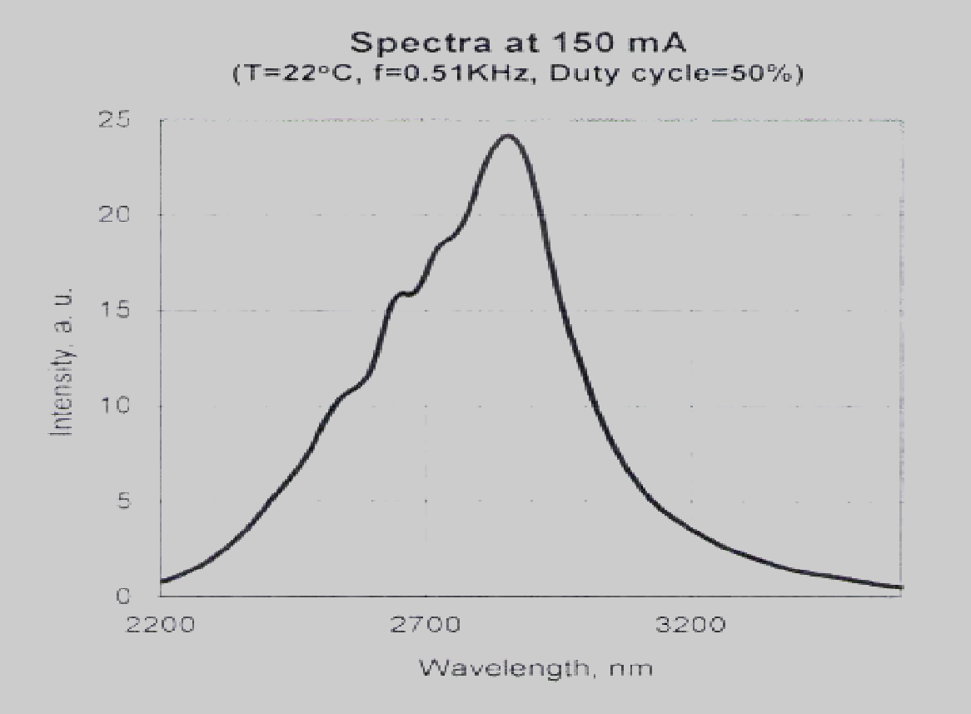
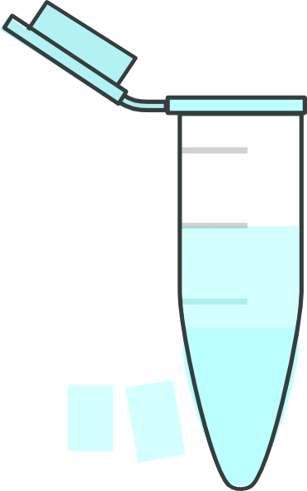
Infrared light (IR) - an electromagnetic radiation (EMR)
Spectra of LED with emission max.
λ = 2.9 μm
Light Emitting Diode (LED)
Optical power
29.5 µW
10 min
4550
3450
2780
Wavenumber cm⁻¹
protein
IR absorption of water

Slide 6
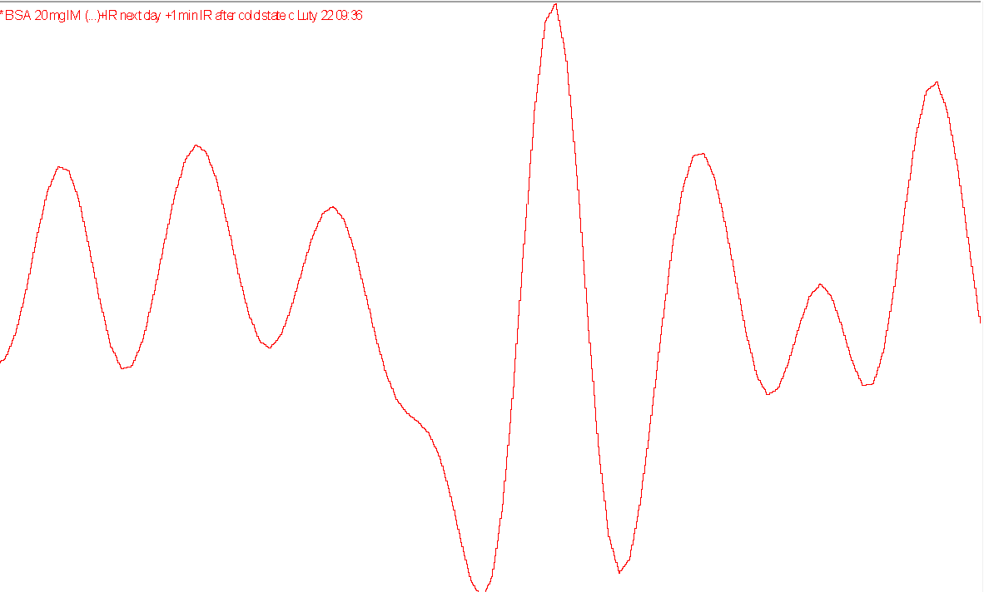
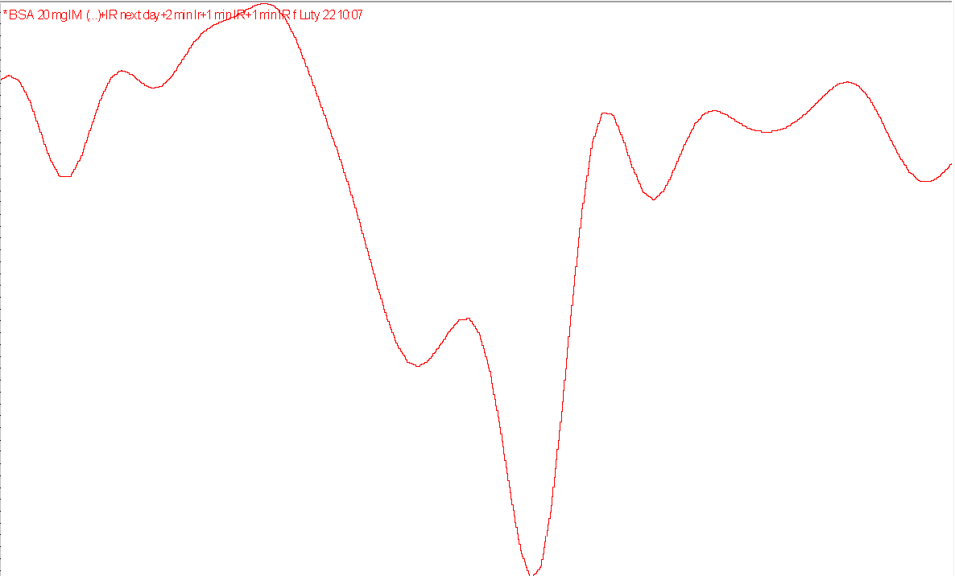
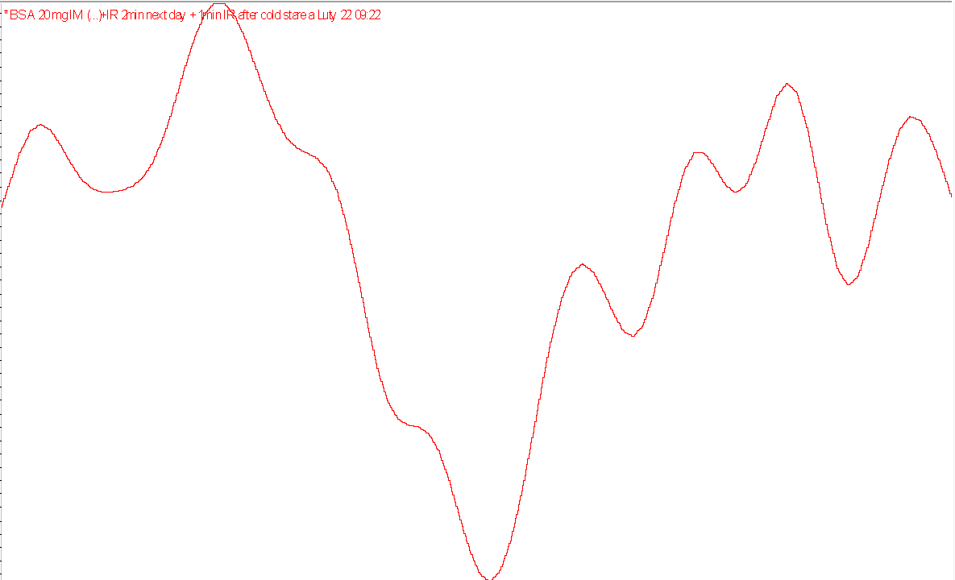
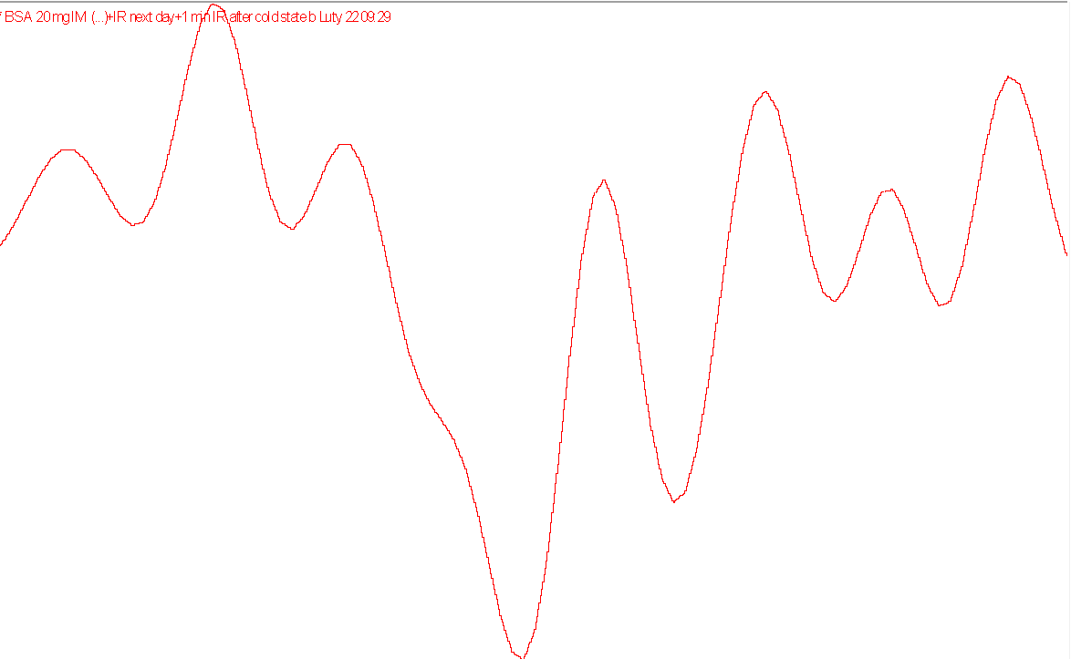
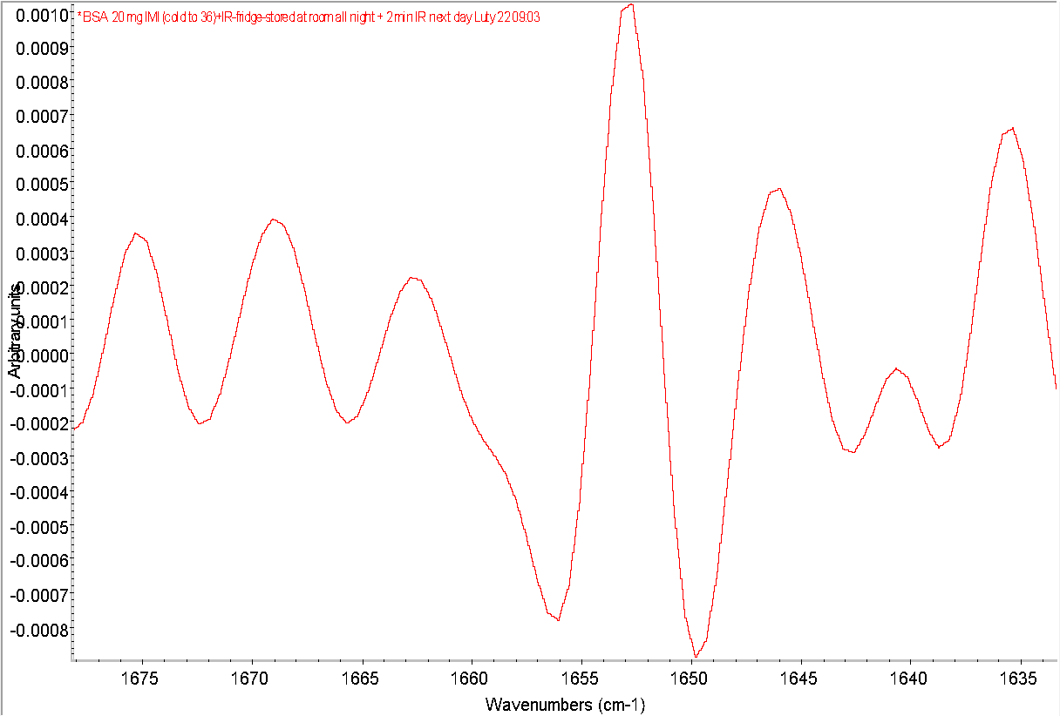
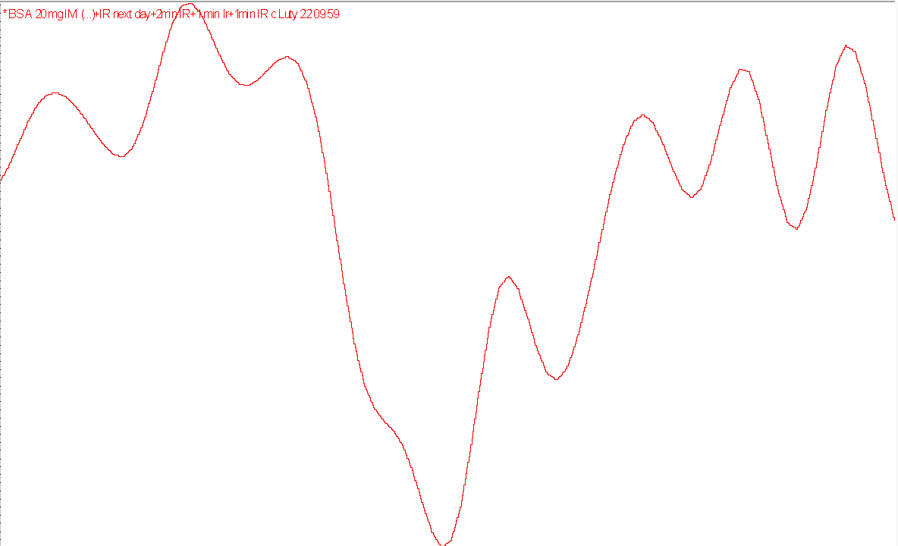
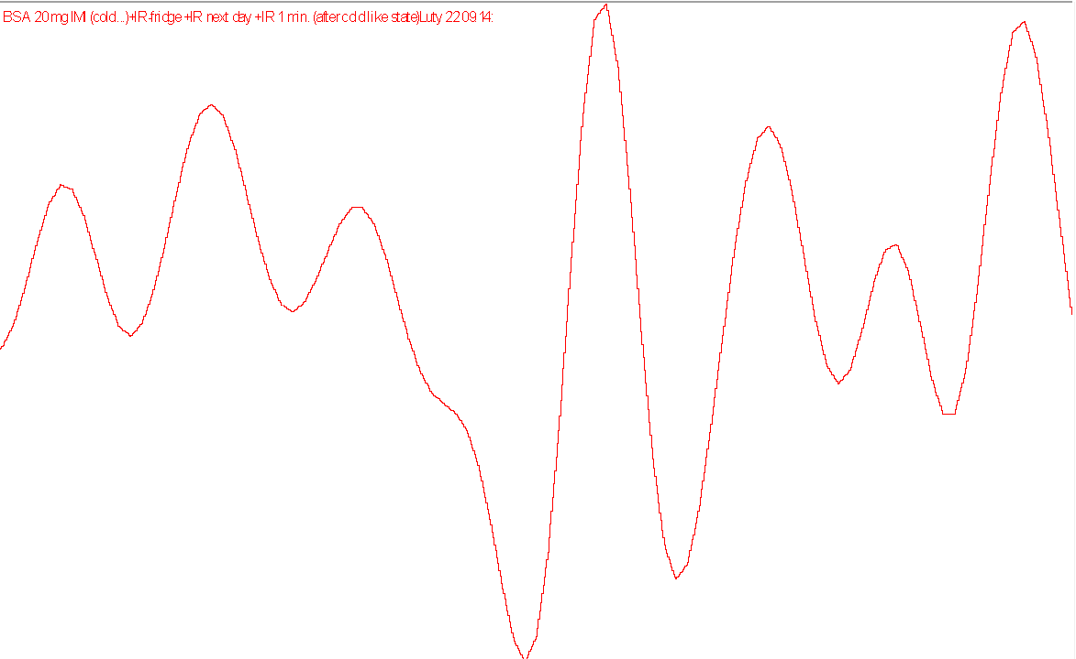
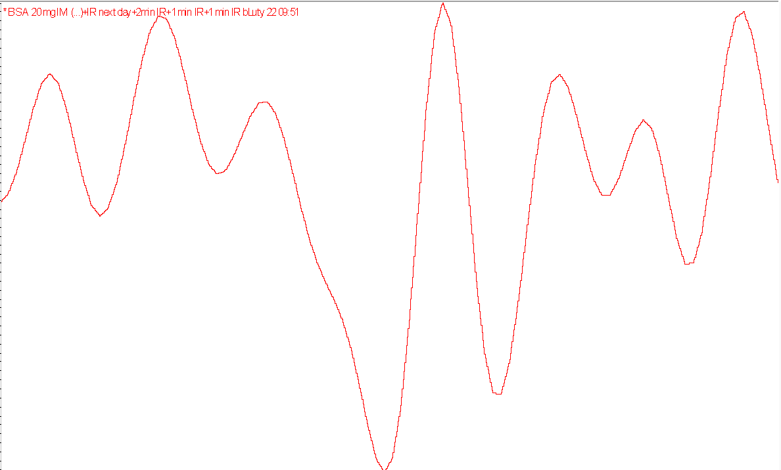
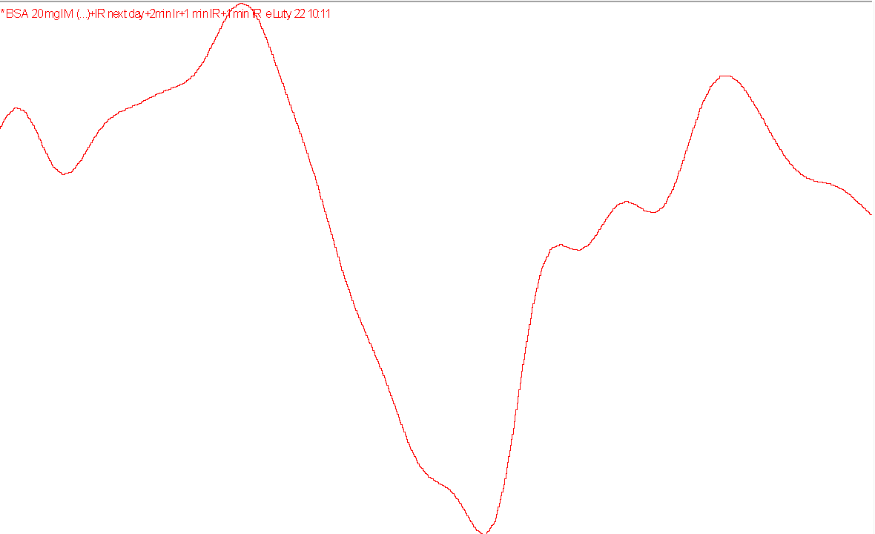
IR-induced protein conformational fluctuations
surface active ions, cold
degassed
α helix
Random
coil
α helix
degassed + IR = no effect
no surface active ions
gas cavities
Imidazole, 20 mM
Wavenumber (cm⁻¹)
Second derivative of FTIR-ATR spectra of bovine serum albumin (BSA) in imidazole buffer
H₂O
Wavenumber (cm⁻¹)

Slide 7
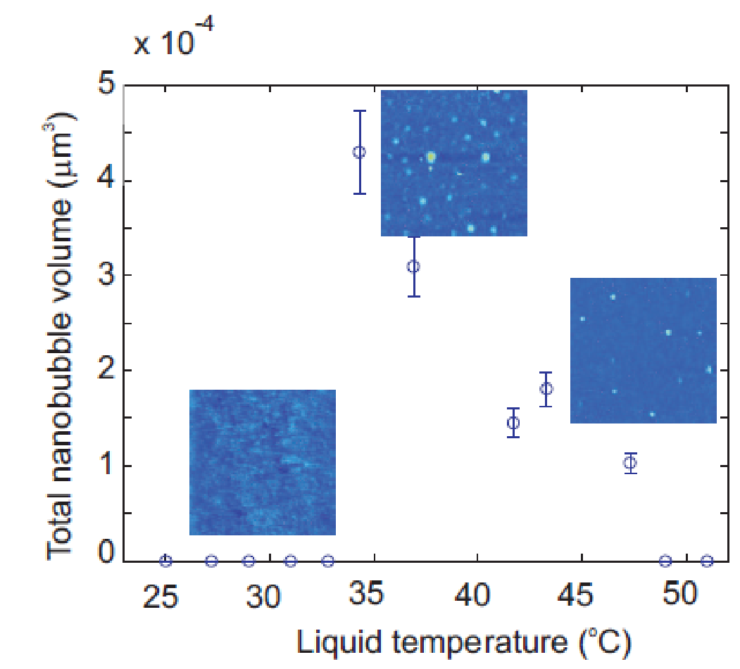
Nanobubbles as a target of IR-induced protein conformational fluctuations
Nanobubbles drive primary protein fold.
Sen and Voorheis (2014) J. Theoretical Biology
Nanobubbles provide hydrophobic attractions.
after Seddon et al. (2011)Phys. Rev. Lett.
Attard (2003) Adv. Colloidal Interf. Sci.

Slide 8
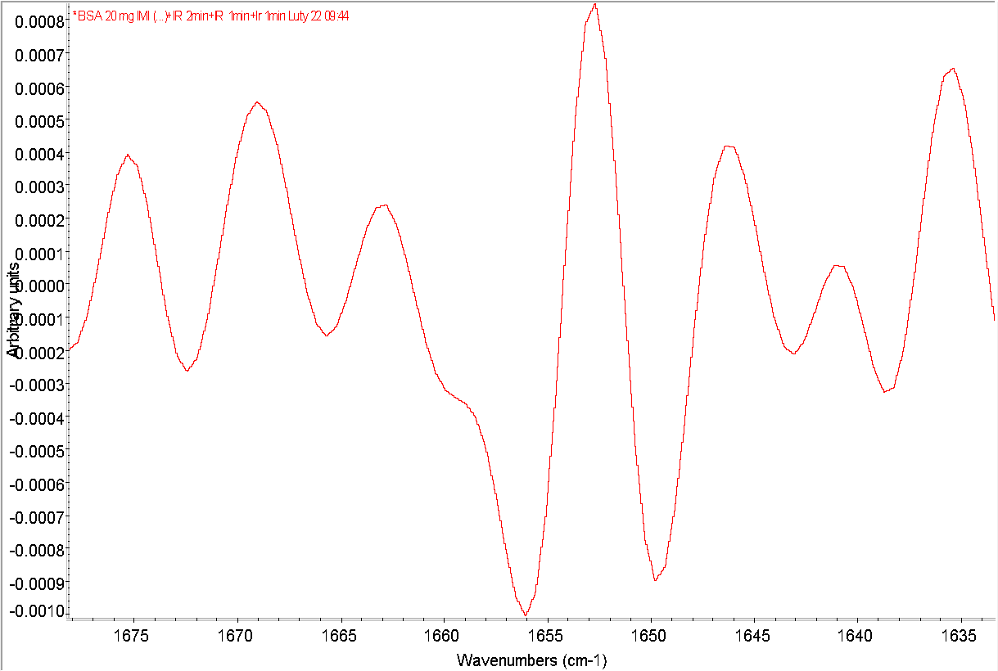
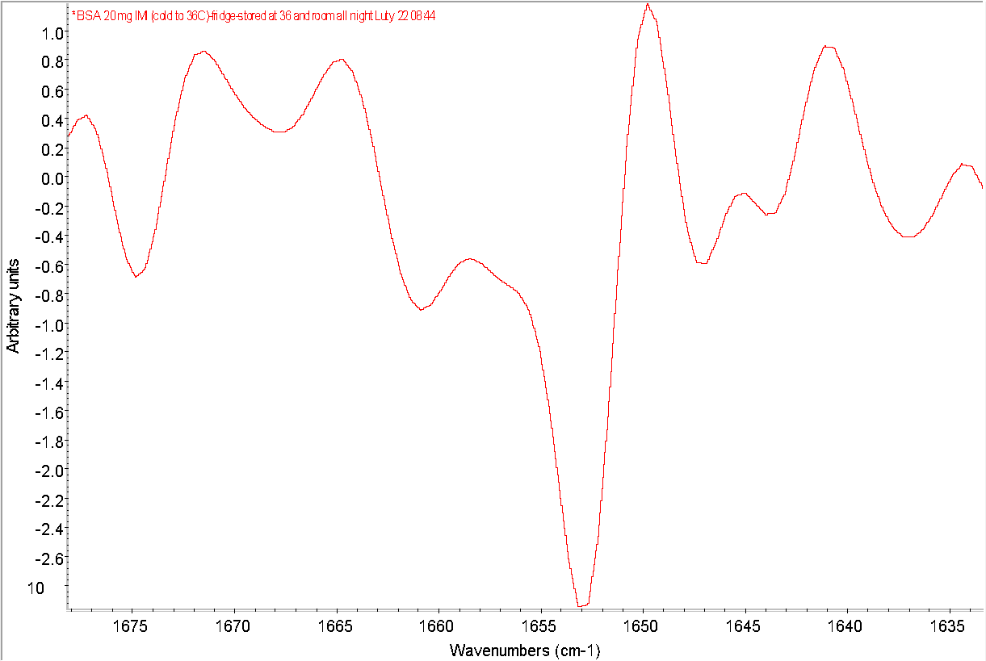
IR-induced structural fluctuations
and Ling’s active vs. resting state
- ATP
+ X⁺ + Y-
+ ATP
random
α helix
random
α helix
extended
folded (compact)
hydrated
dehydrated

Slide 9
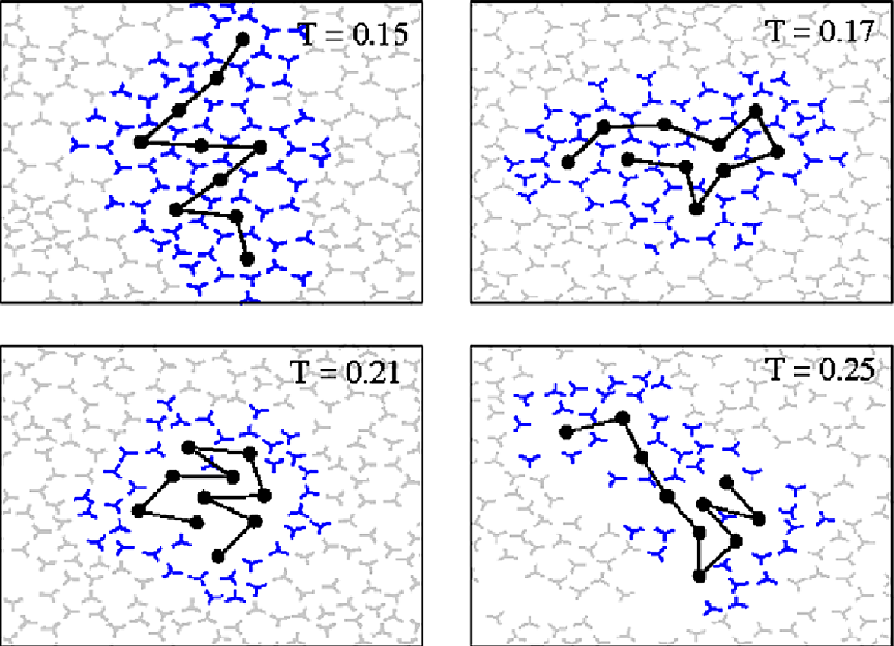
Bubbles implication for heat/cold protein denaturation
cold
Cold denaturation – exothermic,
reversible
Heat denaturation – endothermic,
often irreversible
room
hot
modified after C.L. Dias et al. / Cryobiology 60 (2010) 91–99

Slide 10
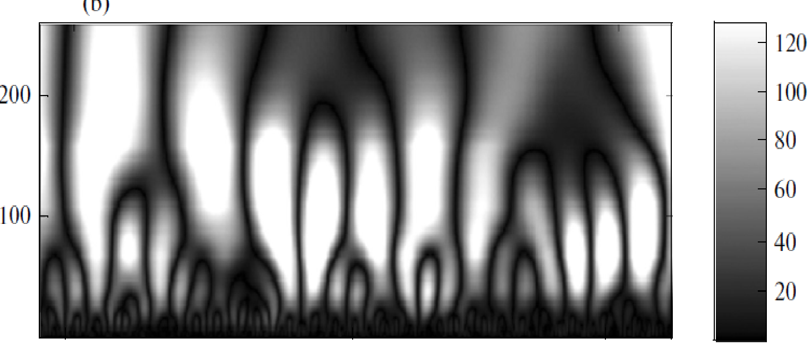
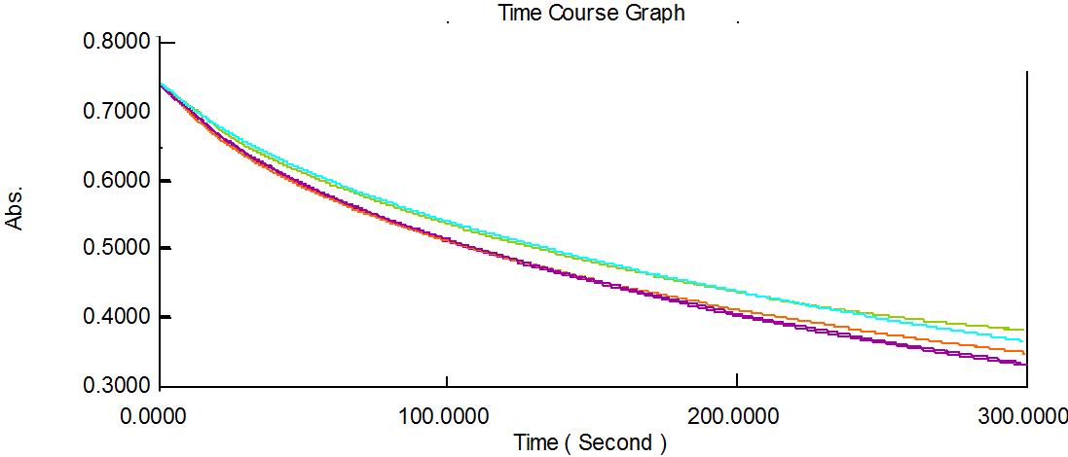
IR – triggered conformational fluctuations
and protein enzymatic activity
Wave analysis of the fluctuations of the sum surface energy of the bubbles in a liquid
coeff.
Shatalov et al. (2012) Biophysics
time
Lysozyme activity against Micrococcus lysodeikticus cells
degassed

Slide 11
UV-VIS evidence of structural changes
Control – partially disordered
IR-induced folding
a
b
Unfolding = Increased absorbance at 278 nm
Fig. UV –VIS spectra of BSA in imidazolium buffer (pH = 7.36) at a) control conditions and b) after 10 min. exposure to IR light
278

Slide 12
Protein - surface intercations
after Monopoli et al. (2011),
Nature Nanotechnology 6
Lysozyme (Lys), M_{w} =14 kDa, pI = 11
SiO₂ , 10-20 nm
Ovalbumin (OVA), M_{w} = 45 kDa, pI = 5.1
Bovine serum albumin (BSA), M_{w} =64 kDa, pI = 4.7

Slide 13
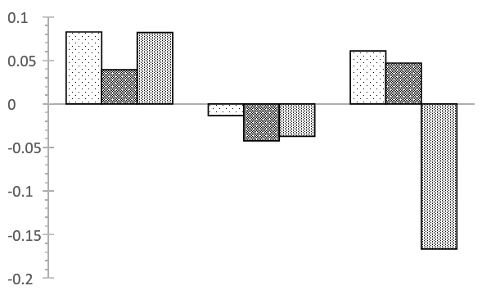
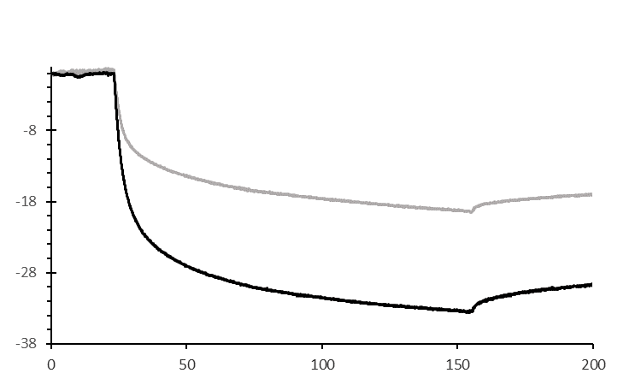
Effect of IR light on protein – water affinity
NaCl
H₂O
Buffer
Δ hydrophilicity
Lys
OVA
BSA
a
Δf (Hz)
Adsorbed mass
Frequency shift on adsorption of BSA from buffered aqueous solution on SiO₂ sensor. Black – IR-exposed protein, grey- control conditions
Lys
OVA
BSA

Slide 14
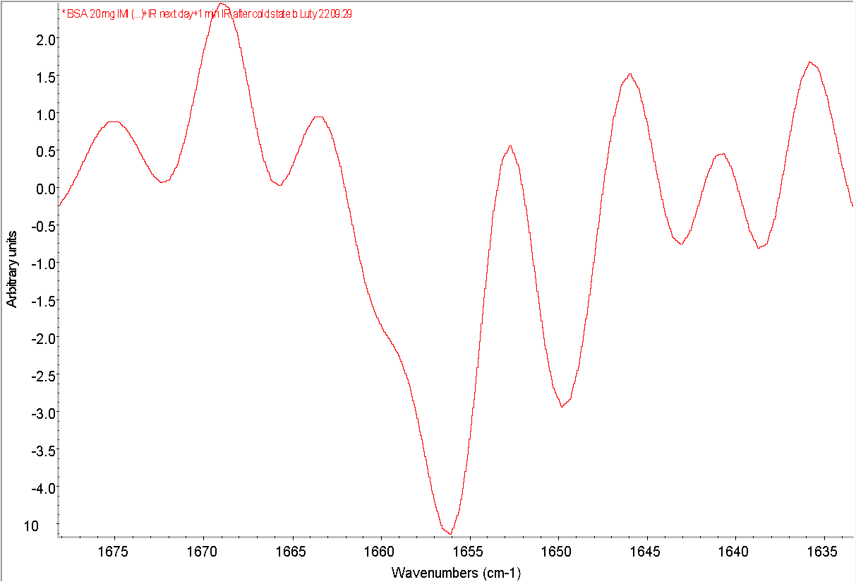
Structural changes on adsorption
a
b
random
random
α helix
α helix
Second derivative of FTIR-ATR spectra of BSA adsorbed on ATR crystal surface from a) control
and b) IR-exposed solution
IR light protects BSA from denaturation on adsorption the the solid surface

Slide 15
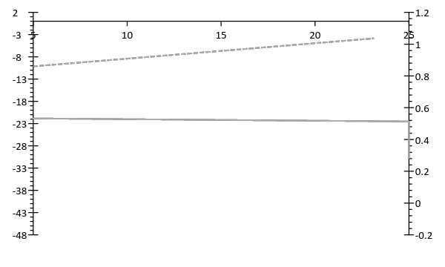
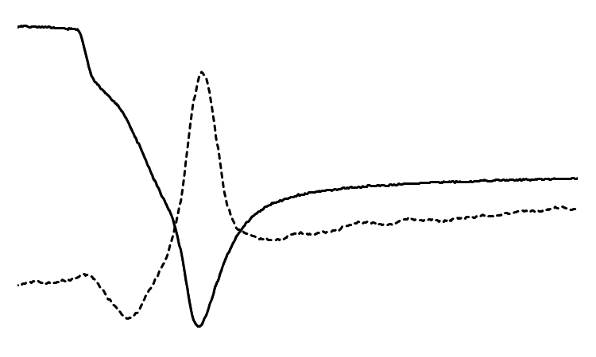
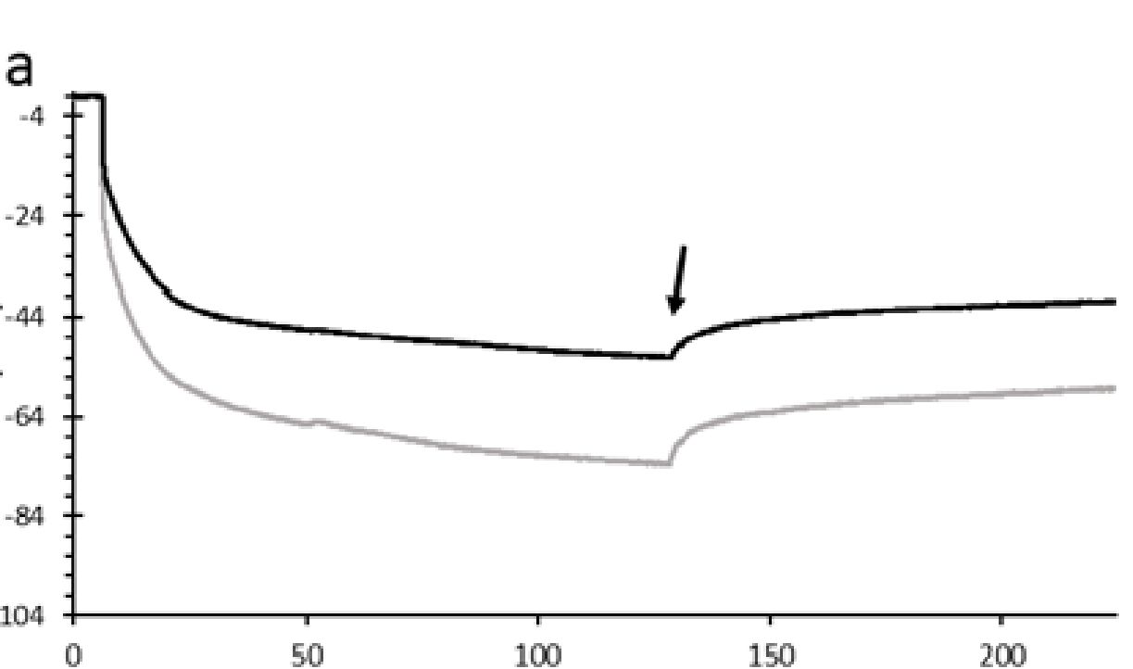
Effect of IR light on protein – water affinity
NaCl
H₂O
Buffer
Δ hydrophilicity
Δ frequency (Hz)
Δ dissipation (10⁻⁶)
Adsorbed mass
Lys
OVA
BSA
Δf (Hz)
time (min)
Adsorbed mass
Frequency (solid lines) and dissipation (dashed lines) shifts on adsorption of lysozyme from unbuffered aqueous solution on SiO₂ sensor. Black – IR-exposed lysozyme, grey- control conditions
Frequency shift on adsorption of Lys from buffered aqueous solution on SiO₂ sensor. Black – IR-exposed protein, grey- control conditions
Lys
OVA
BSA

Slide 16
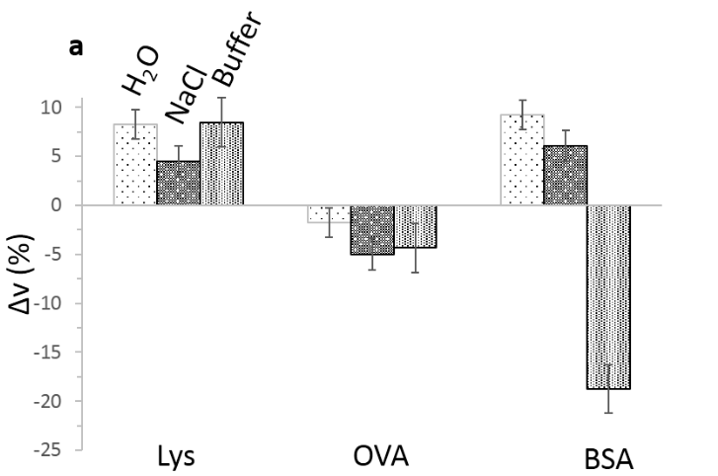
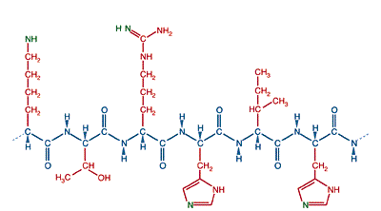
Character of functional groups and water structuring ability
Basic functional groups
The positively charged amino-acid residues form stronger and longer-lived hydrogen bonds with water than the negatively charged residues (Bandyopadhyay et al. J. Am. Chem. Soc. 2005)
H
H
δ-
δ-
δ-
H
H
δ-
Content of basic amino acids in g/100g of protein
Lys
6.3
5.7
2.3
2.35
5.7
12.7
after Tristam (1953)

Slide 17
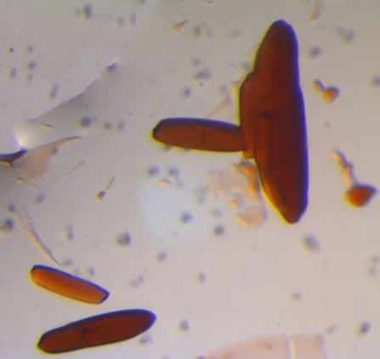
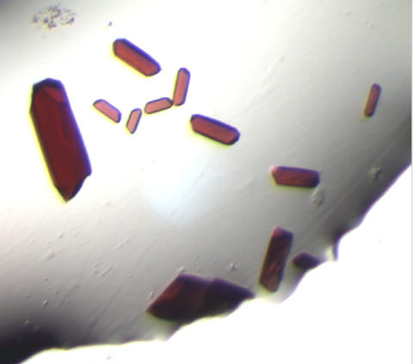
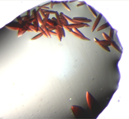
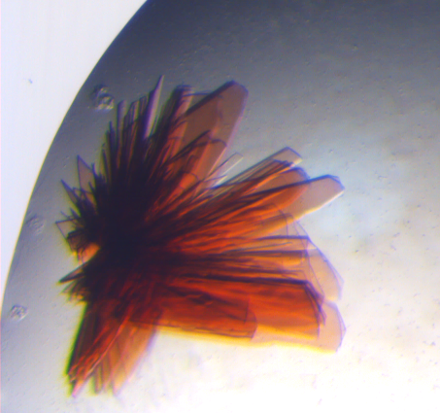
Infrared light induced protein crystallization
Hemoglobin from bovine blood
Myoglobin from equine skeletal muscle
control
+ LED
Desulfovibrio gigas aldehyde oxidoreductase (DgAOR)

Slide 18
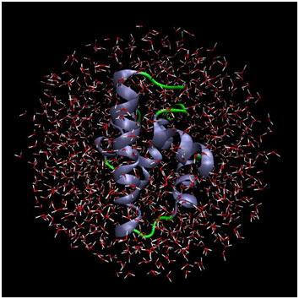
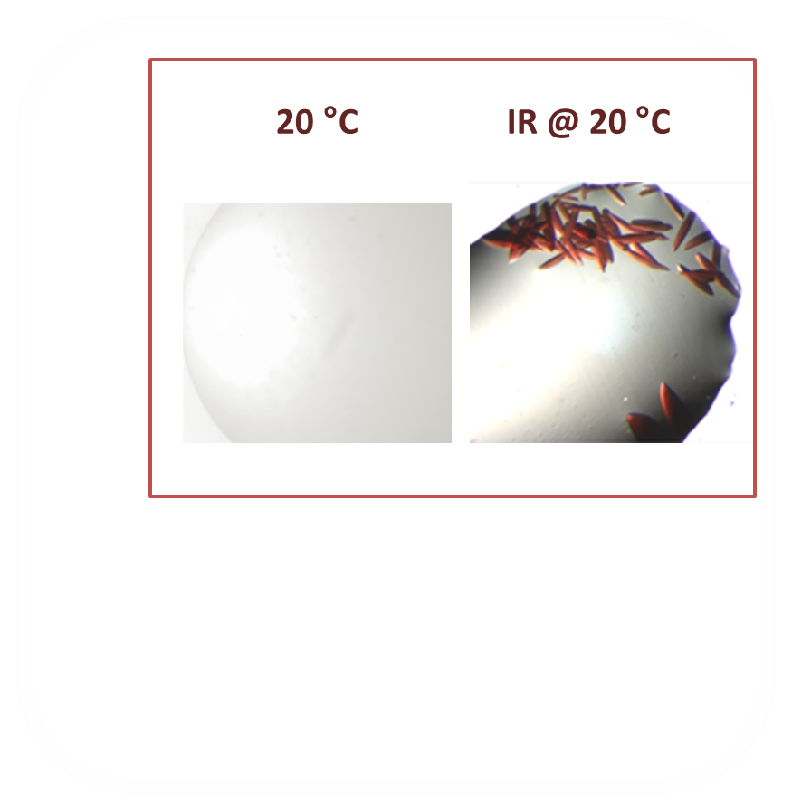
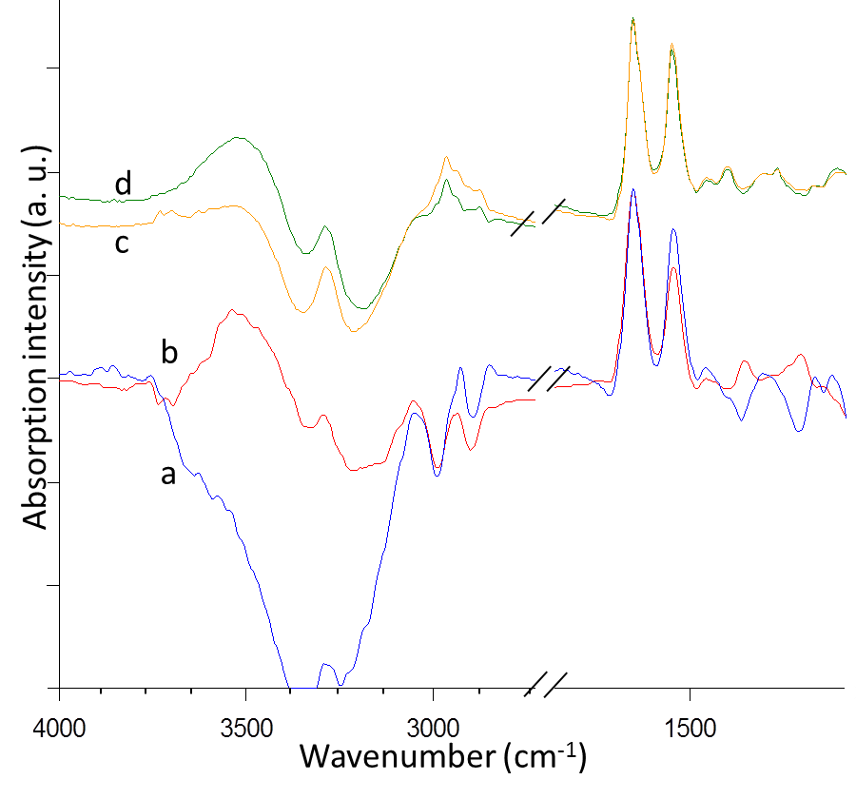
IR – modulated hydration and protein
self-assembly
Release of ordered interfacial water on crystal contact formation is the main driving force for crystallization.
Structuring of the protein interfacial water promotes crystallization.
hemoglobin
lysozyme
FTIR –ATR spectra of control a) and irradiated b) solution of lysozyme and control c) and irradiated d) solution of hemoglobin

Slide 19
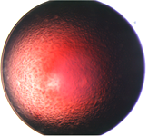
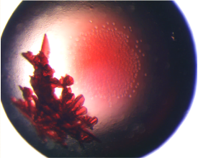
IR-induced structuring of protein interfacial water.
Periodic vs non-specific self assembly
IR @ pH = 9
pH = 9
IR @ pH = 9
pH = 8.2
pH = 9
Wavenumber (cm⁻¹)

Slide 20
Conclusions
Infrared radiation (IR) can induce fluctuations of protein conformation between partially disordered (extended, more hydrated) and folded state.
Nanobubbles mediate effect of IR on protein structural fluctuations:
adsorption/nucleation of bubbles at non-polar compartments drives folding and dehydration (supports hydrophobic interactions);
displacement of bubbles promotes/or is promoted by interfacial water structuring (enhanced hydration).
IR protects protein from denaturation during its adsorption on the surface
and from non-specific aggregation in solution
Acknowledgments
Fuga number DEC-2015/16/S/ST4/00465

Slide 21
Thank You

