Slide 1
Regulation of glycolytic oscillations by the dynamics of intracellular water
Henrik S. Thoke¹, Sigmundur Thorsteinsson² Roberto P. Stock¹, Luis A. Bagatolli^{1,3}, and Lars F. Olsen^{1,2}
¹Center for Biomembrane Physics (MEMPHYS) and ² Institute for Biochemistry and Molecular Biology, University of
Southern Denmark, Campusvej 55, DK5230 Odense M, Denmark. ³ Yachay EP and Yachay Tech, Yachay City of
Knowledge, 100650 Urcuquí-Imbabura, Ecuador

Slide 2
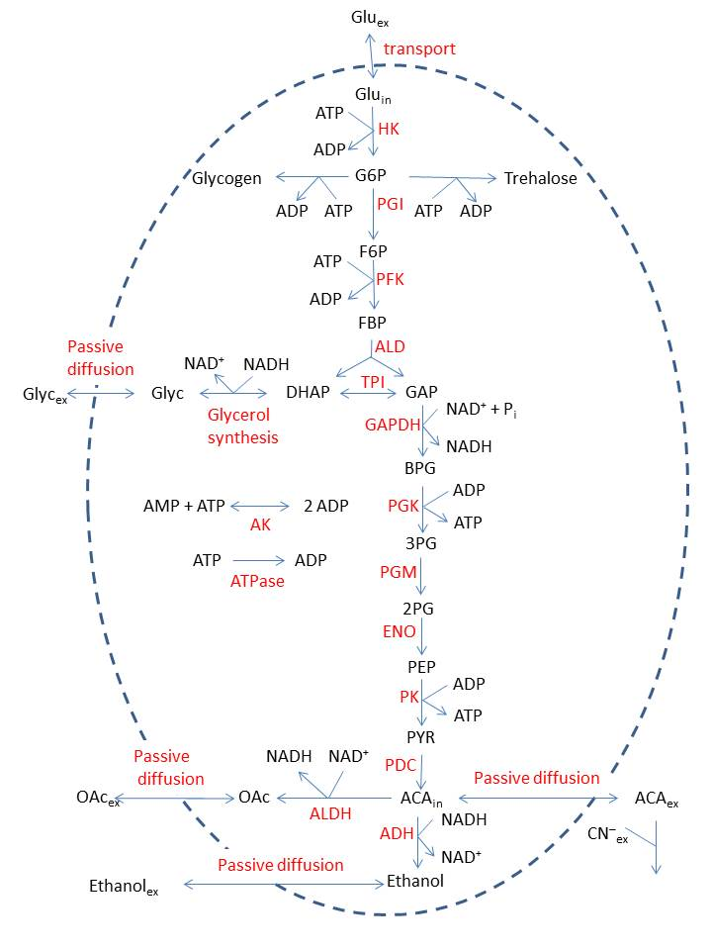
Glycolysis in yeast

Slide 3
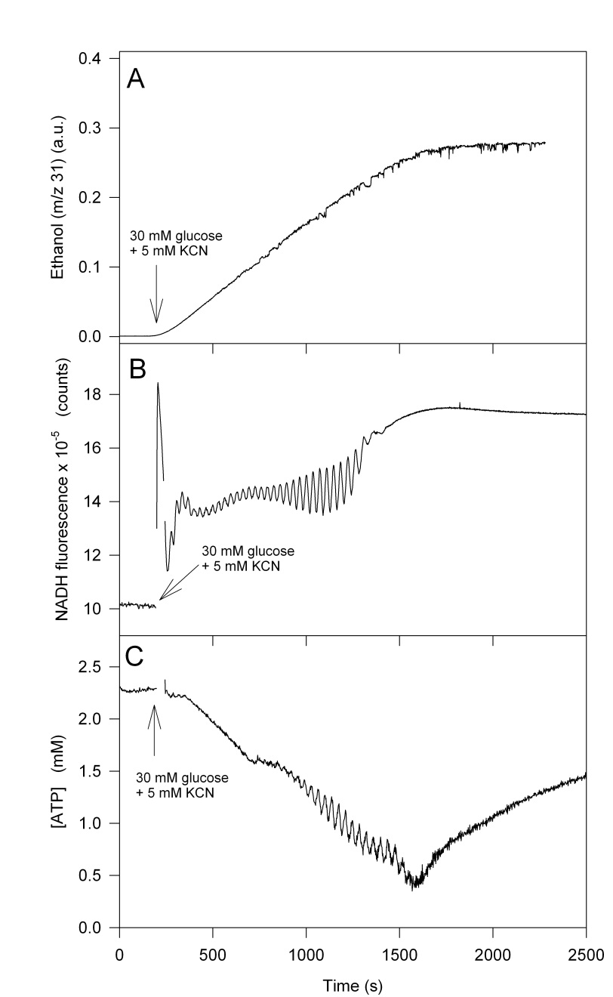
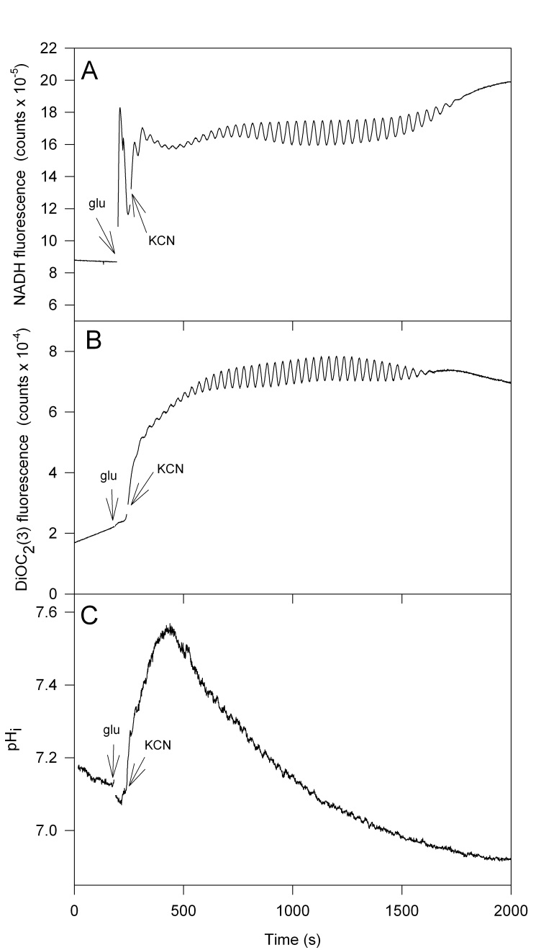
Glycolytic oscillations in yeast
Ethanol
NADH
NADH
Δψ_{m}
ATP
pH_{i}

Slide 4
D₂O decreases the frequency
NADH
Frequency

Slide 5
Cell interior is crowded
Proteins and RNA amount to 300-400 g/l
Water hydrates membranes and large biomolecules
Hydration reduces the mobility of water
Up to 70% of intracellular water is immobilized
Water can form of extended hydrogen bond networks

Slide 6
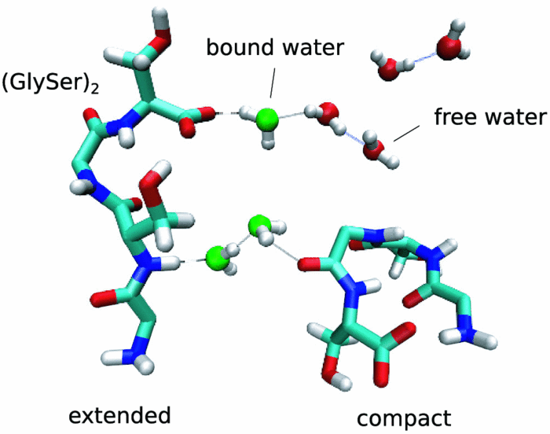
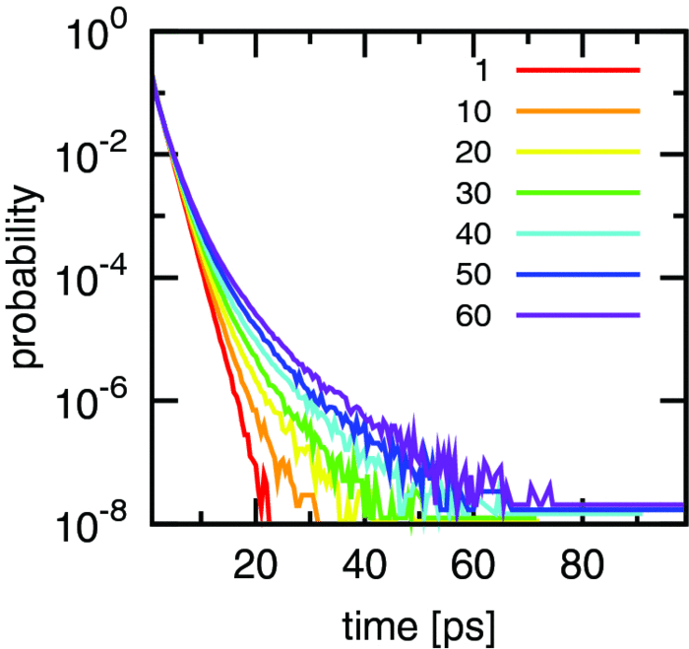
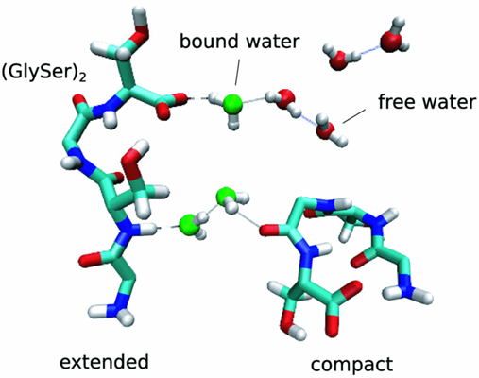
Molecular crowding increases amount of bound water
Water-water hydrogen bonds lifetime distributions
No of
peptides
Cheng Lu et al J. Chem. Phys. 141(4) , 045101 (2014)

Slide 7
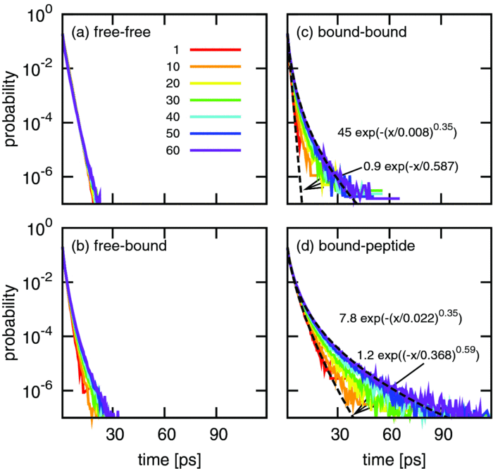
Water-water hydrogen bonds lifetime distributions for different water configurations
Cheng Lu et al J. Chem. Phys. 141(4) , 045101 (2014)

Slide 8
Conclusion
Molecular crowding is not just an excluded volume effect
Solvent shows non-trivial behaviour
Solvent dynamics determines peptide dynamics

Slide 9
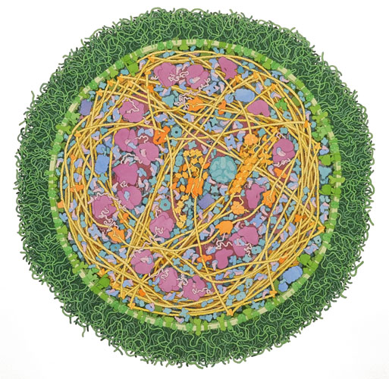
-Water constitutes the most abundant component of the cell. Its unusual properties as a polar solvent have been recognized as part and parcel of life processes. While van't Hoff's insight has proven invaluable, it reaches its limit of usefulness when water itself is strongly impacted by solutes (that is, deviates from tractable ideality).
-Water in the cell is not just a medium where reactions occur but an active participant, e.g. many cellular reactions are condensations that produce water, or hydrolytic ones that consume it.
Many cellular processes, such as secretion and endocytosis, have been productively modeled by responsive hydrogels. An explicit treatment of the dynamics of intracellular water should, therefore, provide elements for a more detailed structural, mechanistic and dynamical understanding of the coherence of cellular behavior, that is, the coupling between chemical and mechanical levels of description.
The aim of this investigation was to study water dynamics in real time in oscillating yeast cells using fluorescence methods.
The molecular level at which glycolytic oscillations are generated and controlled is not the subject of this study; the subject is the effect of these oscillations at the cellular level.
Crowding in a mycoplasma cell (D. S. Goodsell 2011).
Notes:
While van't Hoff's insight has proven invaluable, it reaches its limit of usefulness when water itself is strongly impacted by solutes (that is, deviates from tractable ideality).

Slide 10
Fluorescent Probes Measuring Water Dynamics (DAN probes)
6-Acetyl-2-(dimethylamino)naphtalen (ACDAN)
6-Propyl-2-(dimethylamino)naphtalen (PRODAN)
6-Lauryl-2-(dimethylamino)naphtalen (LAURDAN)

Slide 11
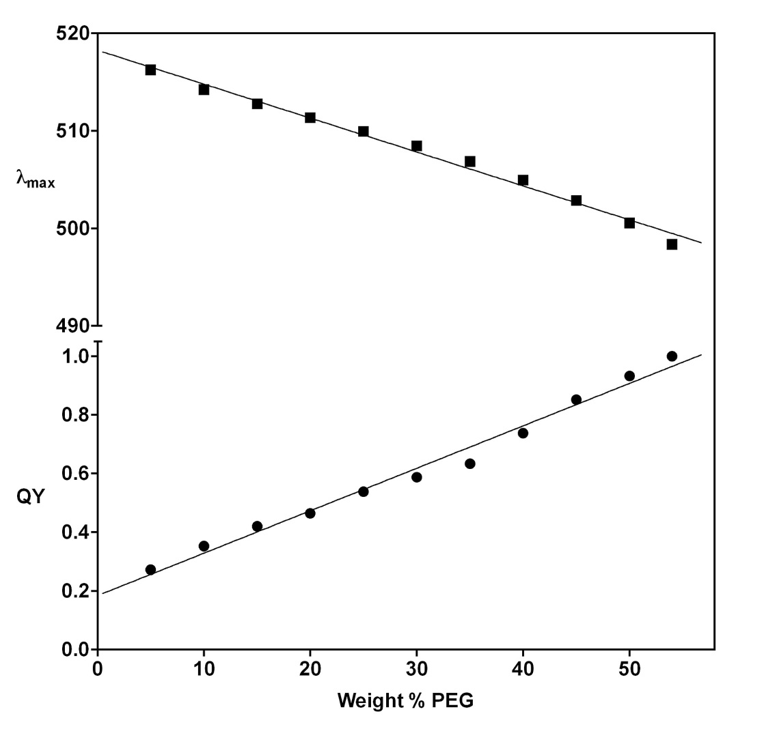
Effect of crowding by PEG800 on ACDAN fluorescence properties

Slide 12
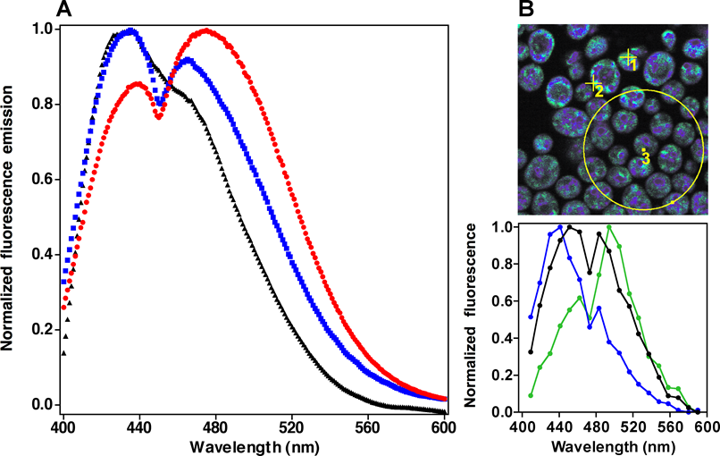

Fluorescence response of DAN probes in resting yeast cells.
Thoke HS, Tobiesen A, Brewer J, Hansen PL, Stock RP, et al. (2015) Tight Coupling of Metabolic Oscillations and Intracellular Water Dynamics in Saccharomyces cerevisiae. PLOS ONE 10(2): e0117308. https://doi.org/10.1371/journal.pone.0117308
http://journals.plos.org/plosone/article?id=10.1371/journal.pone.0117308

Slide 13
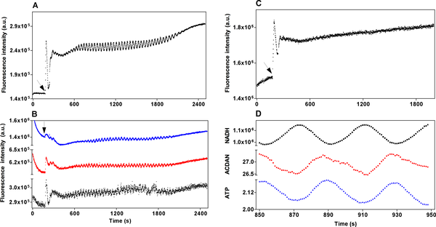
Oscillatory behavior of glycolysis and DAN probes in the fluorometer.
6-ANS
PRODAN
ACDAN
LAURDAN
Thoke HS, Tobiesen A, Brewer J, Hansen PL, Stock RP, et al. (2015) Tight Coupling of Metabolic Oscillations and Intracellular Water Dynamics in Saccharomyces cerevisiae. PLOS ONE 10(2): e0117308. https://doi.org/10.1371/journal.pone.0117308
http://journals.plos.org/plosone/article?id=10.1371/journal.pone.0117308

Slide 14
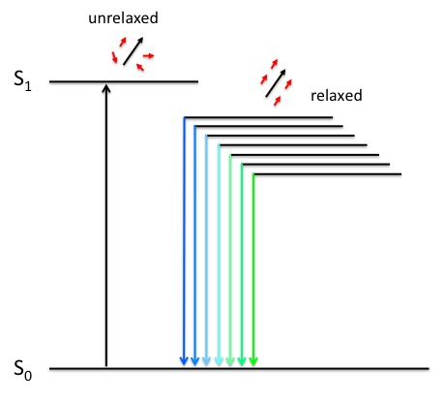
Generalized Polarization function (GP):
- Assumes 2 states (high and low water dipolar relaxation).
LAURDAN Generalized Polarization (GP)
1 > GP > -1
I_{B}
I_{R}
High GP
Low GP
I_{B}
I_{R}
unrelaxed
relaxed
Gel phase (35°C)
Fluid phase (50°C)
Wavelength (nm)

Slide 15
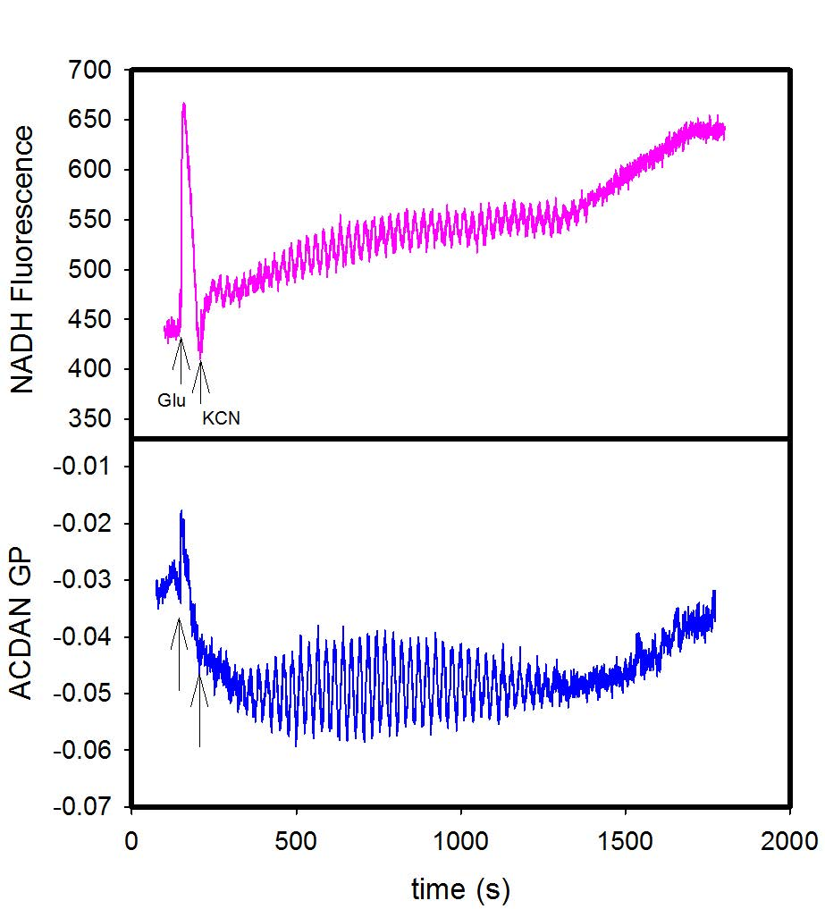
ACDAN GP oscillates in antiphase with NADH

Slide 16
ACDAN GP oscillates in phase with ATP

Slide 17
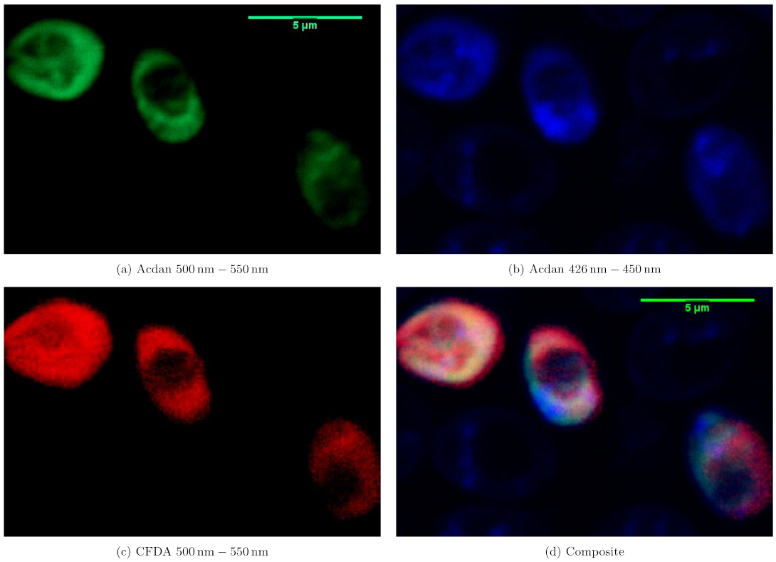
ACDAN co-localizes with CFDA, a probe used to measure cytoplasmic pH

Slide 18
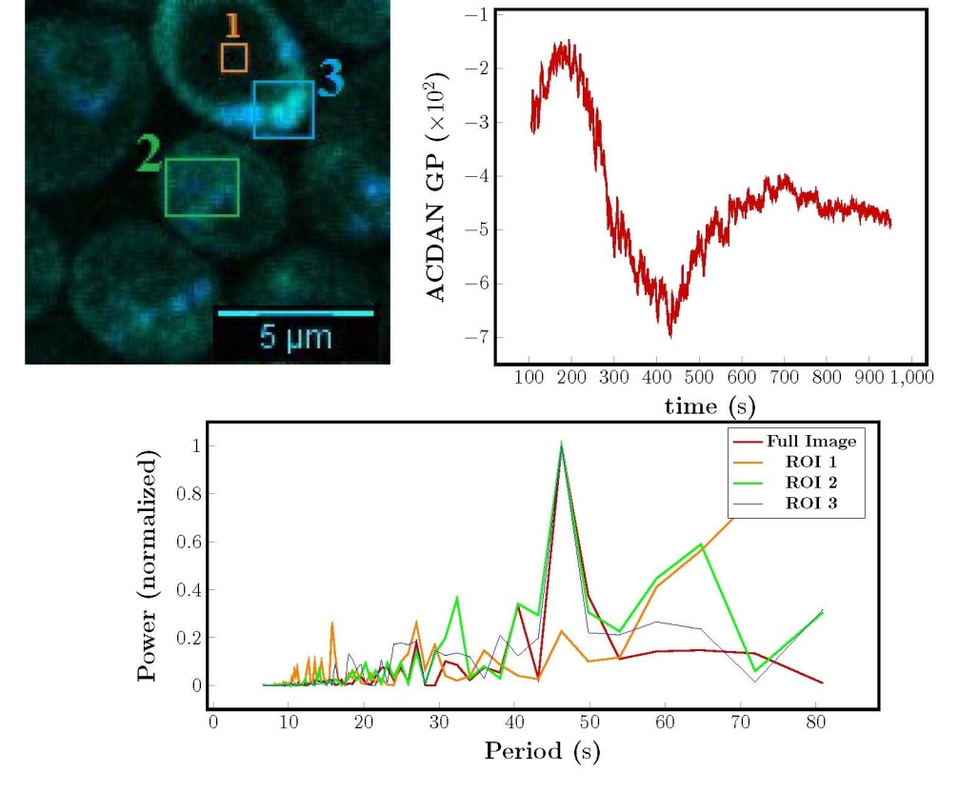

Slide 19
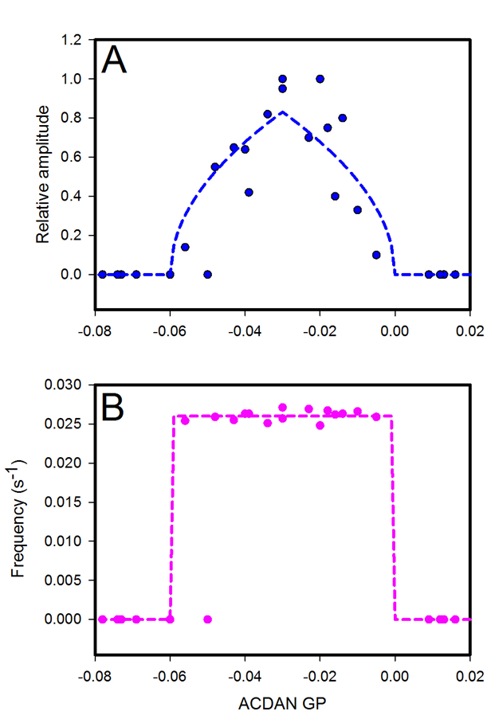
Null mutations affect oscillations
Supercritical Hopf
bifurcations
3 different
Strains with
Null mutations
Mutations are in genes coding for glycolytic enzymes, mitochondrial enzymes, ATPases
Actin polymerization, micotubule formation

Slide 20
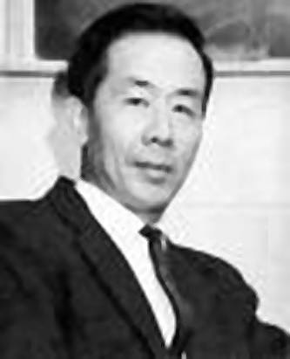
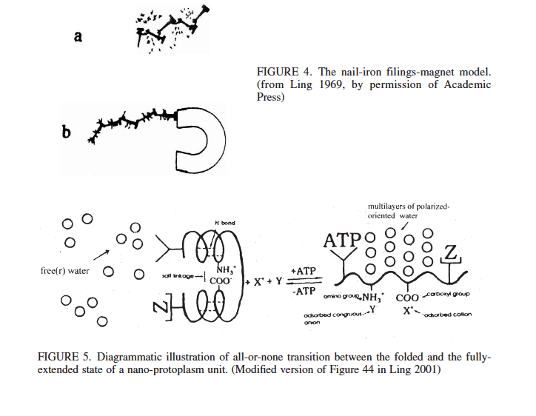
The work of Gilbert Ning Ling:
The Association-Induction hypothesis
G. Ling “Nano-protoplasm: the Ultimate Unit of Life” Physiol. Chem. Phys. & Med. NMR (2007) 39: 111–234
G. Ling “What Is Life Answered in Terms of Properties and Activities of Auto-cooperative Assemblies of Molecules, Atoms, Ions and Electrons Called Nano-protoplasm” Physiol. Chem. Phys. & Med. NMR (2012) 42: 1–64.

Slide 21
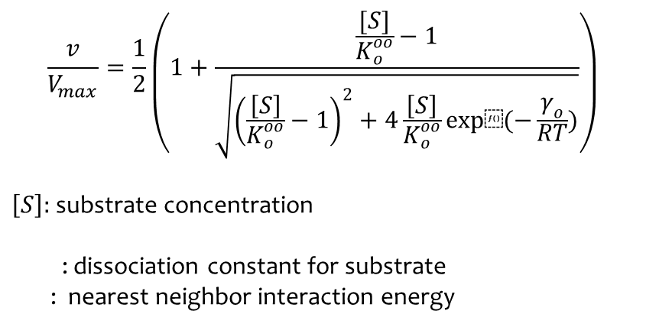
Yang-Ling isotherms
In the absence of cardinal adsorbents
$$\frac{v}{V_{max}}=\frac{1}{2}\left(1+\frac{\frac{[S]}{K_{o}^{oo}}−1}{\sqrt{{\left(\frac{\left[S\right]}{K_{o}^{oo}}−1\right)}^{2}+4\frac{\left[S\right]}{K_{o}^{oo}}exp⁡(−\frac{γ_{o}}{RT})}}\right)$$
$\left[S\right]:$ substrate concentration
: dissociation constant for substrate
: nearest neighbor interaction energy

Slide 22
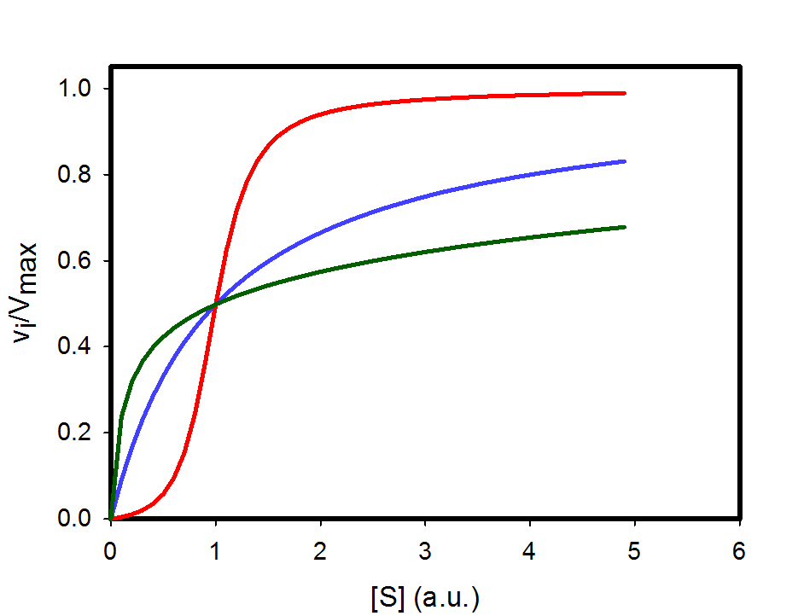
One theory can account for them all
Yang-Ling isotherm
Hyperbolic kinetics (blue)
Positive cooperativity (red)
Negative cooperativity (green)
Furthermore there is no requirements for no of subunits or srtuctural changes ( )

Slide 23
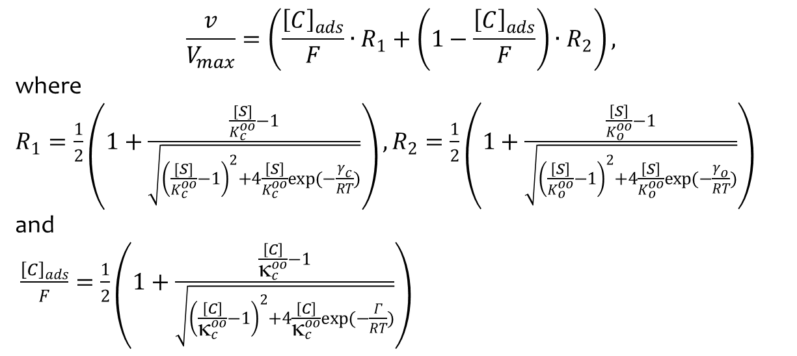
In the presence of cardinal adsorbents
$$\frac{v}{V_{max}}=\left(\frac{{\left[C\right]}_{ads}}{F}∙R_{1}+\left(1−\frac{{\left[C\right]}_{ads}}{F}\right)∙R_{2}\right),$$
where $R_{1}=\frac{1}{2}\left(1+\frac{\frac{[S]}{K_{c}^{oo}}−1}{\sqrt{{\left(\frac{[S]}{K_{c}^{oo}}−1\right)}^{2}+4\frac{\left[S\right]}{K_{c}^{oo}}exp(−\frac{γ_{c}}{RT})}}\right), R_{2}=\frac{1}{2}\left(1+\frac{\frac{\left[S\right]}{K_{o}^{oo}}−1}{\sqrt{{\left(\frac{\left[S\right]}{K_{o}^{oo}}−1\right)}^{2}+4\frac{\left[S\right]}{K_{o}^{oo}}exp(−\frac{γ_{o}}{RT})}}\right)$ and
$\frac{{\left[C\right]}_{ads}}{F}=\frac{1}{2}\left(1+\frac{\frac{\left[C\right]}{κ_{c}^{oo}}−1}{\sqrt{{\left(\frac{\left[C\right]}{κ_{c}^{oo}}−1\right)}^{2}+4\frac{\left[C\right]}{κ_{c}^{oo}}exp(−\frac{Γ}{RT})}}\right)$

Slide 24
In the presence of cardinal adsorent
+C

Slide 25
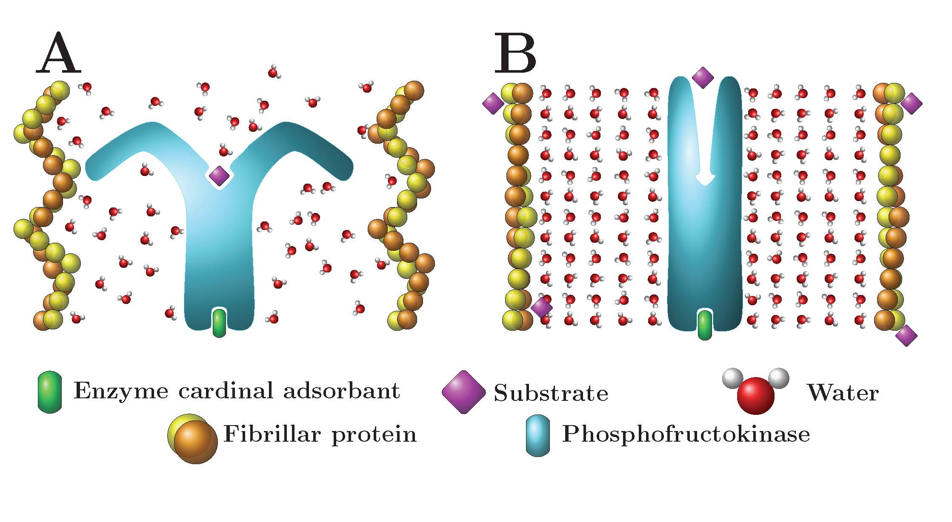
Regulation of PFK activity by the polarity of water
PFK
PFK
(ADP)
(ATP)

Slide 26
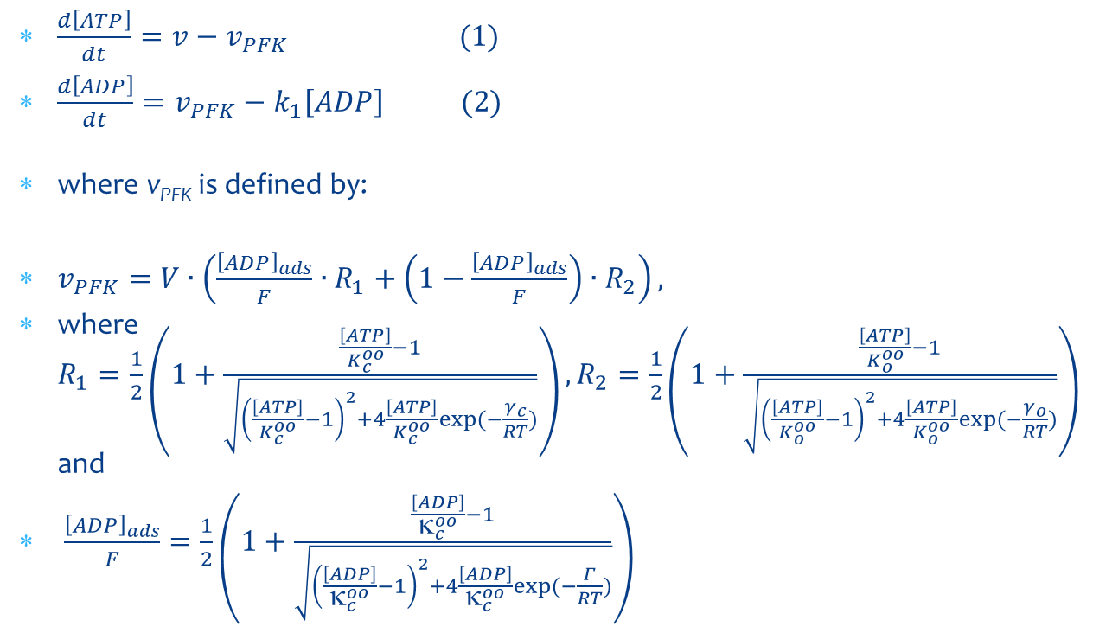
The Equations
$\frac{d\left[ATP\right]}{dt}=v−v_{PFK} (1)$
$\frac{d\left[ADP\right]}{dt}=v_{PFK}−k_{1}\left[ADP\right] (2)$
where v_{PFK} is defined by:
$v_{PFK}=V∙\left(\frac{{\left[ADP\right]}_{ads}}{F}∙R_{1}+\left(1−\frac{{\left[ADP\right]}_{ads}}{F}\right)∙R_{2}\right),$
where $R_{1}=\frac{1}{2}\left(1+\frac{\frac{\left[ATP\right]}{K_{c}^{oo}}−1}{\sqrt{{\left(\frac{\left[ATP\right]}{K_{c}^{oo}}−1\right)}^{2}+4\frac{\left[ATP\right]}{K_{c}^{oo}}exp⁡(−\frac{γ_{c}}{RT})}}\right), R_{2}=\frac{1}{2}\left(1+\frac{\frac{\left[ATP\right]}{K_{o}^{oo}}−1}{\sqrt{{\left(\frac{\left[ATP\right]}{K_{o}^{oo}}−1\right)}^{2}+4\frac{\left[ATP\right]}{K_{o}^{oo}}exp⁡(−\frac{γ_{o}}{RT})}}\right)$ and
$\frac{{\left[ADP\right]}_{ads}}{F}=\frac{1}{2}\left(1+\frac{\frac{\left[ADP\right]}{κ_{c}^{oo}}−1}{\sqrt{{\left(\frac{\left[ADP\right]}{κ_{c}^{oo}}−1\right)}^{2}+4\frac{\left[ADP\right]}{κ_{c}^{oo}}exp⁡(−\frac{Γ}{RT})}}\right)$

Slide 27
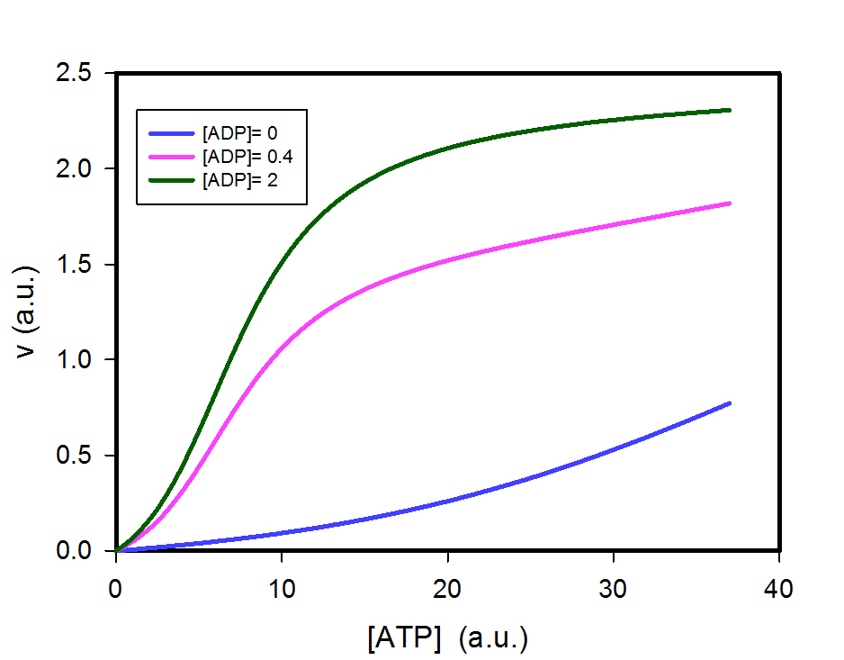
Effect of ADP on v_{PFK}
v_{PFK} (a.u.)

Slide 28
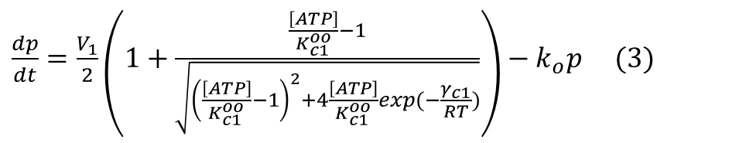
The equations continued
$\frac{dp}{dt}=\frac{V_{1}}{2}\left(1+\frac{\frac{\left[ATP\right]}{K_{c1}^{oo}}−1}{\sqrt{{\left(\frac{\left[ATP\right]}{K_{c1}^{oo}}−1\right)}^{2}+4\frac{\left[ATP\right]}{K_{c1}^{oo}}exp⁡(−\frac{γ_{c1}}{RT})}}\right)−k_{o}p (3)$

Slide 29
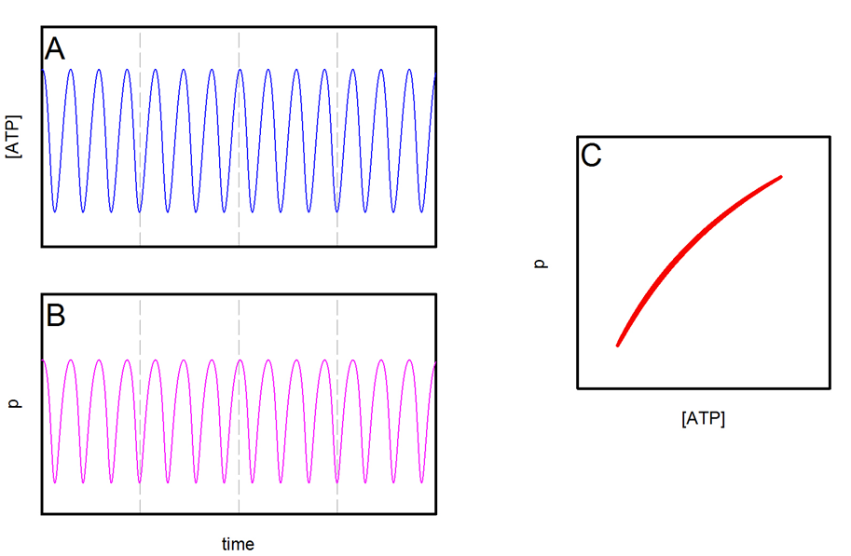
Simulations of model
Experimental phase plot

Slide 30
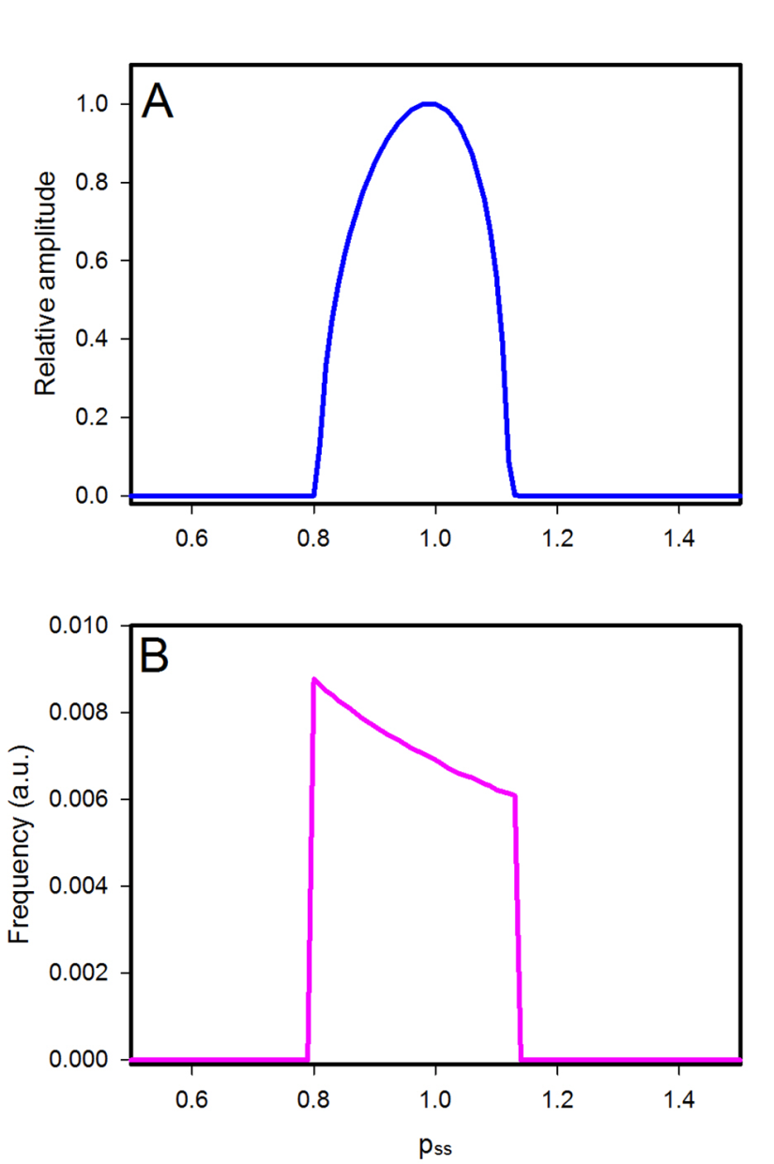

Simulations of Hopf bifurcations
Experimental data

Slide 31
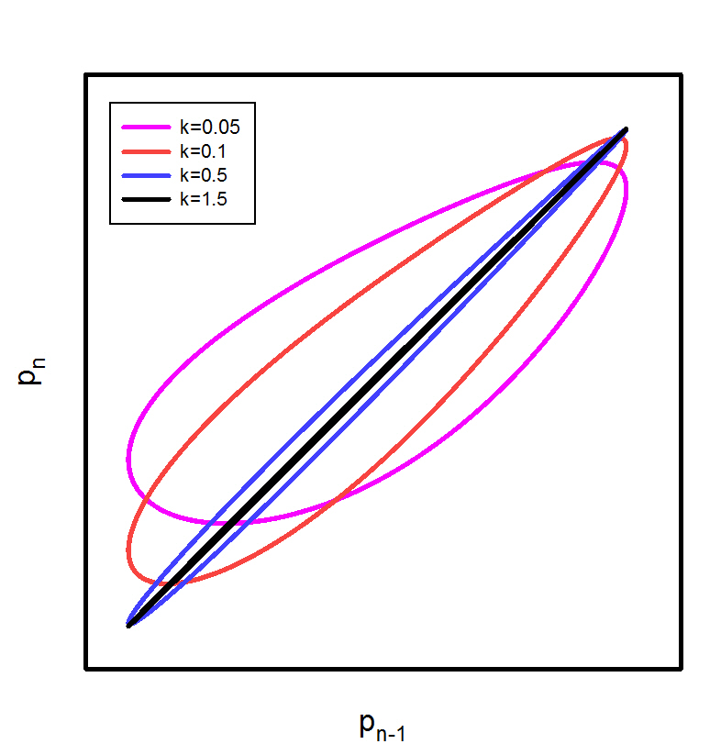
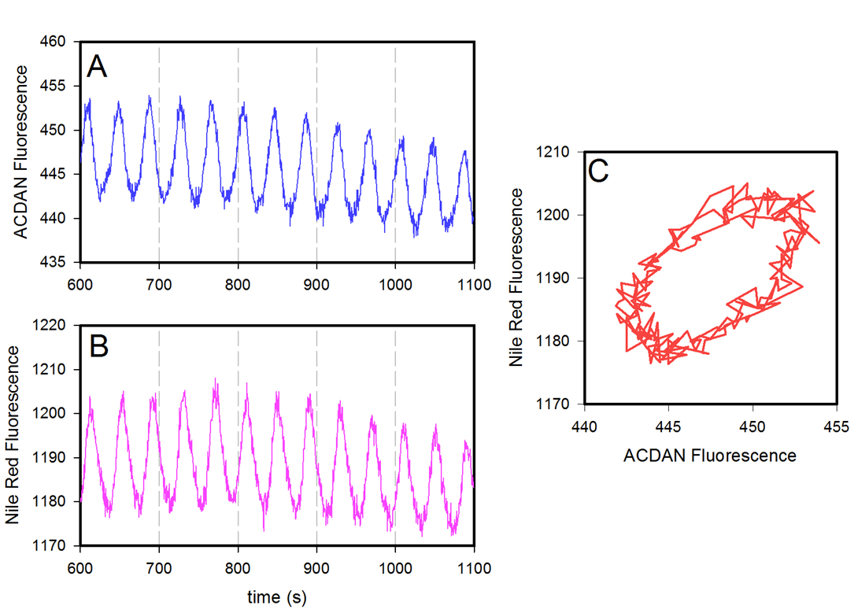
Polarity of water in one domain may couple to another domain
Nile Red is localized in hydrophobic domains where glycolysis is absent.

Slide 32
Detailed model of glycolysis

Slide 33
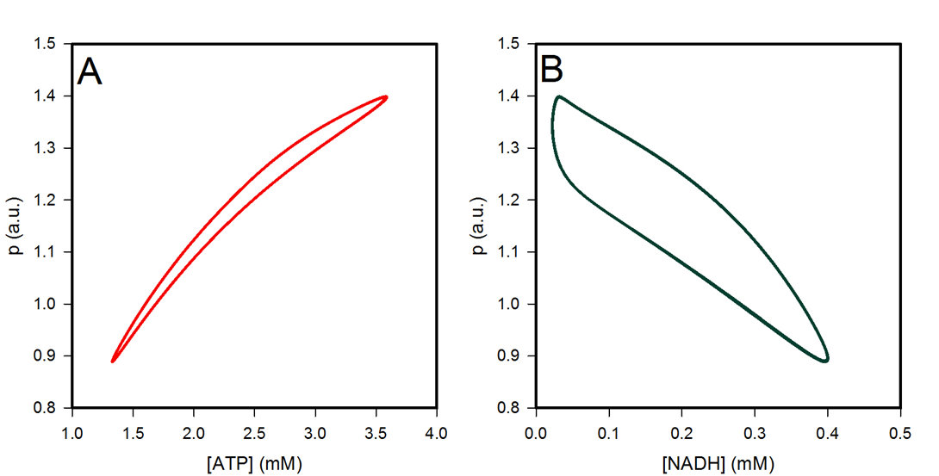
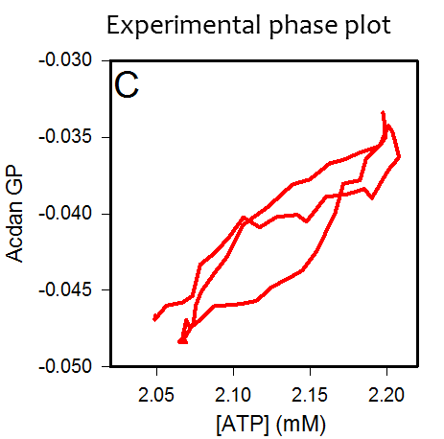
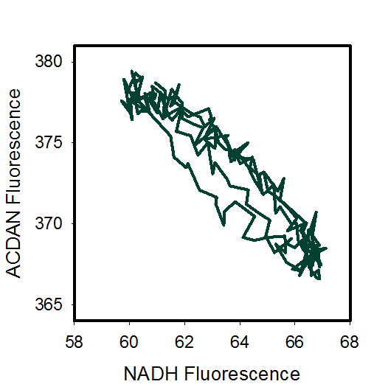
Simulations of detailed model

Slide 34
Conclusions:
Our results provide the first direct spatial and temporal evidence of the intracellular aqueous phase as a medium exhibiting fast and coherent coupling of an intensive (scale invariant) cellular property with metabolic processes.
As metabolism oscillates so do interfacial water dynamics; as D₂O makes the system "heavier", all oscillations are synchronously slowed down. The chemistry and physics of the system are thus bi-directionally coupled.
Considering that polymerization/depolymerization of cytoskeletal structures is strongly dependent on ATP and ATPase activity, it is reasonable to suppose that ATP acts on the overall state of the cytoskeleton and that this impacts dipolar relaxation of the aqueous phase, possibly due to changes in viscoelastic properties of the media.
- This experimental results are well in line with G. Ling association-induction hypothesis (G. Ling. 2007. “Nano-protoplasm: the Ultimate Unit of Life” Physiol. Chem. Phys. & Med. NMR,, 39: 111–234).

