Slide 1
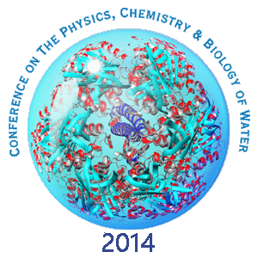
Droplet evaporation method as a potential scientific tool for the detection of supramolecular order in water
Igor Jerman, Petra Ratajc
Oct. 9 – 12
Institute Bion, Ljubljana, Slovenia, EU
Stream Bistritza, Borovetz
Lake Iskar
Bankia Mineral Water

Slide 2
Water science
Even though water is regarded as something long understood and explained by orthodox science – many open-minded researchers know that it still hides many mysteries (water clusters, coherent domains, exclusion zones, so-called memory,...).
Mostly, they can be tackled only by using less standard research methods.
Consequently, in order to combat the orthodox beliefs we should tackle water by new methods.
At first the methods could be clumsy and unreliable but could later become beacons of new scientific breakthroughs.

Slide 3
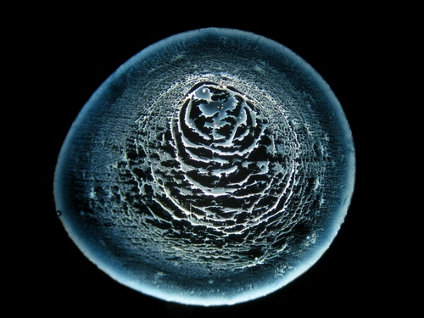
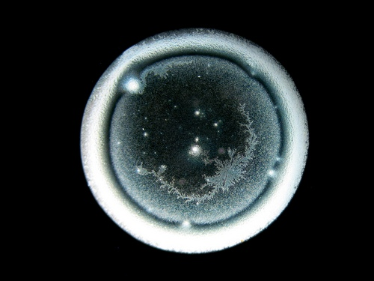
DEM method of water (liquid) research
One of such promising new methods is called droplet evaporation method (DEM).
It consists of monitoring dried water drops by dark field microscopy.
It was discovered in the previous century by Ruth Kübler, a German artist, and further developed by Bernd-Helmut Kröplin, Minnie Hein, Berthold Heusel M. A. and Georg Schröcker.

Slide 4
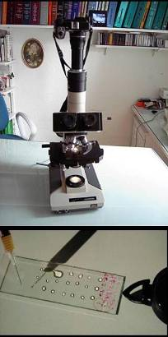
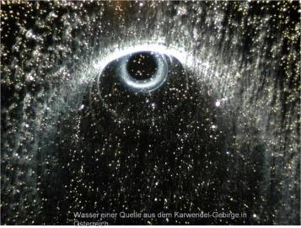
Beginnings...
Ruth Kübler, Berlin
(1925 – 2011)
„das Tropfen-Phänomen“, 1988

Slide 5
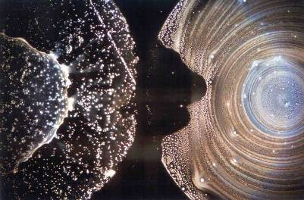
Beginnings...
Prof. Dr. Bernd Kröplin, Institut für Statik und Dynamik der Luft- und Raumfahrtkonstruktionen (ISD) , Stuttgart; 1994
http://www.weltimtropfen.de/

Slide 6
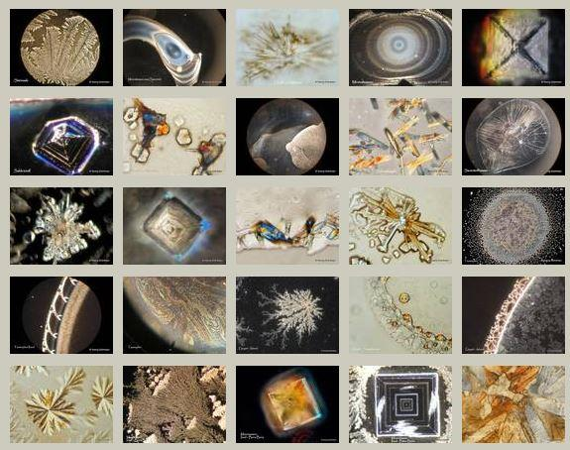
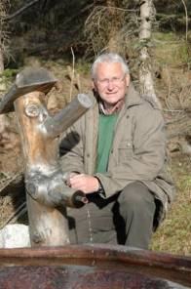
Beginnings...
Georg Schröcker, Salzburg
http://www.wasser-lebt.at/

Slide 7
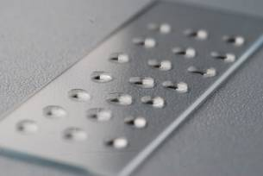
DEM basics
DEM
Strengths
Gives rich possibilities of scientific research.
Possibility of standardizing procedures.
Sensitivity to subtle differences in water.
Computer-based analysis.
Weaknesses
Sensitivity even to an experimenter (experimenter effect) => high variability of results => need for special care.
Only partial theoretical understanding of droplet residue formation => weak explanatory power.
No theoretical knowledge of relation between subtle physical conditions of water and droplet residue formations => weak explanatory or/and predictive power.

Slide 8
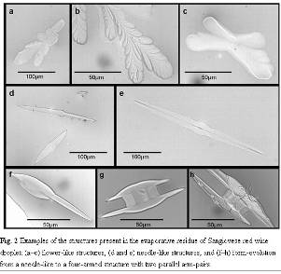
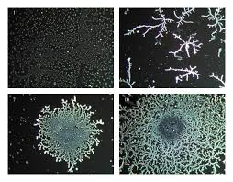
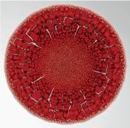
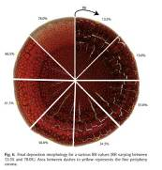
The areas of DEM usage
DEM basics
To monitor diseases via blood drops evaporation,
For salt-induced protein self-assembly research,
Food or beverages quality analysis,
For testing water quality or even type of origin,
For testing quality of seeds soaked in water,
To find out any form of supramolecular order (e.g. water memory) within water or water solutions,
For screening the so-called experimenter effect…

Slide 9
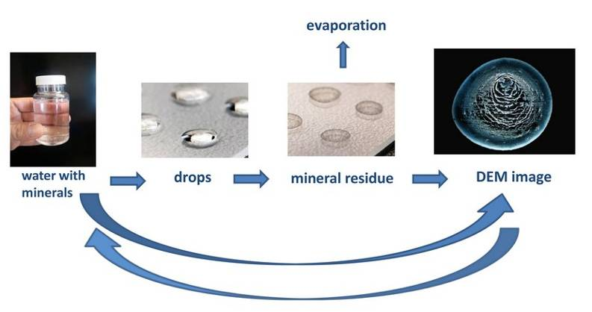
Scheme of DEM
DEM basics
The method consists of creating drops of different solutions on clean microscope slides and drying them under defined conditions. Dry residues are then observed under the microscope. Properly dried drops with no additional artifacts are photographed and analyzed by visual assessment or software.

Slide 10
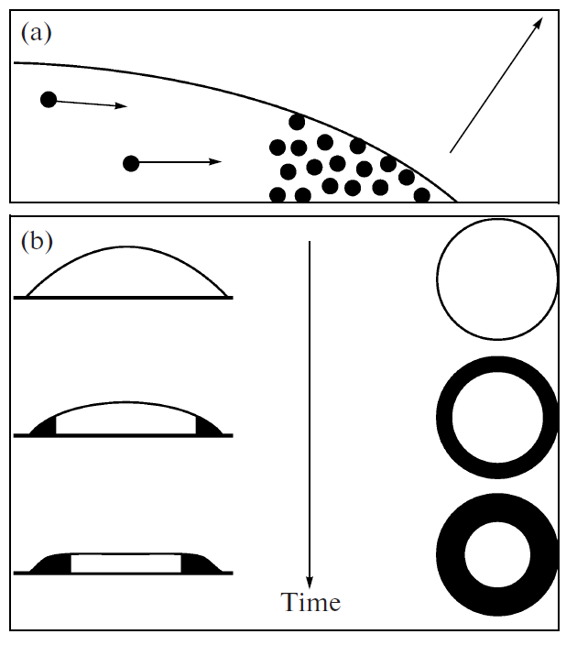
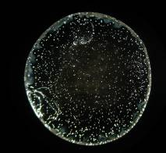
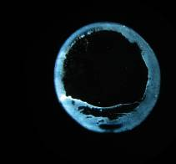
DEM basics
Proposed physical mechanism...
Formation of colloidal residues at the circumference of drying drops
colloidal particles are entrained towards the edge of the drop,
variations of the drop’s shape and formation of residues during drying.
From Yakhno et al. Structural Evolution of Drying Drops of Biological Fluids; Technical Physics 2009, 54(8): 1219-1227
tap water
(TDS: 320 ppm)
spring water
(TDS: 112 ppm)
a

Slide 11
DEM basics
Actual formation...

Slide 12
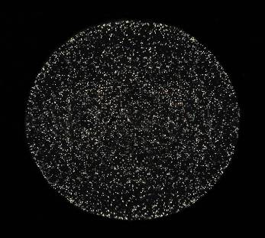
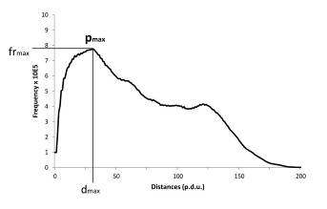
method
Our DEM research method
is based on
Specially developed algorithms used in visual evaluation of images or
Computer analysis of drop residues images,
Computes frequency distribution of distances among all illuminated pixels,
Has the (not yet standardized) unit of measurement) of unstructured droplet residues,
Produces frequency distribution graphs,
Enables statistical analysis of various parameters of DEM images.

Slide 13
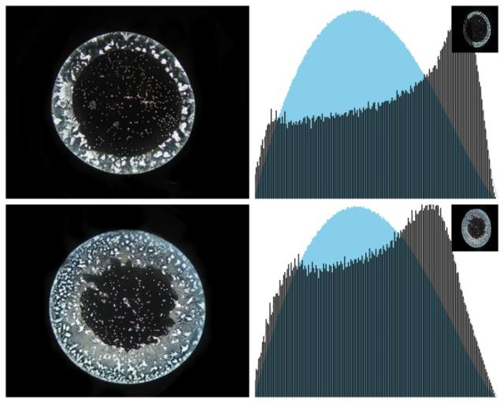
method
Various frequency distribution graphs
unit
ring-like structure
artrificial images
true images of ring-like droplet residues

Slide 14
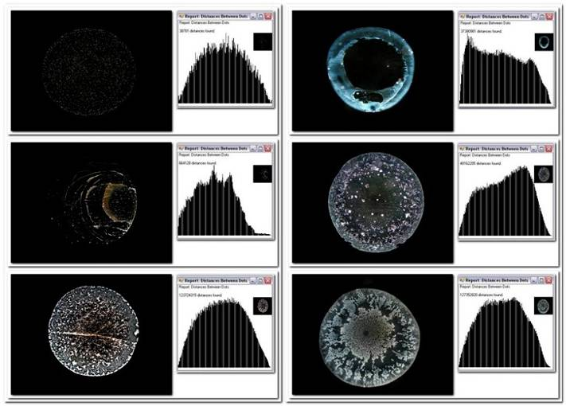
Title
method
Via a specific algorithm we can analyze textures of droplet residues and determine the value of various parameters, especially those of orderliness and complexity. At least for certain water samples and if water is manipulated under similar conditions, the results are reproducible to a certain extent.

Slide 15
method
“Spectral analysis” of droplet residues
similarity
Primerjave frekvenčnih porazdelitev razdalj med točkami pri posameznih tretmajih kapljic.
difference

Slide 16
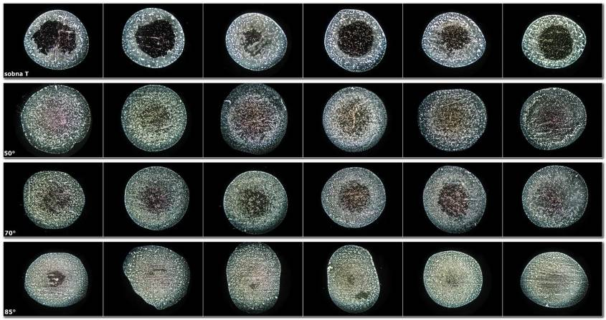
Research of temperature effect on mineral water
pilot research
room T
50°C
70°C
85°C
Mineral water with high total dissolved solids (TDS: 1580 ppm)
Temperature: room T, 50°, 70° and 85°C

Slide 17
Change of water => droplet residues under the influence of sound
pilot research
control
test
Observe the change of coloration.

Slide 18
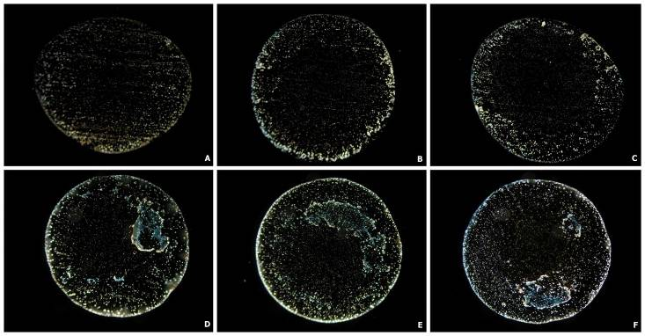
Change of water => droplet residues under the influence of orgone tube
pilot research
ABOVE: control (tap) water, BELOW: with orgone gun treated (tap) water
With orgone treated water we can clearly discern blue structures that are absent with ordinary tap water.

Slide 19
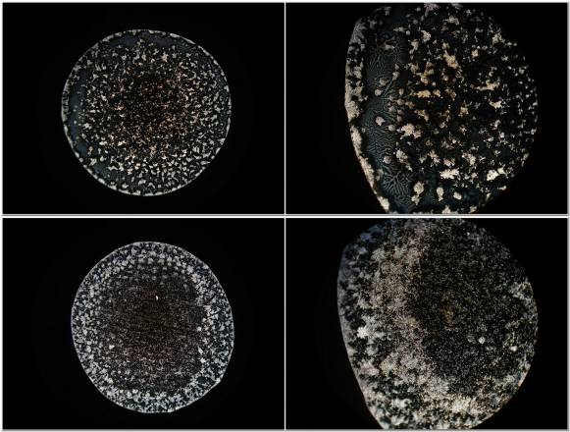
Change of water => droplet residues under the influence of informed salt
pilot research
control (typical image)
(entire drop – 40x; detail – 100x magnification)
test
(entire drop – 40x; detail – 100x magnification)
mineral water (TDS: 1580 ppm)

Slide 20
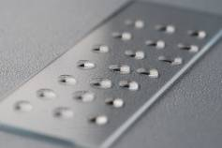
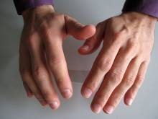
Experimenter effect (two researchers)
pilot research

Slide 21
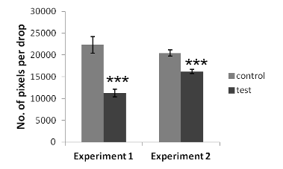
Spiritual healer 1
pilot research
Experiment 1:
control
test
Experiment 2:
control
test

Slide 22
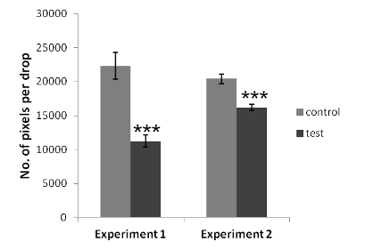
Spiritual healer 1
pilot research
Experiment 1:
Experiment 2:

Slide 23
Spiritual healer 2 - meditation
pilot research
ABOVE: control (mineral water with high TDS), BELOW: meditation

Slide 24
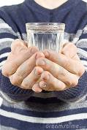
Spiritual healer 3
pilot research
ABOVE: control (mineral water with high TDS), BELOW: healer thought effect.
ABOVE: control (spring water with low TDS), BELOW: healer energy effect .

Slide 25
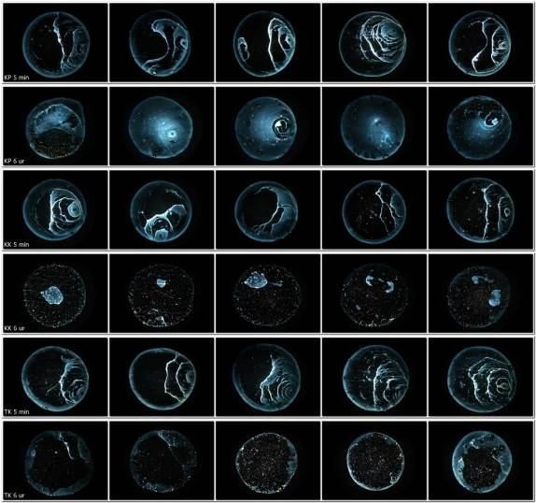
Crystal glass (vs. Duran glass beakers) subject to subtle physical (field) influence (spring water)
pilot research
5 min
Duran glass beakers
6 hours
5 min
control crystal glass
6 hours
5 min
influenced crystal glass
6 hours

Slide 26
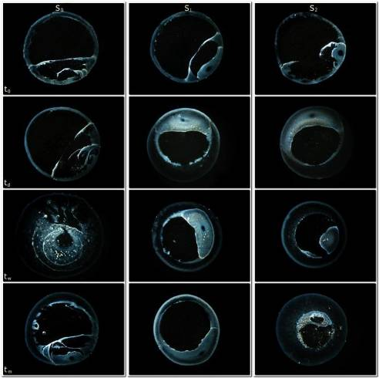
A Further Indication of Self-Ordering Capacity of Water Via Droplet Evaporation Method
systematic research
Time of incubation:
1 hour
1 day
1 week
1 month
Surface area:
small
medium
big

Slide 27
A Further Indication of Self-Ordering Capacity of Water Via Droplet Evaporation Method
systematic research
Linear regression analysis between two parameters (d_{max} and fr_{max})
at 1 hour, 1 day, 1 week and 1 month of incubation.

Slide 28
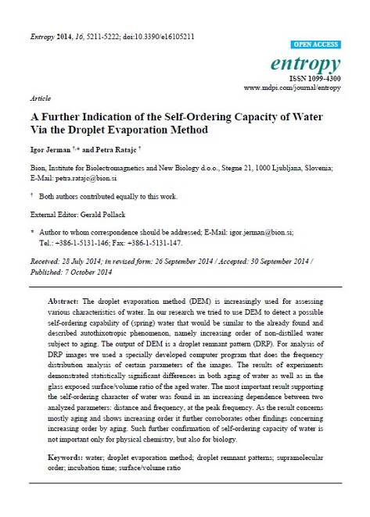
systematic research
Entropy 2014, 16, 5211-5222; doi:10.3390/e16105211
entropy ISSN 1099-4300
www.mdpi.com/journal/entropy
Article
A Further Indication of the Self-Ordering Capacity of Water Via the Droplet Evaporation Method
Igor Jerman* and Petra Ratajc
Published: 7 October 2014

Slide 29
Conclusion and future directions
conclusions
In spite of a weak explanatory power, DEM can demonstrate many unusual phenomena of water-stored influences, like:
Previous temperature exposure,
Effects of sound (memory effect),
Exposure to subtle, as yet physically unidentified physical radiation, like orgone,
Effect of humans: energy or/and thought
Experimenter effect,
Imprinting of water by so-called informed glass or salt…

Slide 30
Conclusion and future directions
conclusions
DEM can be used for deeper and thorough analyses of water orderliness.
It could reveal some further mysteries of water.
It should be
More standardized,
Subject to further systematic research to achieve a deeper and more comprehensive theoretical understanding of mechanisms,
Connected to other water research methods like conductivity measurements, NIR spectroscopy, DLS, …

Slide 31
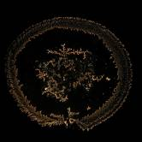
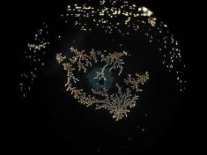
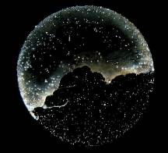
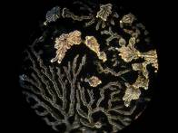
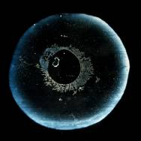
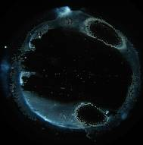
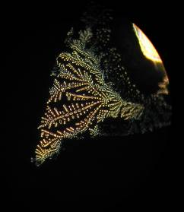
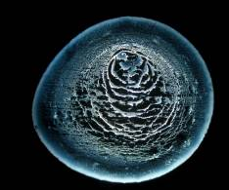
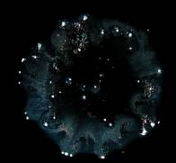
Thanks for your attention

