Slide 1
The Ills of Science Reflections on the Symptoms *Prescription for a Cure
*The Institute for Venture Science

Slide 2
Agenda
“Twilight of the Scientific Age”? Martin Lopez Corredoira
Is the chronic decline curable?
How can the Institute for Venture Science help bring the cure?
Current status of the IVS

Slide 3
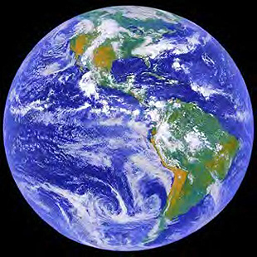
slide of earth
Notes:
You’re a scientist.
•You’ve discovered evidence that the earth is round []
Something like this — But everyone around you thinks the earth is flat.
• You expect that the world will welcome your stunning revelation…. but will it?
• If you look at recent history, you might find reason to be less than optimistic.
• Progress in science has certainly been impressive -- just read newspapers, scientific magazines. But ask yourself: how much of that progress is revolutionary? [ ]

Slide 4
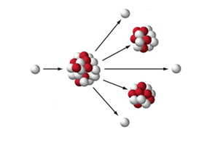
Revolutions since 1970?
Conceptual (not technological)
Realized (not promised)
How many can you name?
Notes:
Consider the number of revolutions, say, since 1970.
[ ] I’m talking: Conceptual (not technological --- like the cell phone, or the internet)
[ ] And I’m talking about realized revolutions, not “promises of revolution” like “new cancer drug promises therapeutic breakthrough”.
•I’m talking, for example about:
[ ] Ability to split the atom (70 years ago).
[ ] The structure of DNA, revealing the principles of genetics (60 years ago).
• Think about it: in the modern era – say, since 1970 -- how many CONCEPTUAL revolutions like those can you name, THAT HAVE ALREADY SUCCEEDED IN CHANGING THE WORLD? PAUSE [ ]

Slide 5
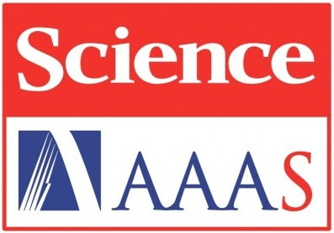
How many modern revolutions?
125th Anniversary Edition, 2005
Notes:
Editors of Science Magazine put their heads together to identify the most important revolutions
from the time of the Greeks until the time of publication.

Slide 6
1865-1905 1965-2005
Alfred Nobel
James Clerk Maxwell
Thomas Edison
Marie Curie
J. J. Thompson
Max Planck
Orville and Wilbur Wright
Albert Einstein
Hamilton Smith
Daniel Nathans
Kary Mullis
Seiji Ogawa
Andrew Wiles
Suo Guo
Ken Kemphues
Ian Wilmut
Notes:
We constructed two charts from that list:
• Discoveries in the 40-year period back from 2005; and the 40-year period back from 1905.
• We asked many scientists and non-scientists how many names they recognized.
Most people recognized all or most names on left, and many even knew what they achieved.
Few could identify even one name on right.
Left: fundamental discoveries: changed our lives. Right: mainly incremental or technical – nothing monumental.

Slide 7
Why challenge conventional thinking with revolutionary ideas?
Aren’t we making great progress?
We advance through revolutions
splitting of atom
antibiotics
double helix DNA
Revolutions now sparse – how many can you name?
Notes:
Plenty of incremental advances. Not many revolutionary breakthroughs
How many modern (past 40 years) revolutions can you name?
--- not TECHNOLOGICAL, but SCIENTIFIC
--- not PROMISED, but REALIZED (leave time to let them think)

Slide 8
Why Few Revolutions?
Revolutionary ideas challenge status quo
threaten stakeholders of prevailing paradigm threaten grant reviewers
therefore, revolutionary change suppressed
Notes:
If you propose *free* mineralized water cures cancer, drug companies will ensure you get nowhere.
If you propose round earth to flat-earth grant reviewer, you’ll get no research money.
Smart investigators avoid challenging the stakeholders of the status quo.
So revolutionary ideas rarely see the light of day.

Slide 9
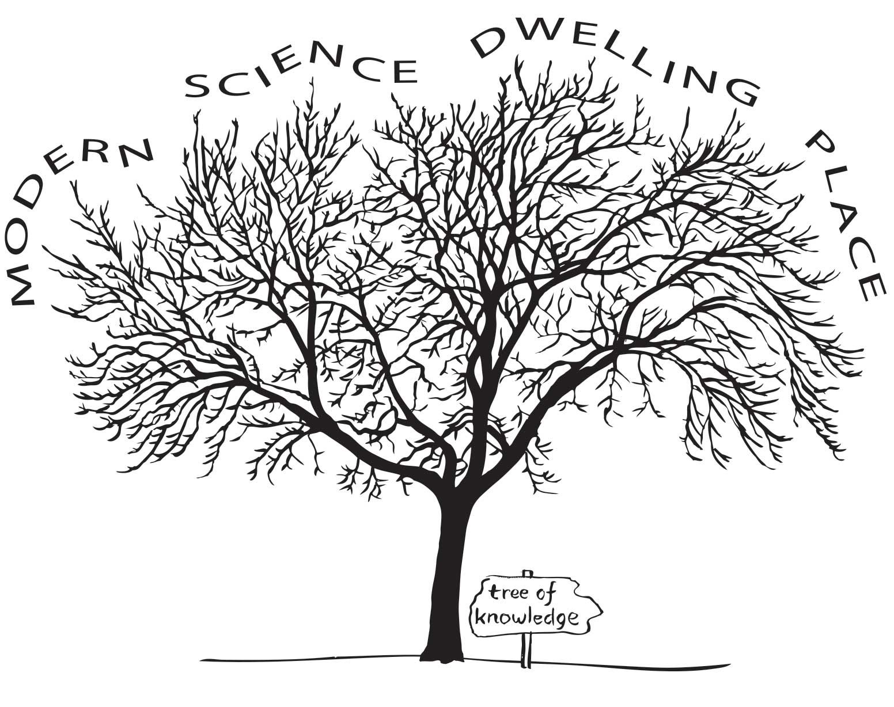
Safe
Non-disruptive
Notes:
No threat to main limbs, where stakeholders dwell.
Hoping for personal “success,” scientists strive to become world’s expert on some narrow, non-disruptive area. They get the funding, keep the laboratory engines humming, crank out results, get continued funding, etc. Rat race of productivity. Incremental gains.

Slide 10
Pruned limb?
Heliocentric solar system
Handwashing before surgery
Notes:
Revolution comes when someone detects problem in some critical limb: an observation that doesn’t fit.
EXAMPLES:
Earth-centric solar system became unwieldy. Heliocentric solar system of Galileo led to revolution.
2. Women often died of post-childbirth infection. Semmelweis discovered that women would do fine if examining physicians washed their hands before conducting internal exams: a revolution in medical care.

Slide 11
revolutionary advance
Notes:
The new growth can produce something more fruitful and enduring. Those are the breakthroughs, the revolutions.
Current “safe” science = no new growth.
Scientists and administrators know the problem: too much incentive to build at the periphery; not enough incentive to build major new green limbs.
Everyone wants to repair the system.
But bureaucracies move slowly.

Slide 12
Fresh perspective: Different reality
Notes:
(After explaining the animation, you can reinforce by mentioning the round earth example. Something like:
It’s like the round Earth: from a local perspective, the Earth surely seems flat; but when seen from a satellite, it’s surely round.
Fresh perspectives can bring new realities. We need to allow room for those fresh perspectives. Some of them will bring the badly needed revolutions.

Slide 13
$$$$$$$$$$$ → Few Revolutions
$ 0 → Numerous Revolutions
Why?
Are scientists stupider?
Are the problems harder?
Is everything already known??
Notes:
Here’s the paradox: Trillions spent on science during past 40 years – FAR more than spent throughout all of history. But we’ve seen few revolutions.
• Compare this to a century ago: [ ]
[ ] Little institutional support of science. Numerous revolutions. [ ]
[ ] Why the difference?
[ ] Are scientists stupider now? -- I hope not!
Are the problems harder? – That’s a convenient excuse but I know of no evidence.
Is everything already known? -- If so, then why haven’t we been able to solve our numerous societal problems? [ ]

Slide 14
$$$$$$$$$$$ → Few Revolutions
$ 0 → Numerous Revolutions
Why?
The culture of science today
Power of “experts” and vested interests
Notes:
I think the reason lies in the culture of science today — the way we do science [ ]
[ ] We put our stock in the opinions of professional “experts.” Expert” opinion has become so powerful, so dominant, that any challenge gets reflexively dismissed: Don’t disturb our important progress with your crazy ideas.
• We treat challengers with scorn and disdain [ ]

Slide 15
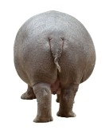
Scorn and disdain
Notes:
[ ] No way; [ ] you’re proposing WHAT? [ ]Yuk!
• It’s hard for us to entertain the possibility of a new reality.
• But that’s how science works. When Einstein first proposed relativity, physicists hammered him for years. The same with Galileo: When he advocated a sun-centered universe, he got into serious shit.
• Those are crazy ideas turned received wisdom (for most). But almost always they are first welcomed as you see in the slide [ ] PAUSE

Slide 16
Plenty of round-earth ideas out there
“If the idea is any good, it would have been discovered earlier”
Notes:
Round-earth ideas are not in short supply. I know dozens, in fields ranging from the origin of life to the origin of death, from what happens in the depths of the sea to the far reaches of the cosmos. Many are supported from surprisingly extensive experimental evidence.
• But the USUAL response goes something like this: [ ]
[ ] well, if the idea is really any good, it would have been discovered earlier, and by now everyone would surely know about it. So, your idea must be worthless junk. Case closed! Stop bothering me with nonsense.
• Let me just give a couple of examples of some current round earth ideas.[ ]

Slide 17
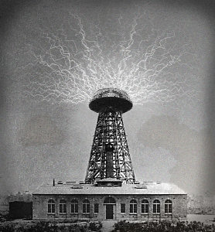
1. Energy
Notes:
Energy. Everyone is looking for renewable energy sources. [ ]
[ ]Tesla showed long ago that electrical energy in the atmosphere could be harvested for practical use.

Slide 18
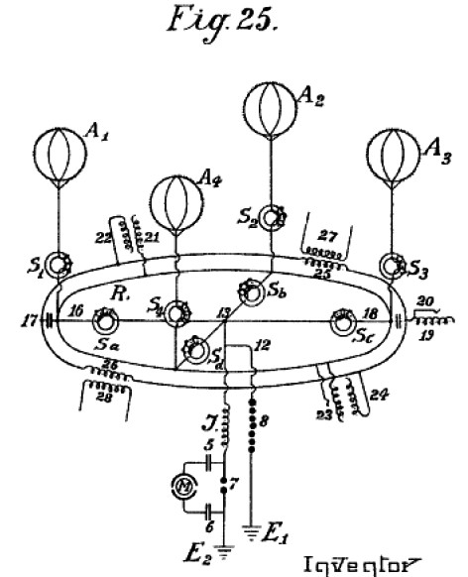
balloon
motor
Hermann Plauson, 1925
Notes:
Here’s one realization: -- a patent dated 1925, showing how you can tap that energy: A series of balloons suspended high up, holding up a circular metal ring. Attach one electrode to the ring, and another to the earth. The huge potential difference can run a motor.
• Modern versions demonstrate a lot of energy — basically free for the taking.
• So the energy is clearly present and harvestable, but we really don’t understand WHY that energy is there to begin with — a SCIENTIFIC question, whose answer could lead to important practical outcome. [ ]

Slide 19
Notes:
OMIT?Here’s another energy machine that works on electricity: the lifter.
• Power supply 10 KV. Negative pole to bottom aluminum foil with very thin wire. Positive pole to the top wire,
[ ] Turn on. Lifts off – with no moving parts!!
• We even have one in our laboratory – rises about one meter. Other designs, which you can see on the web, rise to the ceiling.
Nobody REALLY understands the underlying principle. Imagine if we understood the principle, and could go on to develop scaled up versions.

Slide 20
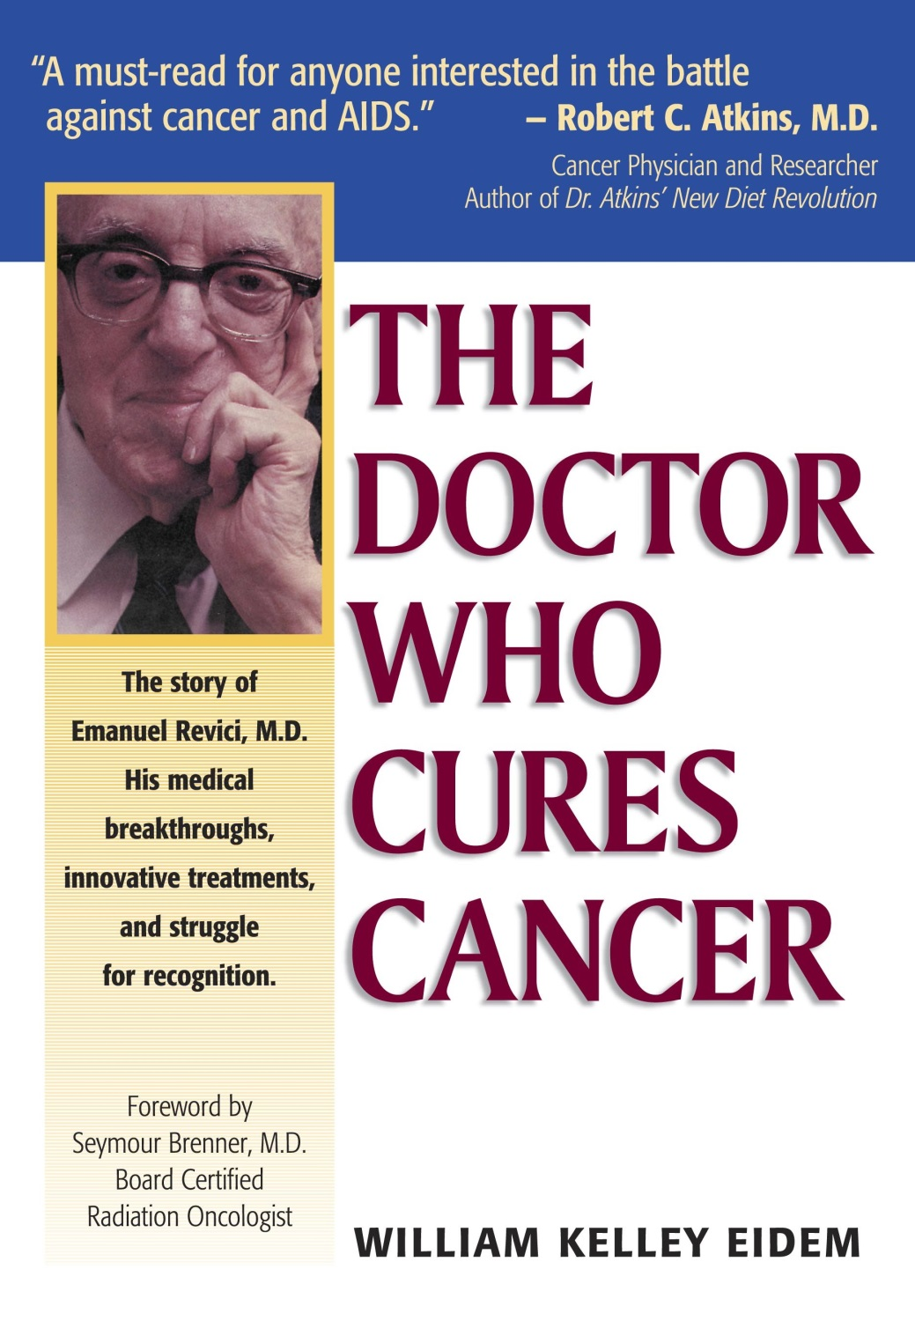
2. Health
Arie Horowitz <arie2006@gmail.com>
“I don’t know how he [Revici] does it, but people walk in dead and walk out alive.”
Notes:
A second critical issue… Health. Let’s consider cancer. [ ]
[ ] You’ve probably never heard of this book – about the late Dr. Emanuel Revici. His approach centers on forcing fluid-pH values, changed in cancer, back to normal, and thereby eradicating tumors.
• The book describes how Revici developed this technique and how successful it’s proven to be.
• We might not trust the evidence presented in the book, but an important testimonial lends some measure of credibility: [ ] [READ IT]
• This comes from John Heller, the former head of the famous Sloan-Kettering Cancer Institute.
• You’d think this approach might warrant some serious testing, but there are no clinical trials.
• In fact, doctors touting any kind of “alternative” approach are labeled charlatans, to be prosecuted to the fullest extent of the law. That happened to Revici. And it continues to happen to others.
• The prevailing mantra: alternatives must be worthless – otherwise they would already be in full use in every clinic.
• But…without systematic testing, how can we be sure? [give time to think] [ ]
+ Bill Bengston

Slide 21
Problems remain unsolved
Getting energy
Curing cancer
Understanding brain function and dysfunction
Combatting global warming
Wiping out the AIDS epidemic
Eliminating starvaton
Etc.
Notes:
So, two of our most pressing problems remain unsolved: [ ] getting the energy we need [ ] and curing cancer. And more…(list} [ ], [ ]…
• These problems have resisted solution for decades. Yet, we routinely reject the out-of-the-box ideas that might just lead to solutions. PAUSE [ ]

Slide 22
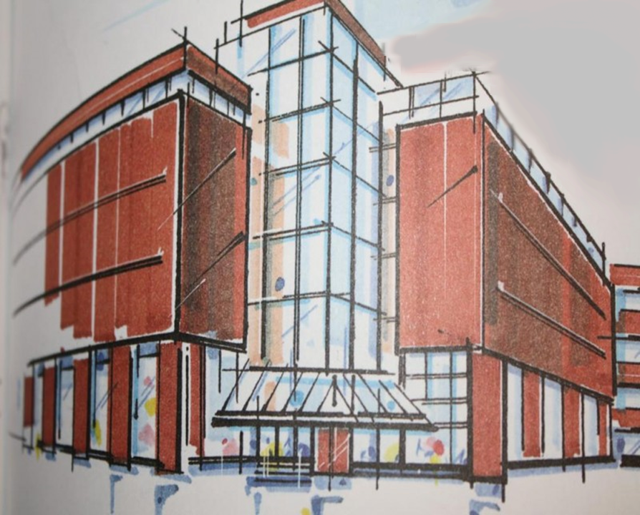
The Institute for Venture Science (IVS)
Notes:
A Foundation devoted to revitalizing science: [ ] We call it (IVS) [ ]
[ ] – not here yet, but hopefully coming soon….
• The IVS is a foundation that funds grants. It identifies the most promising new ideas that have potential to turn previous understanding upside down. It provides the wherewithal for scientists to pursue those revolutionary ideas.
• But the feature that makes it uniquely different is this: It funds not just a single scientist or group, but a dozen groups worldwide pursuing the same idea. It sets up a critical mass of effort.

Slide 23
How will IVS foster revolutionary advance?
Groundbreaking proposals
Scathing critique from field’s leaders
Evaluators from outside field
Fund selected proposals liberally
Fund multiple groups on same theme
A dozen groups can’t be ignored
Notes:
End with: Sound ideas will prevail; revolutionary advance
That’s why it’s VENTURE science.

Slide 24
slide of earth
Notes:
• So, if there’s promising evidence that the earth might be round when everyone presumes it’s flat, it’s not just one group isolated out there, but a dozen groups []

Slide 25
slide of earth
Notes:
each one testing with an independent method to see if the earth is really round.
• It’s easy to dismiss one round-earth scientist as a nutcake, but a dozen scientists at the annual meeting of the “shape of the earth” society presenting evidence, can’t be so easily dismissed.
• So round earth and flat earth ideas begin competing equally, on the same podium.
• If the evidence fits round earth better, then everyone who counts will know: a revolution will quickly follow, and we can go on to build on that round earth concept instead of continuing to insist that the earth is flat. If flat earth fits the evidence better, then, the flat-earth paradigm will be strengthened -- and that’s not bad. Either way, the investment pays off. PAUSE
• How does the IVS accomplish all this? [ ]

Slide 26
IVS Funding Goal
$10 billion endowment
$ 0.5 billion per year interest
Funds 50 ideas (x 10 labs) simultaneously
<1% of US annual research budget
multiple revolutions
Notes:
To get this foundation off the ground, we need funding. [ ]
[ ] Looking for a $10 billion endowment.
[ ] Use the interest each year – say $0.5 billion — to fund the research.
[ ] Could simultaneously fund 50 revolutionary ideas – a number that seems reasonable based on the several dozen meaningful challenges I know, and the many more challenges in the diverse fields I don’t know.
• $ 0.5 billion per year sounds like a lot, but [ ]
Less than 1% of the US annual science budget!
For this, we get 5 revolutions (I think more), which will revitalize the world — in ways we can’t possibly imagine. [ ]

Slide 27
Future
New Solutions
Future
Fresh
Insights
Economic Revitalization
Revolutions
New
Technologies
Revolutions

Slide 28
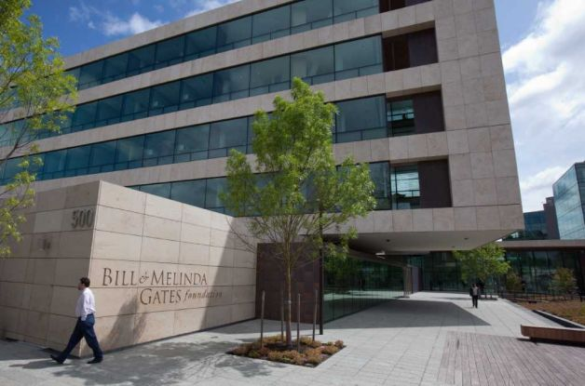
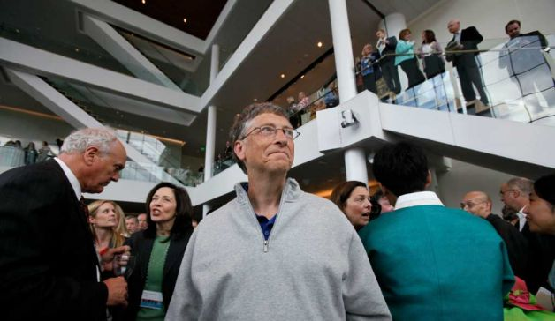
Attracting donors
Notes:
It’s something like creating the Bill and Melinda Gates Foundation. Gates will probably be remembered less for creating his Microsoft fortune, than for creating this enduring gift to humanity.
• To get the ball rolling, we need $50 million – for setting up a staff, moving into a physical facility, and beginning to solicit and fund some proposals. As the Institute ramps up, more and more of that $10 billion will be needed – the full amount probably within three years.
• We have excellent leadership, a detailed operative plan, and a gangbusters idea designed to succeed to impact the world. We just need a startup commitment to move to the next step. [ ]

Slide 29
Investment Amplification
Solar Cells
Computers
Smart Phones
Digital Cameras
Microprocessors
Photodiodes
Integrated circuits
Diodes, Transistors
Discovery of Semiconductor Materials
Notes:
Magnify impact of your investment a thousand-fold, in the same way as:
Discovery of penicillin started the pharmaceutical industry
Discovery of microwave amplification started the laser optics industry

Slide 30
Numerous multi-billionaires
Many signed the “giving pledge”
Many want to give back to society
Many want to leave a legacy

Slide 31
The [your name here]
Institute for Venture Science
Notes:
Creating The Institute for Venture Science
for the future of humanity.

Slide 32
Why can we make it happen?
Advisory Panel: World-class experience
Michael Crosby - Executive Director, National Science Board
Peter Katona – President, Whitaker Foundation
Jon Strauss – CFO, Howard Hughes Medical Institute; President, four universities
Alexander Konovalov – Rector, Kazan University, Russia
Barry Marshall – Nobel laureate
Kary Mullis – Nobel laureate
Stane Pejovnik – Rector, Ljubliana University
Douglas Randall – Member, National Science Board
Don Miller – Chief, Cardiovascular Surgery, University of Washington
Executive staff: Commitment; complementary skills
James Ryder - VP Lockheed Martin
Frank Costanzo - Senior level political advisor
Susan Schirott - HMO Executive
Gerald Pollack - Professor, University of Washington (Executive Director)
Notes:
Omit us?

Slide 33
Unthinkable ideas today Received wisdom tomorrow
The Institute for Venture Science …
Notes:
Unique program
Potentially high impact
Opportunity for pioneering support and meaningful legacy

Slide 34
Website www.theinstituteforventurescience.org

