Slide 1

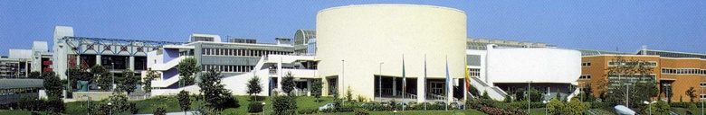
Iterative Procedures to Highlight the Formation of Molecular Aggregates of Water Molecules in Pure Perturbed Water
Department of
Chemical Sciences
Campus of Monte Sant’Angelo
Naples, Italy
V. Elia, E. Napoli
Notes:
1
Let me thank Prof. Pollack for kindly inviting us at this eleventh Water Conference. But above all I have to thank him for the astonishing discovery of the Exclusion Zone, which gave our group the input to continue our studies. And to sail in practically still uncharted seas. We enjoyed it so much and we still do.

Slide 2
“If we knew what it was we were doing, it would not be called research,
would it?”
A. Einstein
Notes:
Let me cite some notable thinkers facing some new and yet unknown phenomena. I think we are living such an exciting adventure!

Slide 3
When a thing was new people said:
"It is not true."
Later, when its truth became obvious, people said:
"Anyway, it is not important,"
and when its importance could not be denied, people said:
"Anyway, it is not new."
William James

Slide 4
Title: "Chiral micron-sized H2O aggregates in water: Circular dichroism of supramolecular H2O architectures created by perturbing pure water"
Tracking #: 2016-07808
Authors: Elia et al.
Dear Dr. Elia,
I regret to inform you that the PNAS Editorial Board has declined your manuscript [MS# 2016-07808] for further consideration. We receive many more good papers than we can publish and the Board must carefully weigh which papers merit external review. The expert who served as editor concluded that while interesting, your paper lacked the broad appeal necessary for further consideration by the journal.
Thank you for submitting your manuscript to PNAS. I am sorry we cannot be more encouraging this time, and I hope that you will consider submitting future work to PNAS.
Sincerely yours,
Inder M. Verma
Editor-in-Chief
****************************
Please note that the PNAS License to Publish conveyed at initial submission is terminated.
Overall Rating: Reject with no chance for re-submission
Editor Comments:
The interpretation of the experiments as evidencing pre-existing aggregates in the liquid is inconsistent with the known physics of liquid water. The assumption that the freeze-dried residue consists of those aggregates is unsupported.
Notes:
Here I report the refusal letter by PNAS, a prestigious scientific journal (Impact factor = 9). The Editor comments in red is a clear example of how the «pathologic skepticism» still plays an important role within the international scientific community. The rejected manuscript even contained the photographs of the aggregates, obtained by fluorescence microscopy, which we will show in one of the next slides! The sample was analyzed using the most advanced analytical techniques and no substance other than the solvent was detected. This answer is of the kind: “It is not true”

Slide 5
15th July 2015
Dear Professor Elia,
Thank you for submitting your manuscript "Chiral Water - Circular Dichroism of Perturbed Pure Water" for our consideration. But now that we have had a chance to carefully consider the work, we find that we are unable to publish it in Nature.
As you may know, we decline a substantial proportion of manuscripts without sending them to referees, so that they may be sent elsewhere without delay. In such cases, even if referees were to certify the manuscript as technically correct, we do not believe that it represents a development of sufficient scientific impact to warrant publication in Nature. These editorial judgements are based on such considerations as the degree of advance provided, the breadth of potential interest to researchers and timeliness.
And in this case, we do not feel that your paper has matched our criteria for further consideration and therefore feel that it would find a more suitable outlet in another journal.
I am sorry that we cannot respond more positively on this occasion, but hope that you will rapidly receive a more favourable response elsewhere.
Best wishes,
Magdalena Helmer
Dr Magdalena Helmer
Senior Editor
Nature
4 Crinan St
London, NI 9XW, UK
www.nature.com/nature
Notes:
Here we see the opinion of the Editorial Board of the journal Nature, which proves to be completely close-minded regarding scientific innovation, even when supported by unequivocal experimental evidence. This answer is of the kind: “Anyways, It is not Important”

Slide 6
Paraphrasing the statement of Galileo Galilei ..
«And yet it moves!»
one might say:
«And yet it aggregates!»
Notes:
I hope you will excuse the disrespectful comparison but..

Slide 7
Iterative Procedures to Highlight the Formation of Molecular Aggregates of Water Molecules in Pure Perturbed Water
We studied the effect of natural hydrophilic polymers, cellulose derivatives, or synthetic ones such as Nafion, on water. The procedure consists of immerging this material in water for several minutes, then extracting it and drying it at room conditions. We iterate the two steps several tens of times.
The iterative procedure of drying and rehydrating produces large variations of the electrical specific conductivity χ and of pH.
Notes:
Now let’s start talking about our iterative procedures. In the next slides we will show how the iteration of the simple drying and rehydrating of Nafion or Cellulose modifies the physico-chemical properties of water, such as pH and conductivity, in a substantial way.

Slide 8
Methods
The perturbed water was obtained using these different protocols:
EDS (Extremely Diluted Solutions). Obtained through an iterative process of successive dilutions and agitations.
IFW (Iteratively Filtered Water). Obtained through an iterative process of successive filtrations through sintered glass filters.
INW (Iteratively Nafionized Water) &
ICW (Iteratively Cellulosized Water).
Obtained through an iterative process of successive drying and wetting of the Nafion or Cellulose polymers.
Notes:
This presentation will illustrate three different iterative methods to “perturb” water. All the methods produce very similar systems with quite peculiar properties.
The first method is the classical one employed by Homoeopathic Medicine, which produces extremely diluted solutions (EDS).
The second method (IFW) was first introduced in our lab. It produces solutions with physical-chemical properties similar to those of EDS.
The third method exploits the Exclusion Zone discovered by Gerald (INW and ICW).
Hahnemann was the first who discovered the iterative procedure. In fact, the protocol for preparing the EDS (Extremely Diluted Solutions) of Homeopathic Medicine consists in a double iterative procedure of dilution and violent agitation (succussion). Probably Hahnemann’s method is the first one to use the iterative procedure to perturb water.
We added at least two new iterative procedures to perturb pure water: IFW and INW (or ICW).
And now we will present the results obtained using Hydrophilic Cotton.

Slide 9
The Effect of Nafion(INW) and Hydrophilic Cotton(ICW HC)
on the
Sovramolecular Structure
of Water
Notes:
Nafion membranes with a surface of 60-120 square centimeters were placed in a Petri capsule of polystyrene, in contact with 10-50 ml of pure water.
Manual agitation is performed repeatedly, so that the liquid laps against the membrane.
The membrane is then removed from contact with the liquid, and we follow the evolution of electrical conductivity, which systematically increases.
The membrane is then dried and put back into the INW, so that we can iterate the process of drying and rehydrating.
In the case of Hydrophilic Cotton we used a chunk of similar size to the Nafion one.
The manual procedure consists in dipping the piece of cotton in water and then removing it from the liquid and squeezing it.
The cotton is then left to dry at room temperature and put back in the ICW, so that we can iterate the process of drying and rehydrating.
In the next slides we’ll briefly illustrate again the phenomenology obtained when using Nafion, in order to show similarities and peculiarities in the results.

Slide 10
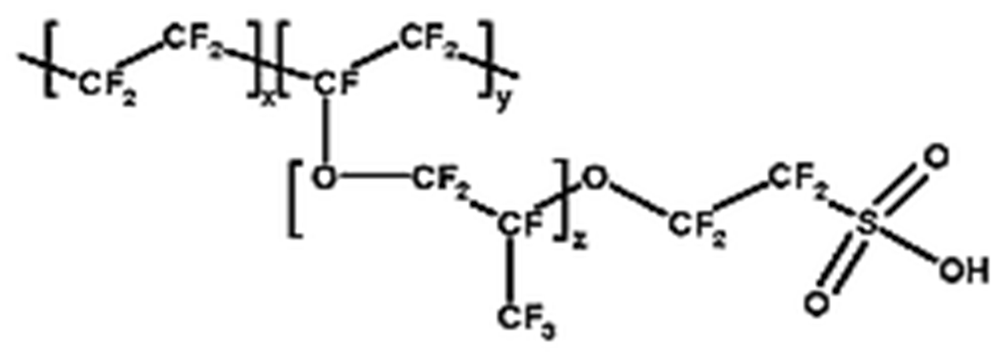
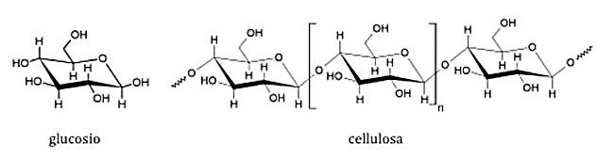
Nafion
Glucose
Cellulose
Notes:
As many of you know Nafion is a tetrafluoroethilene polymer with side chains bearing sulfonic groups. The hydrophilic group.
In the ICW technique we employ stock Hydrophilic Cotton, the one for sanitary use, declared by the producer company as: extra India pure cotton free of impurities
Nafion and Cellulose are two polymers that are very stable and practically insoluble.

Slide 11
The water in contact with the strongly hydrophilic Nafion membrane and Hydrophilic Cotton have changed, and no longer matches the chemical and physical parameters of distilled water. Varied parameters:
pH
Specific Electrical Conductivity
Heat of mixing with acids and bases
Density
IR, UV
Fluorescence Microscopy
Light Scattering
And new physical chemical properties appear:
Circular Dichroism
Fluorescence Spectrum
Notes:
Water after the INW procedure (using Nafion) or the ICW procedure (Hydrophilic Cotton) has deeply changed all of its physico-chemical parameters compared to pure water.
[ Leggere le proprietà: pH ecc. ]
In the next slides I will briefly summarize the papers we published on this topic, and I will finally introduce the experimental findings on circular dichroism spectroscopy.

Slide 12
Perturbed Water
in the
Liquid State
Notes:
In the next slides I will describe some of the physico-chemical properties of Nafionized water and of Cellulosized water (using Hydrophilic Cotton), which are quite different from those of ultra-pure ( milliQ ) water

Slide 13
pH vs Log(χ)
Notes:
Here we see the pH as a function of the logarithm of electrical conductivity for Nafionized and Cellulosized water.
Each point is a different sample.
As you can see the two physical systems follow two different trends between pH and the logarithm of conductivity.
Both trends are linear.
The linearity is a symptom of the fractal nature of the aggregates.
Please note how the pH is strongly acid when using Nafion, while it is alkaline when using Hydrophilic Cotton.
This difference highlights the extraordinary versatility of water when it interacts with hydrophilic surfaces,
and also our poor knowledge of the behavior of water.

Slide 14
The specific electrical conductivity increases for both
Nafionized and Cellulosized water
ICW HC χ varies from 1.2 to 6600 µS cm⁻¹
INW χ varies from 1.2 to 1300 µS cm⁻¹
The specific electrical conductivity of MilliQ water is:
1.2 ± 0.2 µS cm⁻¹
Notes:
Electrical conductivity is strongly affected by the iterative methods we have described.
It is linked to both the number of molecular aggregates and to their size.
The variations can reach three orders of magnitude or more.
pH is instead influenced by the chemical affinity of the proton with the aggregates: if the affinity is strong the pH is alkaline. If it is weak the pH is acid.

Slide 15
Fluorescence Microscopy
Notes:
Still pertaining the liquid state of the INW, the next slide contains the first ever photograph of a molecular aggregate of water molecules, of micrometric size.
To obtain such images, nano-spheres of polystyrene soaked in fluorescein are inserted in the liquid sample.
The sample with the nano-spheres is then illuminated using Ultra-Violet light.
Finally using optical microscopy we obtain the following images.

Slide 16
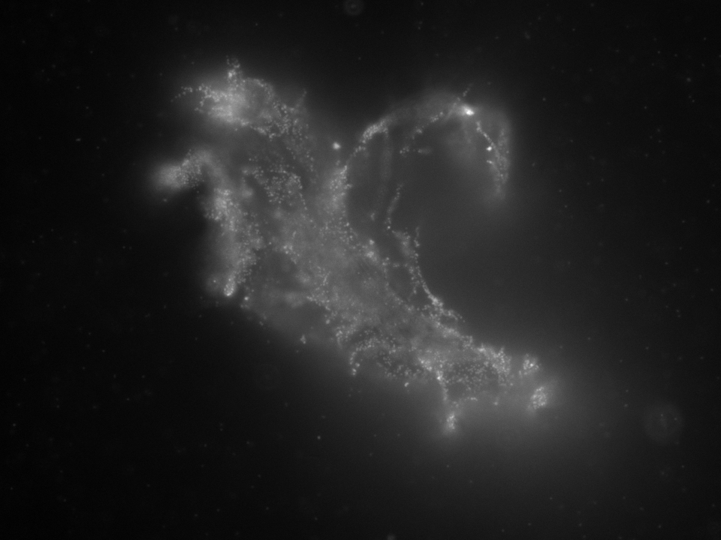
INW
40μт
-------------------------------
INW Iteratively Nafionized Water χ = 200 µS/cm
Molecular Aggregates
in the liquid phase can be seen !
Notes:
A remarkably clear image of an «aggregate» is visible!
This is an aggregate from Nafionized water (INW).
The same happens for EDS and IFW.
For ICW work is in progress.

Slide 17
Circular Dichroism
Notes:
As many of you will know, Circular Dichroism spectroscopy is a widely adopted technique in the study of biological macromolecules.

Slide 18
The Circular Dichroism technique
on a solution measures
the difference of absorption of the
right-handed and left-handed circular polarized light
as a function of the wavelength
Notes:
In this slide there is a brief comment on the physical significance of Circular Dicroism

Slide 19
Notes:
The CD spectra provides important information on the secondary structure of proteins, polypeptides and DNA. The shape of the CD spectrum provides information on the presence in solution of optically active polymers and on their secondary structure (alpha helix, beta sheet or random coil). Of particular note for us is the Beta-sheet spectrum, in red.
In our case, given the chemical composition of the liquids INW, ICW HC and EDS, we are dealing with a supposed macromolecule that contains only oxygen and hydrogen.
It is most probably a fifth phase of water.
In the next slide I’ll show our experimental results on Circular Dichroism spectra.

Slide 20
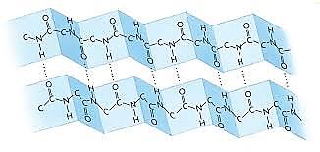
Notes:
Our results of Circular Dichroism, obtained on the various perturbed waters (EDS, INW and ICW-HC), show that the secondary structure of the polymer responsible of the Circular Dichroism is of the beta-sheet kind, whose shape is pictured in the slide.
Naturally in our case, the polymer does not contain neither carbon nor nitrogen atoms.

Slide 21
Circular Dichroism Spectra - INW
Notes:
Some clear examples of CD spectra for INW. As mentioned in the previous slide we are in presence of CD spectra very similar to those of a biological macromolecule such as a polypeptide, with a secondary structure of beta sheet type! Of course since our samples are pure water from a chemical point of view, and not a biological macromolecule, we would expect to obtain flat spectra, i.e. an horizontal lines. It is not so!

Slide 22
Circular Dichroism Spectra - ICW (HC)
Notes:
A Very surprising result, but at the same time very satisfying for us: the INW and ICW HC samples produce very similar Circular Dichroism spectra, despite the very different pH.
In particular both exhibit beta-sheet secondary structures.
Similarities and peculiarities.

Slide 23
Circular Dichroism Spectra of EDS
Notes:
The Circular Dichroism phenomenon is found also in the case of EDS samples.
This graph shows three Circular Dichroism spectra for three different active principles, all 12 CH.
These dilutions are so extreme that they are universally recognized as nothing else than pure water!
Also in this case the secondary structure of the macromolecule is of the beta sheet kind!
The three spectra are very similar to each other, but also feature some differences.

Slide 24
Fluorescence Spectra
Notes:
And now another extraordinary finding. An additional physico-chemical methodology broadly used to characterize biological macromolecules is that of Fluorescence Spectra.
So we also employed it to study our samples of water perturbed with the INW, ICW and EDS procedures.
Of course since our samples are pure water from a chemical point of view, and not a biological macromolecule, we would expect to obtain a flat spectrum.

Slide 25
Fluorescence Spectra of INW and ICW (HC) and EDS
Notes:
In this slide we see the Fluorescence Spectra of three samples: Nafionized, Cellulosized and Extremely Diluted samples.
As you can see we do get fluorescence spectra that are not flat!
The similarities between the three perturbed waters and the biological macromolecules continue to surprise us.
There is a feature found in all three spectrums: the presence of two maximums.
Apart from that, there is a very large difference in both intensity and wavelenght of the maximums.
On this topic Dr. Germano will provide many more details in his presentation tomorrow.
These Fluorescence Spectra underline much better than the Circular Dichroism ones the differences between the two kinds of perturbation techniques.
In fact the shape of fluorescence spectra of EDS, INW and ICW are quite dissimilar.
The Circular Dichlorism ones are on the contrary very similar, all featuring a beta sheet secondary structure of these new macromolecules.

Slide 26
Fluorescence Spectra of EDS
Notes:
Let’s focus now on the Fluorescence Spectra of the EDS samples (Extremely diluted solutions) of three different active principles, all 12 CH.
It seem this measure is capable to distinguish between different active principles, as can be seen from the different shapes for Arsenicum Album, Arnica Montana and Nux Vomica.
It’s a notable result that hints at the possibility of maybe, in the future, to be able to distinguish the nature of the active principle in homeopathic dilutions.
A possibility that maybe could change the history of homeopathic medicine. Work is in progress.

Slide 27
INW, ICW and EDS contain macromolecules that behave similarly to biological macromolecules
Notes:
The perturbed liquids contain different macromolecules that behave simirarly to biological macromolecules.
The analysis of the chemical composition of the liquids does not detect organic or biological molecules.

Slide 28
Perturbed Water
in the
Solid State
Notes:
We were able to obtain a solid-state sample of this macromolecule simply by evaporating, at room temperature and pressure, a few drops of liquid INW, IFW or EDS.
This is how solid-state samples are usually obtained in order to study them with techniques such as Atomic Force Microscopy (AFM).
Another method to obtain a solid residue consists in removing bulk water using a freeze-drying procedure.

Slide 29
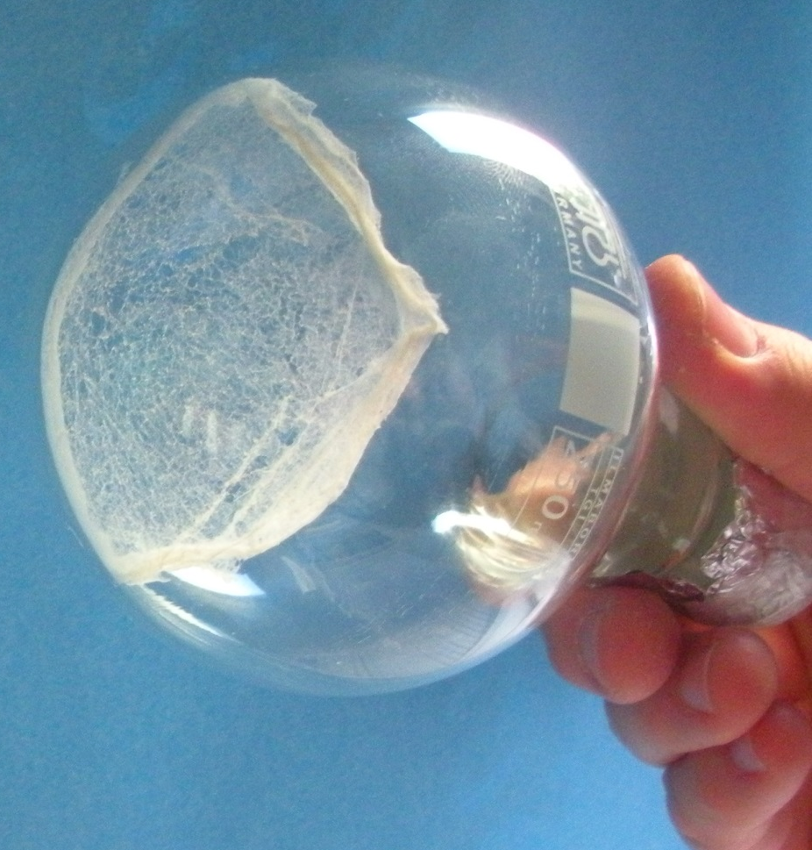
INW
Notes:
This photo shows the solid deposit found after freeze drying of Iteratively Nafionized Water.
One of the more striking examples in terms of quantity of solid.

Slide 30
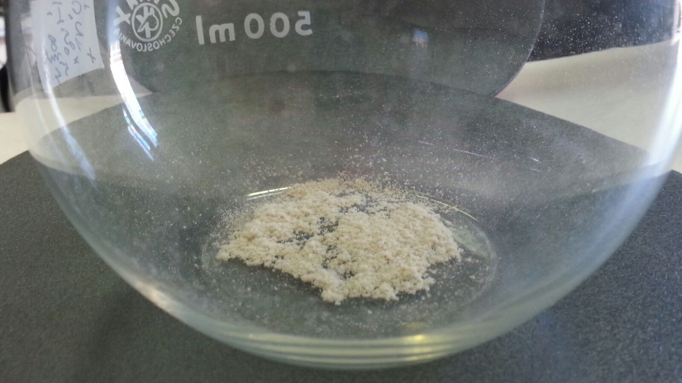
ICW HC
ICW HC
Notes:
Also in this case you can see a solid deposit after freeze drying an Iteratively Cellulosized Water

Slide 31
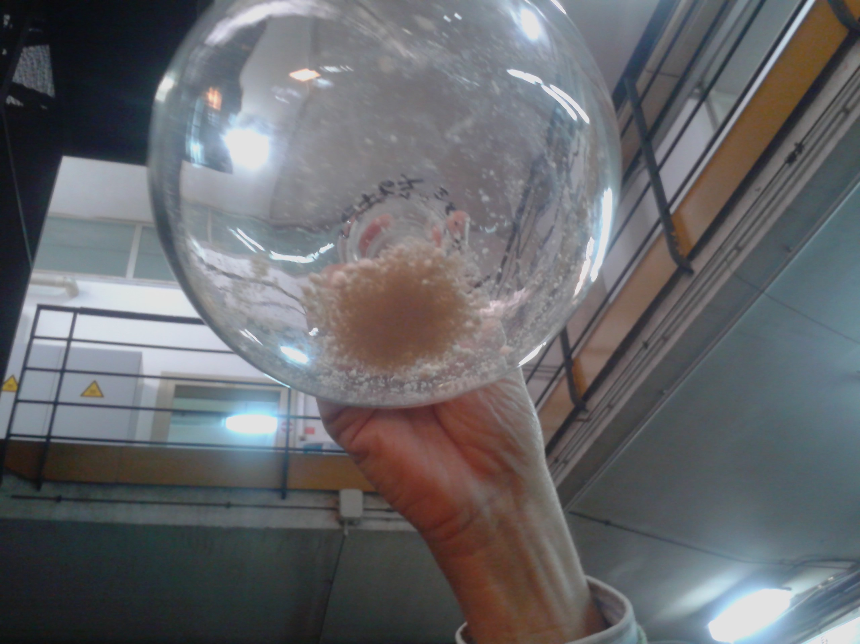
EDS
Notes:
Again the same result using Extremely Diluted Solutions

Slide 32
Of course if we freeze-dry bidistilled water ( milli-Q ) there remains no visible solid residue
Notes:
Obviously

Slide 33
A new solid material was obtained, whose chemical composition is Hydrogen and Oxygen.
It is stable as solid at room pressure and temperature.
Probably it is a new phase of water: the fifth
Perturbed waters contain macromolecules that behave similarly to biological macromolecules
Notes:
CONCLUSIONS (leggere)

Slide 34
” In all important transactions of life we have to take a leap in the dark....”
William James

Slide 35
Thank you
for your attention

Slide 36
Denaturation INW
Notes:
This slide shows the CD spectra for a sample of INW kept at 90°C for 1 hour or 4 hours. It is rather clear that the decrease of CD is fairly slow, demonstrating the extraordinary thermal resistance of this new and unknown macromolecule.

Slide 37
Denaturation in a stove
Notes:
In this slide we see how the prolonged thermal treatment cancels any Circular Dichroism effect.
What has been said till now demonstrates a staggering similarity between INW and a biological macromolecule! This parallel does not end here.
It’s common knowledge that a biological macromolecule, a protein for instance, can exist in its native state or in a denatured state. In its native state it can carry out its biological activity in biological systems.
In the denatured state, instead, it loses this possibility. One of the standard methods to denature a biologic macromolecule is to increase the temperature of the sample. Usually temperatures between 60 and 90 °C are sufficient to reach denaturation, with loss of CD and disruption of the secondary structure.
In this slide we show the CD spectrum of the sample (black curve) and that of the same sample kept at 90°C for 24 hours (red curve), which is identical to the curve of the reference: milliQ water.
An extraordinary similitude.

