Slide 1

About the two phase structure of liquid water
Antonella De Ninno ENEA, Frascati ITALY
October 6th-9th, 2016
Sofia, BULGARIA

Slide 2
Theory foresees that water is a two level system
( this is a higly contrversial issue in the scientific community)
does the experimental evidence support this claim ?
IR spectroscopy
X ray spectroscopy
Optical Kerr effect
TH time domain spectroscopy
spectroscopy
Nanoaggregate formation
EZ water layer
Water polimerization

Slide 3
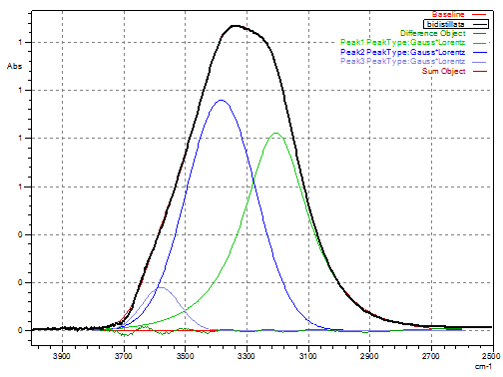
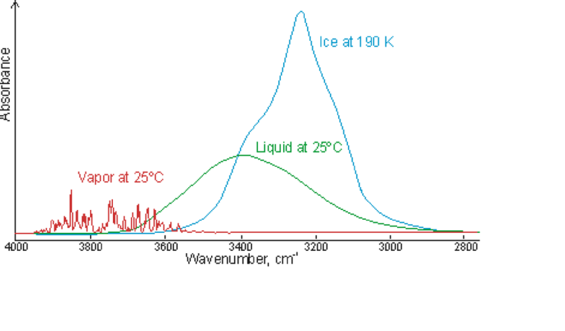
IR spectroscopy
OH stretching in liquid water at room temperature
and pressure absorbs with a wide band in the range
2600-3800 cm⁻¹.
The three sub-peaks are clearly related to the energy
of the vibration of the OH-bond

Slide 4
Why three populations ?
the scattering process takes place on an femtosecond (10⁻¹⁵ s) time-scale, comparable to the time-scale related to the two population dynamics, the two structures cannot be regarded as static on the time-scale of the experiment .
Molecules in intermediate population can be seen as fluctuating between the two states.

Slide 5
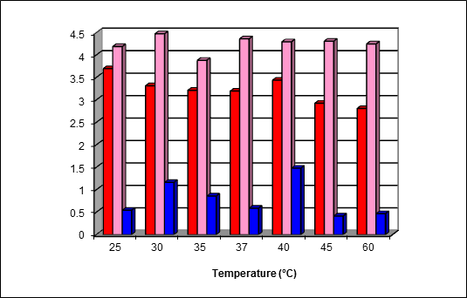
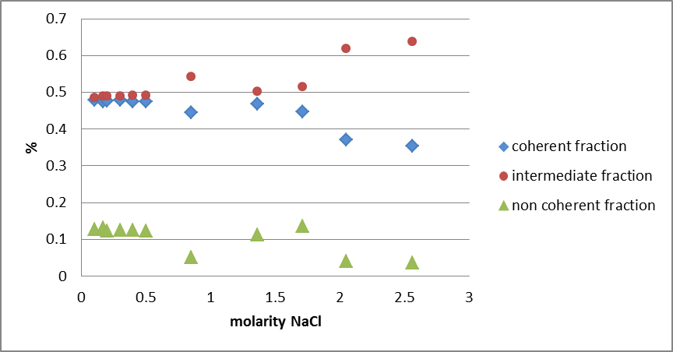
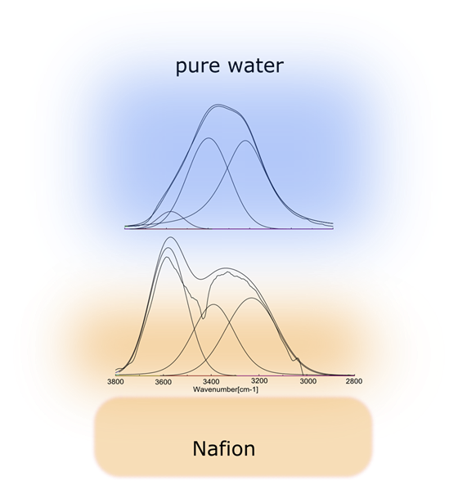
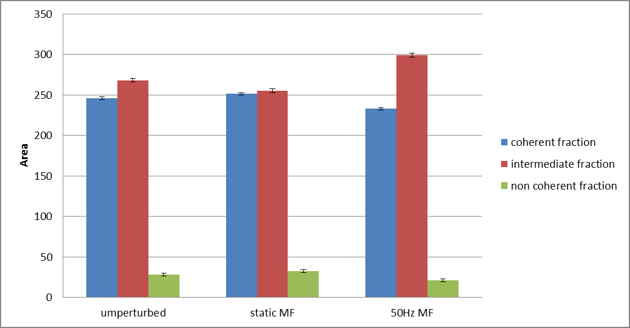
The existence of two population in liquid water makes it very sensitive to the environment
Such a broad peak can be de-convoluted into three gaussians (or gaussian*lorentian) peaks whose area (or height) is subjected to changes due to:
the temperature
the amount of solute
the contact with surfaces
the presence of em fields

Slide 6
X-ray spectroscopy
In 2004 an intense debate started after the publication of the Wernet et al. study regarding the local structure of water based on X-ray Absorption Spectroscopy (XAS) and X-ray Raman Scattering (XRS)
It was observed the spectra of the two fluctuating structures in water which spectroscopically would indicate a model of water in terms of high density water (HDL) and low density water (LDL)
Even in XAS and XRS (like in FTIR spectroscopy), the spectra depend on temperature
and on ion hydration in NaCl aqueous solutions.

Slide 7
Through the combination of SAXS and X-ray spectroscopy a picture of ambient water as a fluctuating liquid with a bimodal distribution of local structures in terms of spatially segregated strongly tetrahedral patches and H-bond distorted structures is obtained
review paper, Nilsson et al., 2010, Journal of Electron Spectroscopy and Related Phenomena, vol. 177( 2–3) 99–129

Slide 8
Why not three populations ?
Since no intermediate structures are seen in the XES or XRS data with increasing temperature and since the scattering process takes place on an attosecond (10⁻¹⁸ s) time-scale, much shorter than any time-scale related to H-bond dynamics , the two structures can be regarded as static on the time-scale of the experiment .

Slide 9
Optical Kerr effect
Time-resolved OKE spectroscopy is a non-linear technique exploiting the transient birefringence induced by the electric field of radiation in an optically transparent and isotropic medium.
In short, the oscillating (femtosecond) electric field of a polarized short laser pulse (the pump) induces optical birefringence in the sample. the induced birefringence reflects the relaxation and vibrational response of the molecules in the sample.
The time-resolved HD-OKE experiment measures the time-dependent correlation function of the water susceptibility (that is, collective polarizability)
Data and analysis show the presence of two distinct modes responsible for the part of the water spectrum normally attributed to the intermolecular stretching vibrations.

Slide 10
the modes observed in the experimental investigations can be associated with two fluctuating water species with different local structures;
The LD water forms are expected to consist of aggregates of a small number of molecules; being mostly localized in space (at least in the temperature range investigated), their dynamics show negligible coupling with the structural relaxation.
The two local configurations of liquid water coexist in the entire temperature interval considered, above and below the melting temperature.
The number/lifetime of the LD species must increase with decreasing temperature.

Slide 11
THz time-domain spectroscopy
This technique uses femtoseconds (10⁻¹⁵s) laser to trigger an optoelectronic switch. As a result of the ultra fast polarization induced in the switch, a bright and short infrared pulse of radiation is emitted.
From the reflection of such a pulse on a surface is possible to obtain information about its optical constants.
The complex dielectric constant of water has been studied in the range 0,1 to about 2 THz as a function of the temperature and
It has been found that there are two relaxation times which describes the behaviour of liquid water.

Slide 12


$\hat{ε}$($ω)=ε_{∞}+\frac{ε_{s}−ε_{l}}{1+iωτ_{D}}$+$\frac{ε_{l}−ε_{∞}}{1+iωτ_{2}}$
double Debye model
Liquid water $τ_{D}$=10 ps; $τ_{2}$=147 fs
free rotator $τ_{free}$=$\frac{2π}{9}\sqrt{\frac{I}{KT}}≈100fs$
$\frac{τ_{D}}{τ_{2}}≈100$

Slide 13
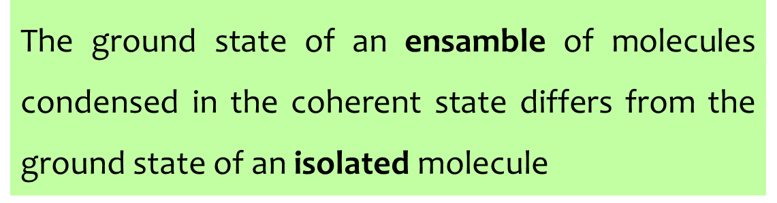
The basic idea

Slide 14
How do we come to such a claim ?
The description of the condensed matter deriving from the interactions:
among the components of the system
between the particles and the (ever –present) electromagnetic field
doesn’t include only the time-independent electrostatic forces ( ionic, covalent and hydrogen bonds) but it also account for the dynamics of the system.
The dynamic evolution of the system is obtained by coupling the Schroedinger
equation to the Maxwell equation instead of solving a system of static equations
á la Poisson.

Slide 15
The complete description of condensed matter in terms of Quantum Electro Dynamics
particles + em fields
leads to the appearance of a ground state whose energy is
lower than the energy of the ground state calculated for an
ensemble of non-interacting particles

Slide 16
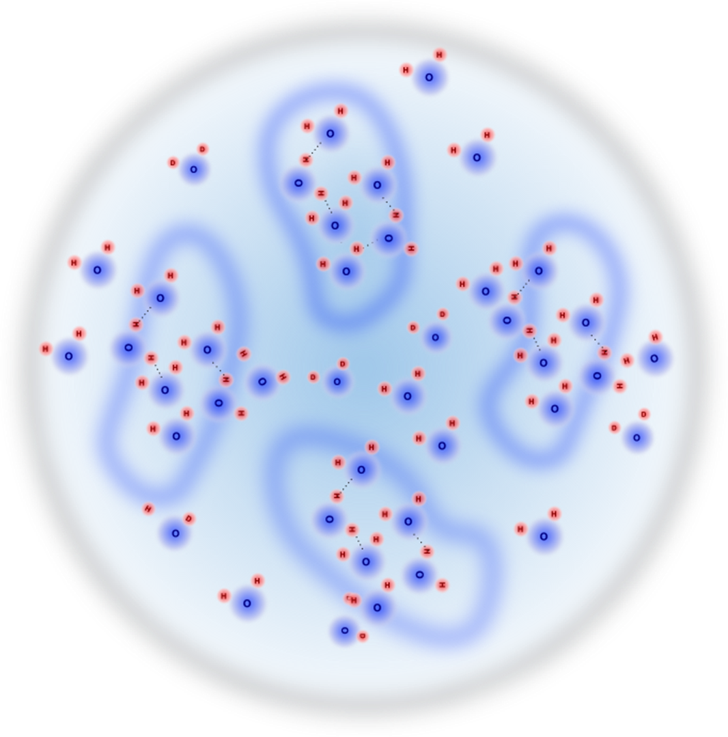

These interactions induce long-range forces which are responsible for the existence of the condensed state.
The short-range static attractions come into play only after the molecules have been brought sufficiently close together by the attraction of the long-range force (dynamical formation of condensed state of matter).
The number of particles “collapsed” in the collective ground state (which we’ll call coherent) is fixed by the temperature.
$F_{c}\left(T\right)$+$F_{nc}$(T)=1

Slide 17

Why the heuristic model of tetrahedral
H-bonded molecules doesn’t fit?
the calculated electronic ground state of the water molecules has a smooth structure without the lone-pairs (highly directional charge densities) required for H-bonds. This makes it very hard to justify the existence of water molecules arranged in long-lived ( ≈ 10⁻¹⁵ s) hexagonal configuration.
Hydrogen bonds are described in terms of an electrostatic attraction in a highly mobile environment
electron cloud of the water molecule

Slide 18
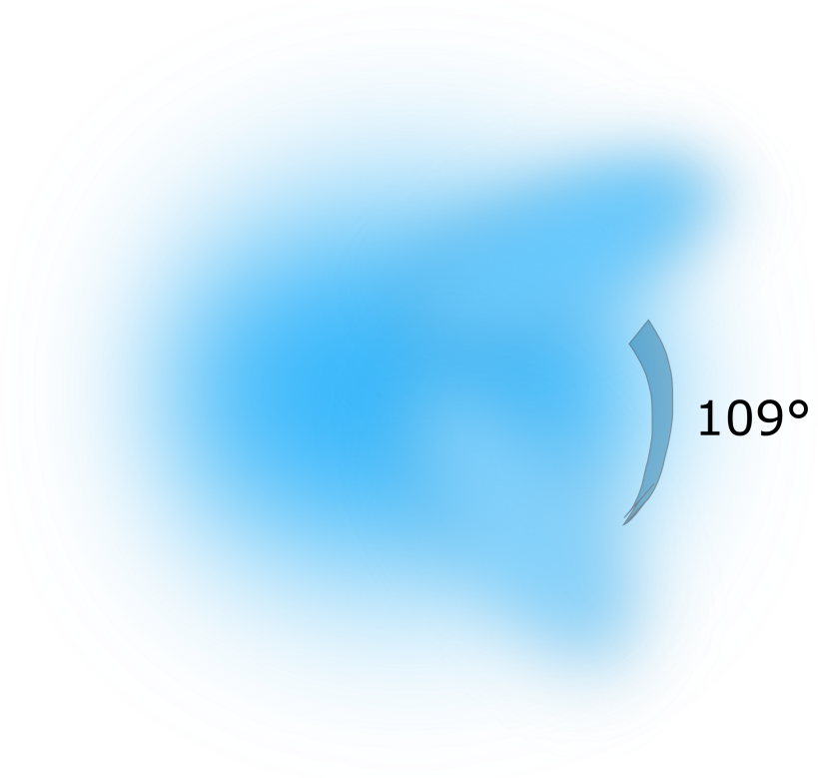
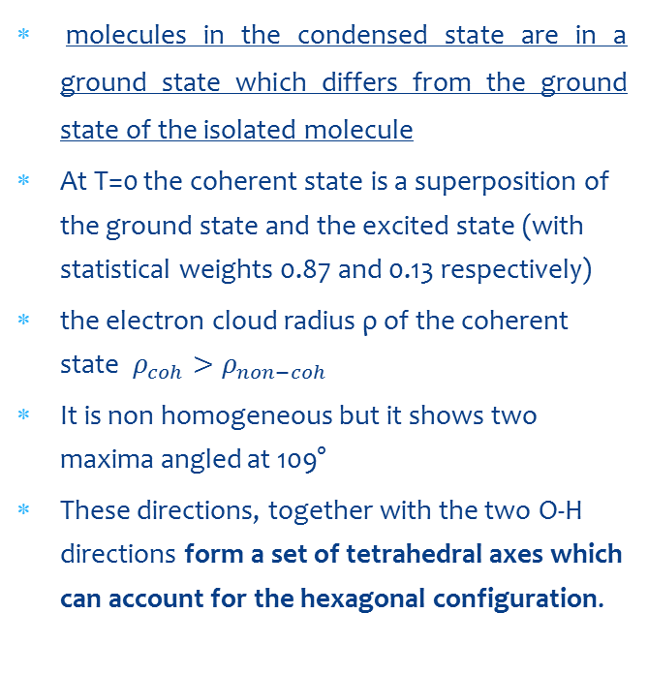
The dynamic base of the (long-lived) thetrahedral model
Let’s remember:
molecules in the condensed state are in a ground state which differs from the ground state of the isolated molecule
At T=0 the coherent state is a superposition of the ground state and the excited state (with statistical weights 0.87 and 0.13 respectively)
the electron cloud radius ρ of the coherent state $ρ_{coh}>ρ_{non−coh}$
It is non homogeneous but it shows two maxima angled at 109°
These directions, together with the two O-H directions form a set of tetrahedral axes which can account for the hexagonal configuration.

Slide 19
Theory of coherence domains in liquid water does not rule out the tetrahedral H-bonded molecules model but it provides a dynamical framework of that model
It would be sensless try to explain the weird phenomenology of liquid water ouside the framework provided by such a theory
theory
model

Slide 20

How to describe a solution

Slide 21
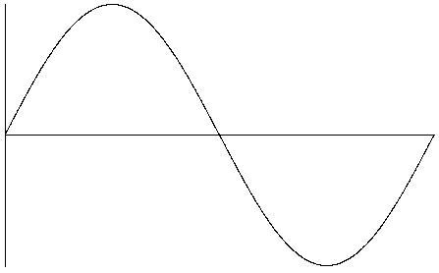
Forces between two non polar bodies separated by a medium depend on the dielectric constant of 1, 2 of the two bodies and 3 of the medium which fills the gap
d < l
l
1
2
The most general formulation of the van der Waals forces
d
characterize the absorption
spectrum of the body
l ~ 1-2 mm

Slide 22
Let suppose that both bodies are sufficiently rarefied.
From the point of view of macroscopic electrodynamics this means that their dielectric permeability are close to 1.
We obtain the classical London formula (1930)
simplified formulation

Slide 23
Attraction and repulsion depend on the medium which fills the gap
In case of different bodies in water the interaction can be either an attraction or a repulsion:
If and have opposite sign
then F < 0 and the bodies will attract each other.
If and have the same sign
then F > 0 and the bodies will repel
for “large” separation, the forces are determined by the electrostatic values of the dielectric constants.

Slide 24
Dielectric properties of water
We see that when the dissolved molecules interact strongly with the solvent the interaction forces between them are no longer determined by their polarizability
but depend on the dielectric constant of the solvent !
experimental value
large distances
*
Static dielectric constant
non interacting dipoles
coherent domains
*
with respect to the wavelength of the em fluctuation

Slide 25
Aqueous solutions used by Prof. Konovalov ‘s group have typical absorption line in their spectrum in the range of 200-600 nm.
Hence, whenever the average distance among particles exceeds such a length the following formula holds
Energy is decreased by the formation of aggregates of coherent water having a higher static dielectric constant (Konovalov nanoaggregates)

Slide 26
CD
Average distance less than λ 200/400 nm
depending on the substanecs
CD
CD
Whenever the average distance, i.e.the dilution
exceeds a thresholds, the nanostructures
appear.
Average distance greater than λ 200/400 nm
depending on the substances

Slide 27
Nanoaggregates features:
The observed stable nano-objects have a size of hundreds of nanometers which is in the same range of the wavelength characteristic of the spectrum of the solute.
The dilution threshold is obtained when the average distance (among particles of solute) exceeds the characteristic absorption wavelength of the solute.
Stable water clusters have a permanent electric charge (ζpotential) due to the quasi-free electrons at the border of the CDs.

Slide 28
The formation of the EZ layer
the displacement of the particles from the EZ proceeds rapidly after the first contact of the suspension with the Nafion surface and then the velocity decreases within few minutes;
the process shows a robust square-root-of time dependence;
the diffusion coefficient extracted from the data yields a value of orders of magnitude larger than the diffusion coefficient expected for the polystyrene particles in water (compatible with the diffusion coefficient of monovalent ions) ;
the thickness of the EZ can be as much as 1 mm (no possibility to accommodate entropy brush models);

Slide 29
Come back again to the van der Waals forces

Slide 30

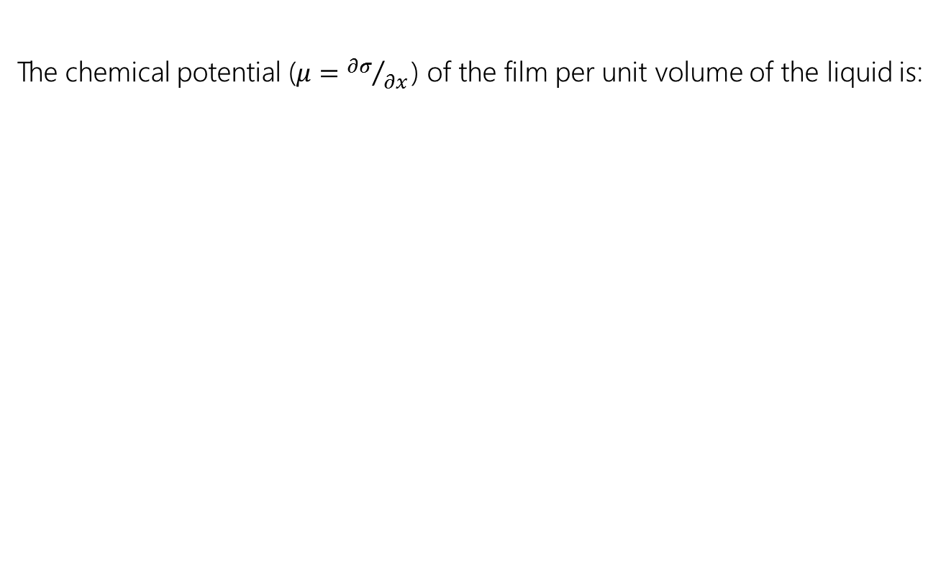
A film of water on the surface of a solid body (EZ water)
The chemical potential ($μ={∂σ}/{∂x }$) of the film per unit volume of the liquid is:
For “large” thickness
depends on the electrostatic dielectric constants of the film and of the solid surface
The function may change sign and be non-monotonic according to the sign of the difference $ε_{water}$-$ε_{solid}$

Slide 31






Paving the way for a theory of EZ water
$$λ≤6 → ε≤3.5$$
$ε_{water}$-$ε_{solid}>0$
$$μ>0$$
repulsive !
Permittivity vs frequency at 25°C for Nafion 117
$$λ>9 → ε≥13$$
$ε_{non−coh}$-$ε_{solid}<0$
$$μ<0$$
attrative !
but only for molecules belonging to non-coherent fraction
$λ$ denotes the number of adsorbed water molecules per SO₃H site of the membrane

Slide 32
Dielectric constant 160
Dielectric constant 12
Nafion
only non coherent molecules are available to form chemical bonds, while CD tend to exclude solutes and do not participate to chemical reactions, thus a flow of non coherent water molecules diffuses towards the Nafion surface with the observed square-root-of time dependence.
Nafion
Nafion acts as a phase separator
EZ water

Slide 33
The formation time and the thickness of the layer may be estimated by the amount of water molecules bound to polymer hydrophilic groups or trapped within the fluorocarbon chains, i.e. depend on quality and thickness of the Nafion film.
It is significant that an overnight washing of the Nafion surface completely remove the EZ layer, thus confirming its dynamic nature.

Slide 34
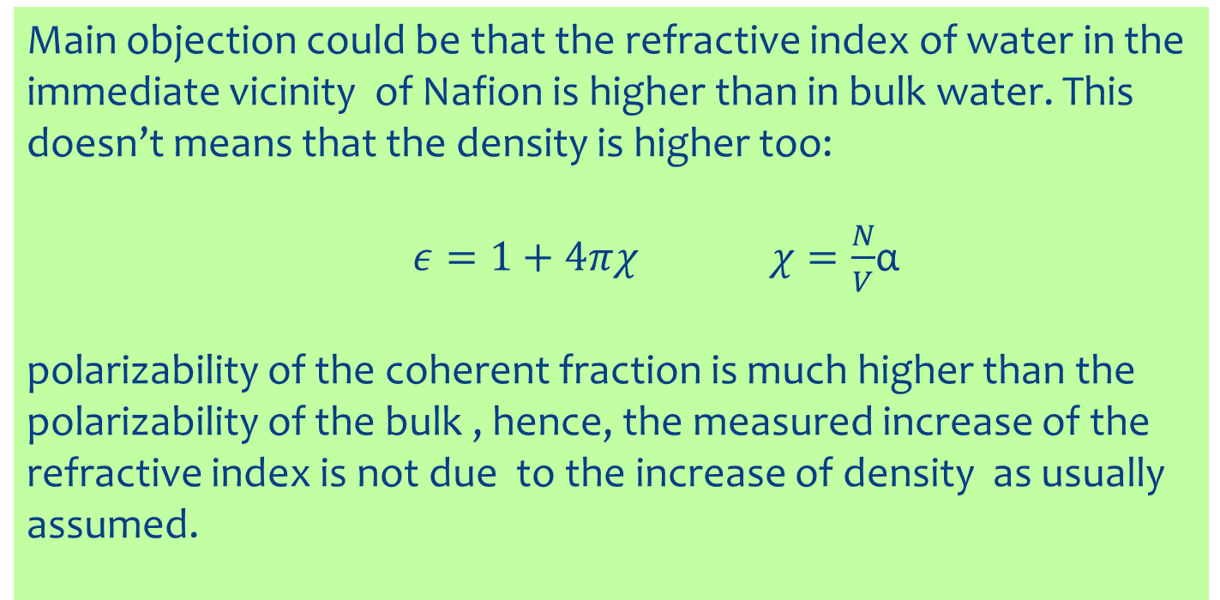
Main objection could be that the refractive index of water in the immediate vicinity of Nafion is higher than in bulk water. This doesn’t means that the density is higher too:
$ε=1+4πχ$ $χ=\frac{N}{V}$α
polarizability of the coherent fraction is much higher than the polarizability of the bulk , hence, the measured increase of the refractive index is not due to the increase of density as usually assumed.

Slide 35
The van der Waals forces provide the formation laws for the nanoaggregates and the EZ layer
The quantitative evaluation of those phenomena requires the Quantum ElectroDynamics description of liquid water

Slide 36
Experimental results from spectroscopy
Nano-aggregates in ultradiluted solutions
EZ water
but even water polimerization, aquaphotomics, em field effects and so on …
Liquid water is a two fluids system whose dynamic formation requires the conceptual framework of Quantum Electro Dynamics

